Slide 1
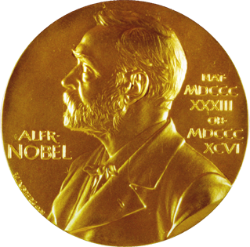
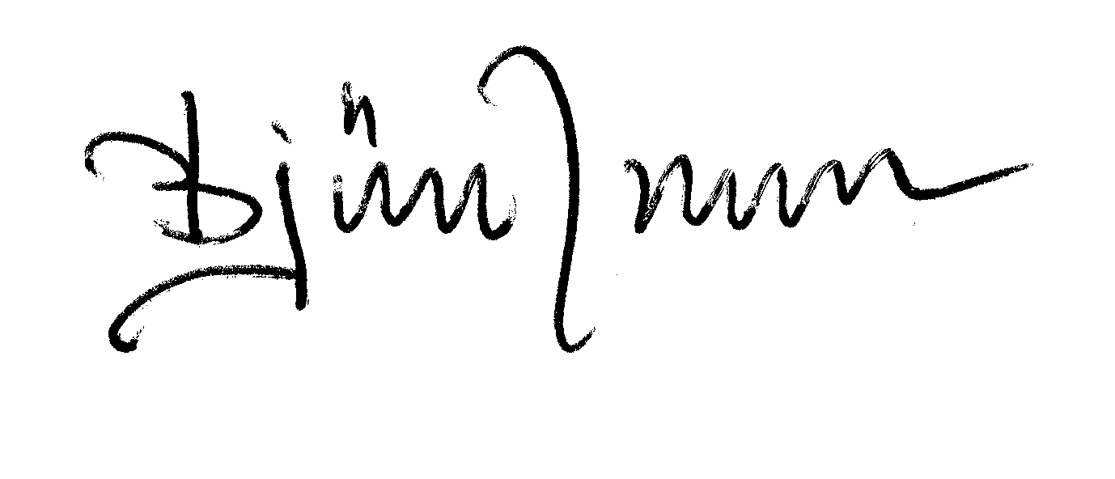
Alfred Nobel and the Nobel Prizes
Pisa, April 10, 2013

Slide 2
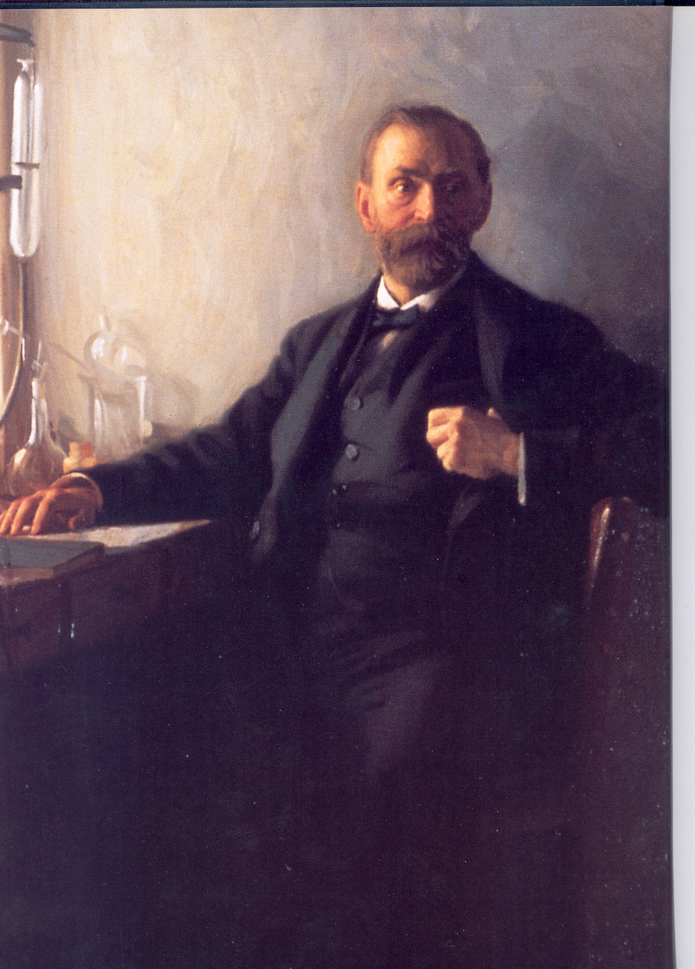
Alfred Bernhard Nobel
Born October 21, 1833 in Stockholm, Died December 10, 1896 in San Remo
Chemist, engineer, innovator, armaments manufacturer and the inventor of dynamite.
102
No
Nobelium

Slide 3
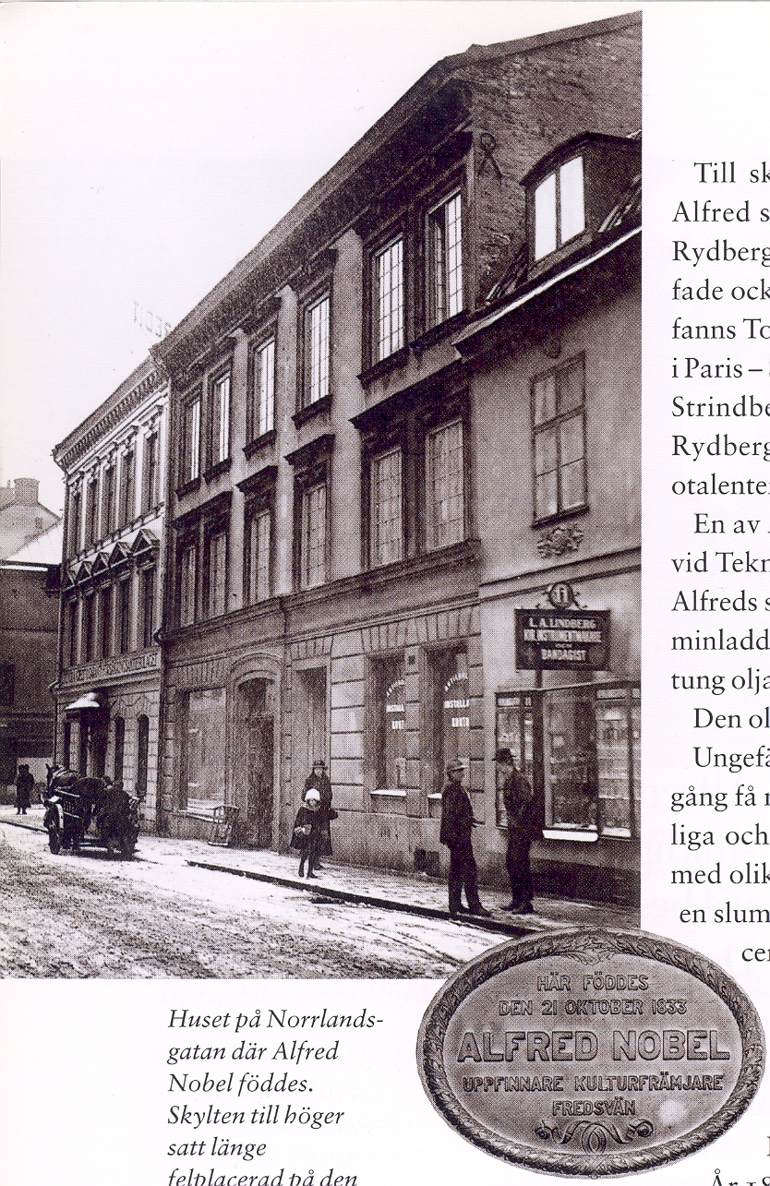
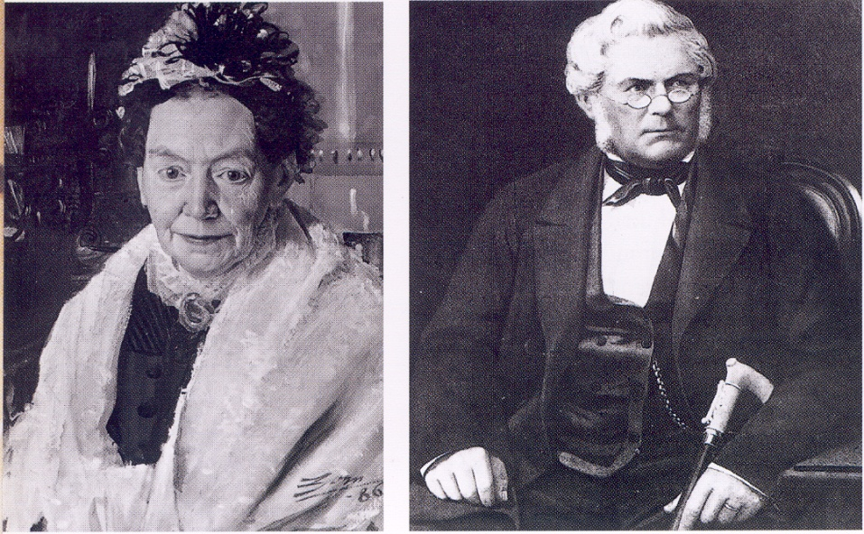
Karolina Andriette
Immanuel
Norrlandsgatan 11 Stockholm, Sweden
Notes:
Immanuel moved to St Petersburg in 1838. His family came after him in 1842. His father was also an inventor. Modern playwood.
Torpedo factory. Alfred had private tutors. He became fluend in Swedish, Franch, Russian, English and German. Later also Italian.
He was interested in literature and studied chemistry. In 1850 he moved to Paris to study chemistry and also to USA.

Slide 4
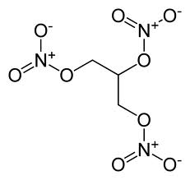
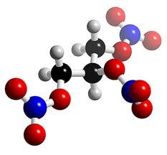
Nitroglycerin (glyceryl trinitrat, propyl-1,2,3 trinitrat)
Invented 1847 by Ascanio Sobrero, Uni. Turin
Notes:
Uppfanns 1847, är en i rent tillstånd färglös, oljig och extremt explosiv kemikalie. Nitroglycerin är ytterst instabilt (både kraftfullt och lättexplosivt) och detonerar med en hastighet på cirka 8000 m/s, motsvarande c:a MACH 23 vid normalt lufttryck 1013 hPa och temperatur +15 C.

Slide 5
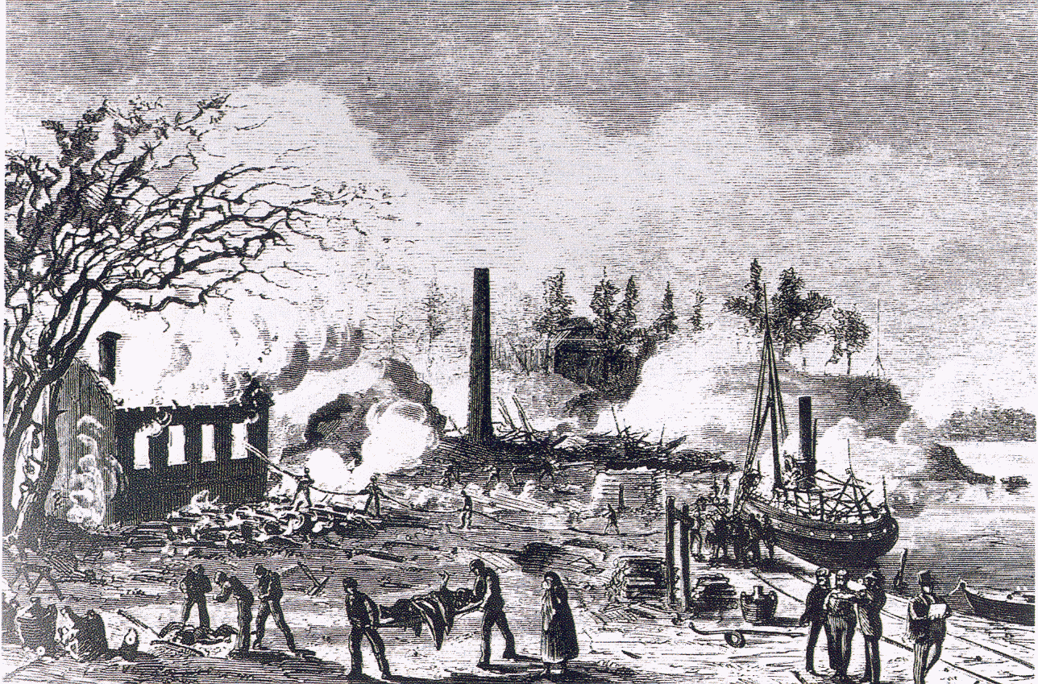
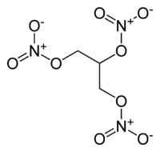
Heleneberg in Stockholm
Saturday September 3, 1864

Slide 6
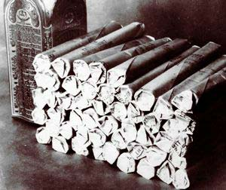
Nitroglycerin incorporated in kiselguhr (diatomaceous earth) becomes safer and more convenient to handle. This mixture was patented in 1867 as DYNAMITE

Slide 7
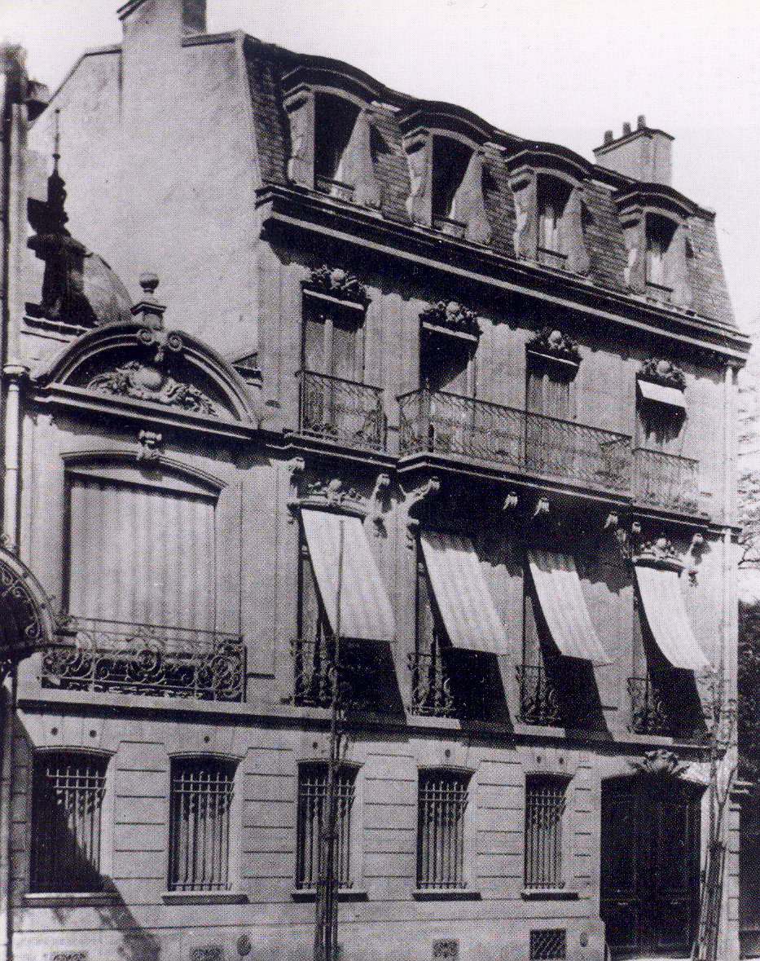
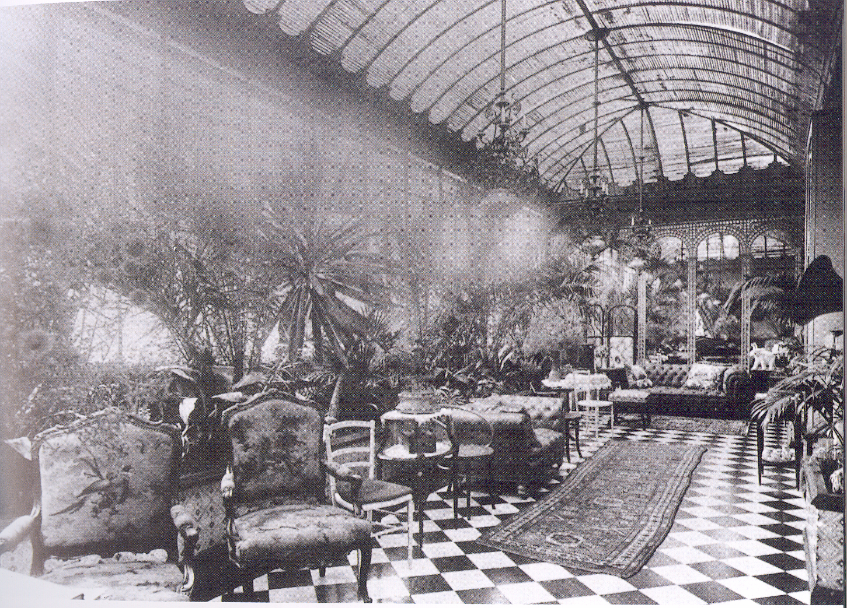
1873
PARIS
"A very wealthy, cultured, elderly gentleman, living in Paris, desires to find a lady also of mature years, familiar with languages, as secretary and manager of his household", (1876).
Notes:
År 1873 flyttade han till Paris som en rik man. Han slog sig ner i ett palats på Rue Malakov. Vita hästar i Bois du Bolonge. Han trivdes bra i Paris. Annons i en Wientidning.
At the age of 43 he was feling as an old man and advertised for a secretary and supervisor of household-

Slide 8
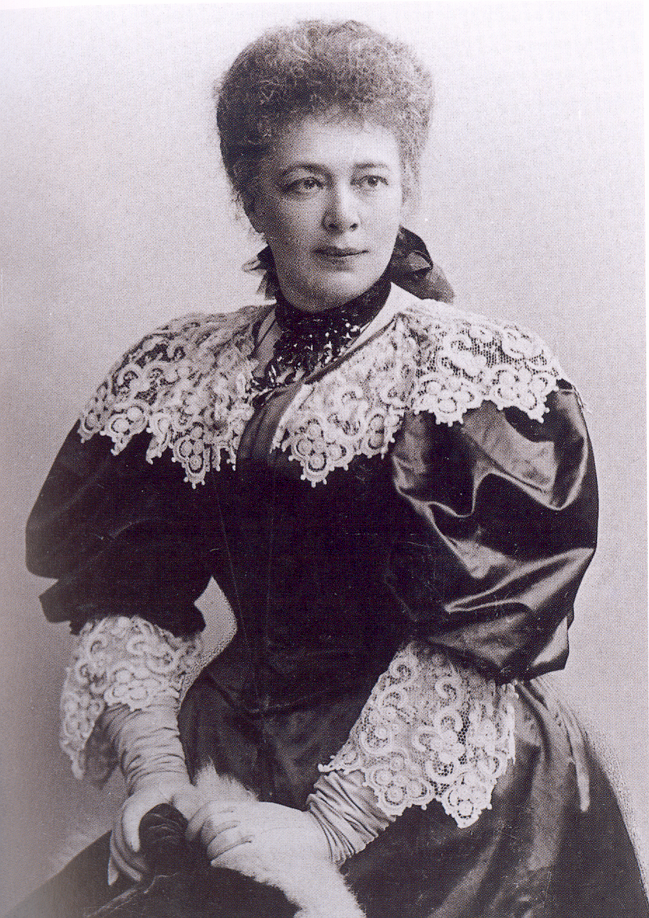
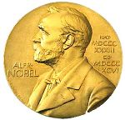
1905
The Nobel Peace Prize
1905 was awarded to
Bertha von Suttner.
Author of “Lay Down Your Arms”
Bertha (Kinsky von Chinic und Tettau) von Suttner
Notes:
Grevinnan Bertha Kinsky von Chinic und Tettau 33 år och ogift. Arbetde hos baronessan von Suttner som guvernant för hennes döttrar. Ned med vapnen 1890. Förlovad med Artur von Suttner. Stack!
Står ensam på Gare du Nord. Åker till Baden dei Wien på kurort för att vila upp sig. Där möter han Sofie Hess, 20 år. Tillsammans i 18 år. Förhållandet haden kanske varat livet ut om inte hon blivit gravid med en annan man, ryttmästare Kapy von Kapivar.

Slide 9
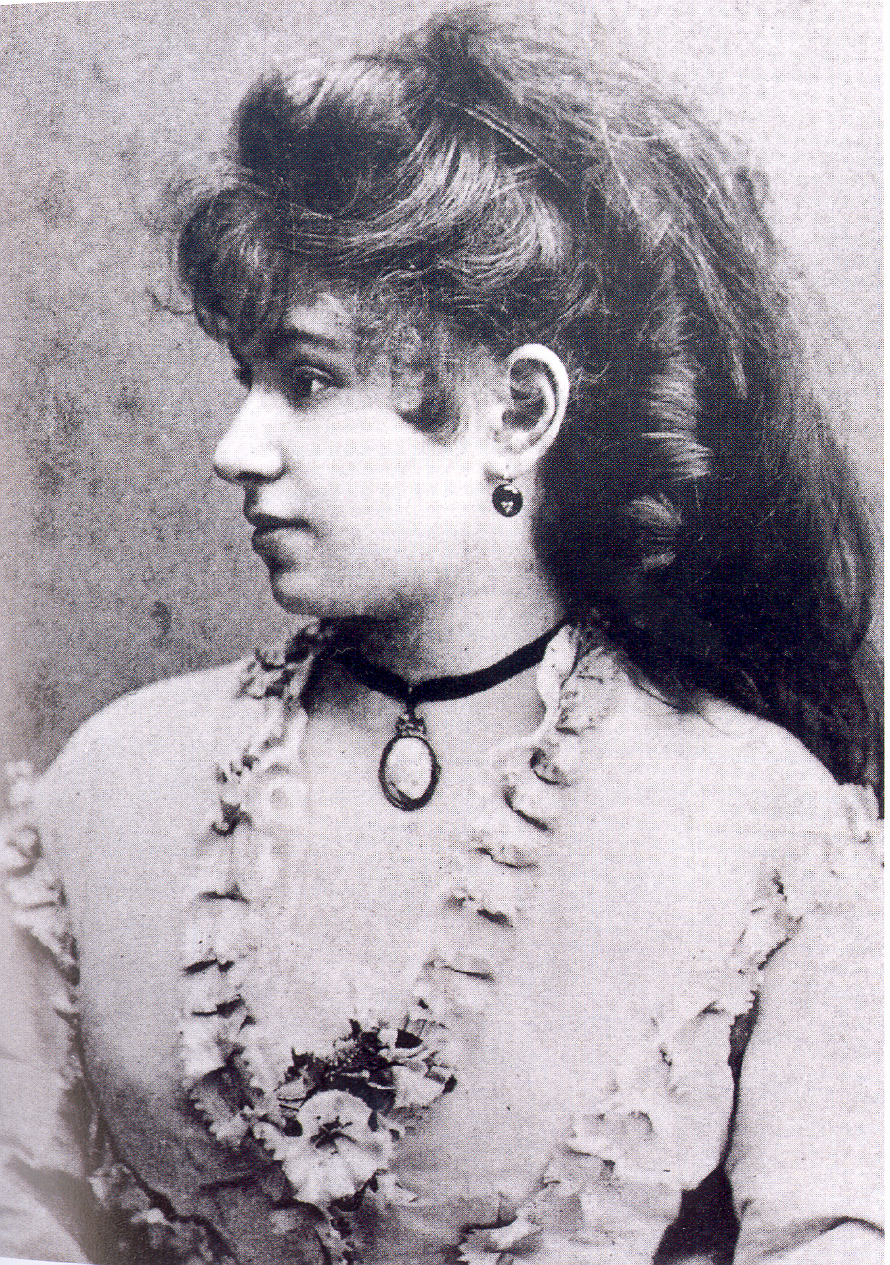
Sofie Hess

Slide 10
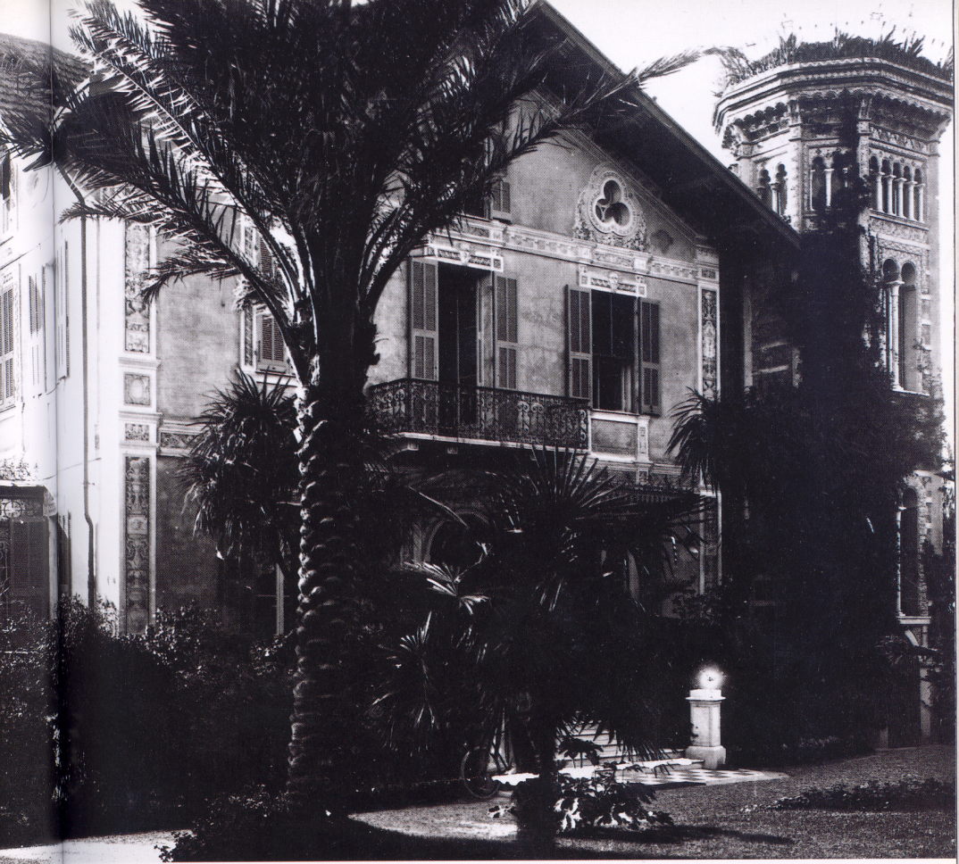
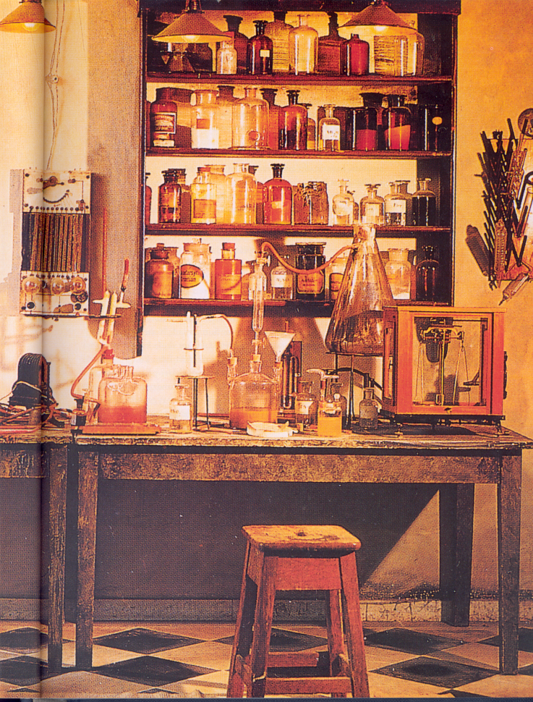
SAN REMO
1890

Slide 11
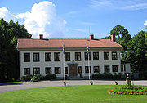
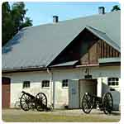
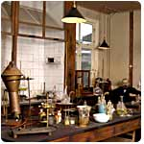
BOFORS
1893 Björkborn

Slide 12
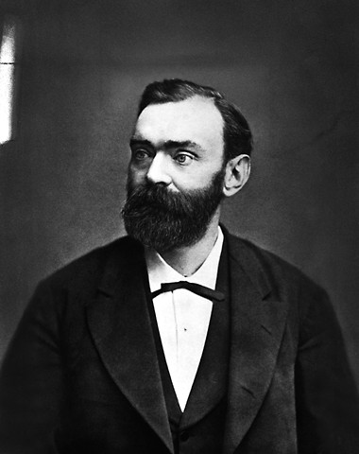
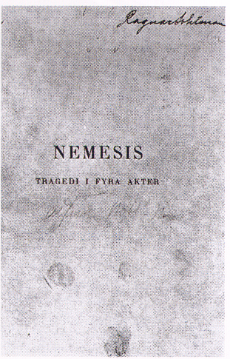
Published in Sweden, 2003 Swedish-Esparanto
My dynamite will sooner lead to peace than a thousand world conventions. As soon as men will find that in one instant, whole armies can be utterly destroyed, they surely will abide by golden peace.

Slide 13
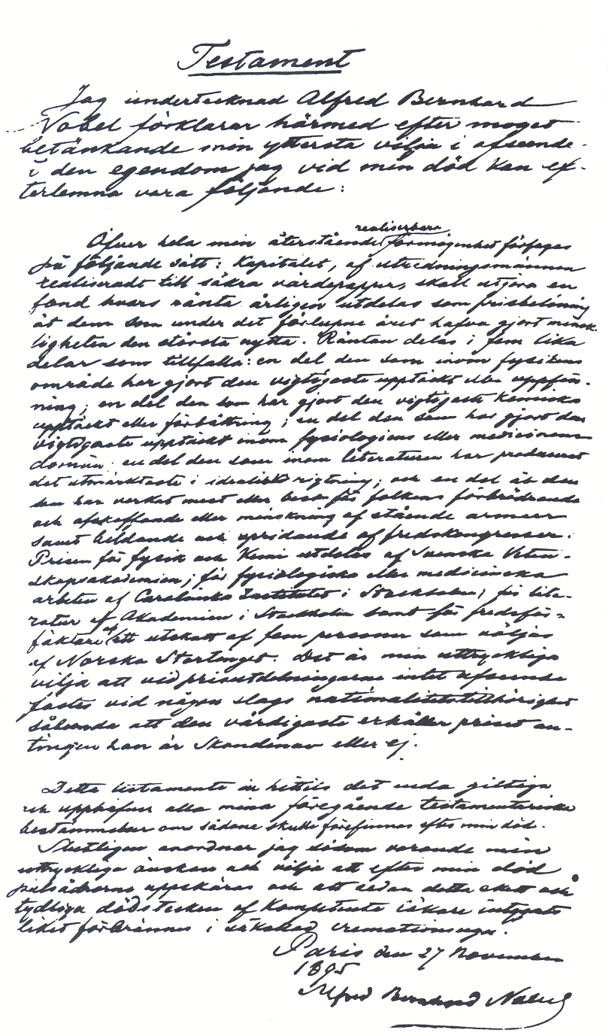

Slide 14
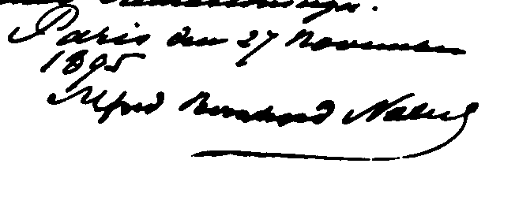
The whole of my remaining realizable estate shall be dealt with in the following way:
the capital, invested in safe securities by my executors, shall constitute a fund, the
interest on which shall be annually distributed in the form of prizes to those who, during
the preceding year, shall have conferred the greatest benefit on mankind. The said interest
shall be divided into five equal parts, which shall be apportioned as follows:
one part to the person who shall have made the most important
discovery or invention within the field of physics;
one part to the person who shall have made the most important
chemical discovery or improvement; one part to the person who shall have made the
most important discovery within the domain of physiology or medicine; one part to the
person who shall have produced in the field of literature the most outstanding work in
an ideal direction; and one part to the person who shall have done the most or the best
work for fraternity between nations, for the abolition or reduction of standing armies and
for the holding and promotion of peace congresses. The prizes for physics and chemistry
shall be awarded by the Swedish Academy of Sciences; that for physiological or medical
work by the Caroline Institute in Stockholm; that for literature by the Academy in Stockholm,
and that for champions of peace by a committee of five persons to be elected by the Norwegian
Storting. It is my express wish that in awarding the prizes no consideration whatever shall be
given to the nationality of the candidates, but that the most worthy shall receive the prize,
whether he be a Scandinavian or not.

Slide 15
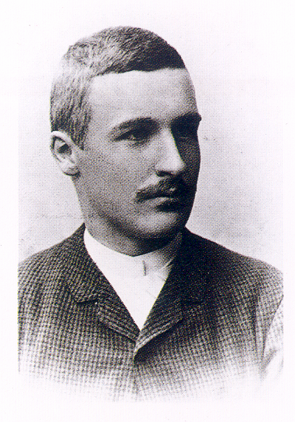
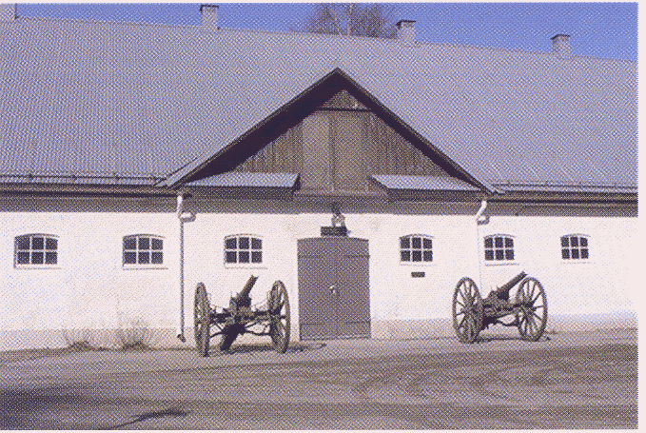
Bofors
Ragnar Sohlman
Notes:
Ragnar Solman, an engineer, was assistant to Alfred Nobel. He was given the task to execute the will of Nobel.

Slide 16
Prize-Awarding Institutions
Physics The Royal Swedish Academy of Sciences
Chemistry The Royal Swedish Academy of Sciences
Medicine The Karolinska Institute
Literature The Swedish Academy
Peace The Norwegian Parliment

Slide 17
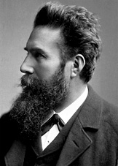
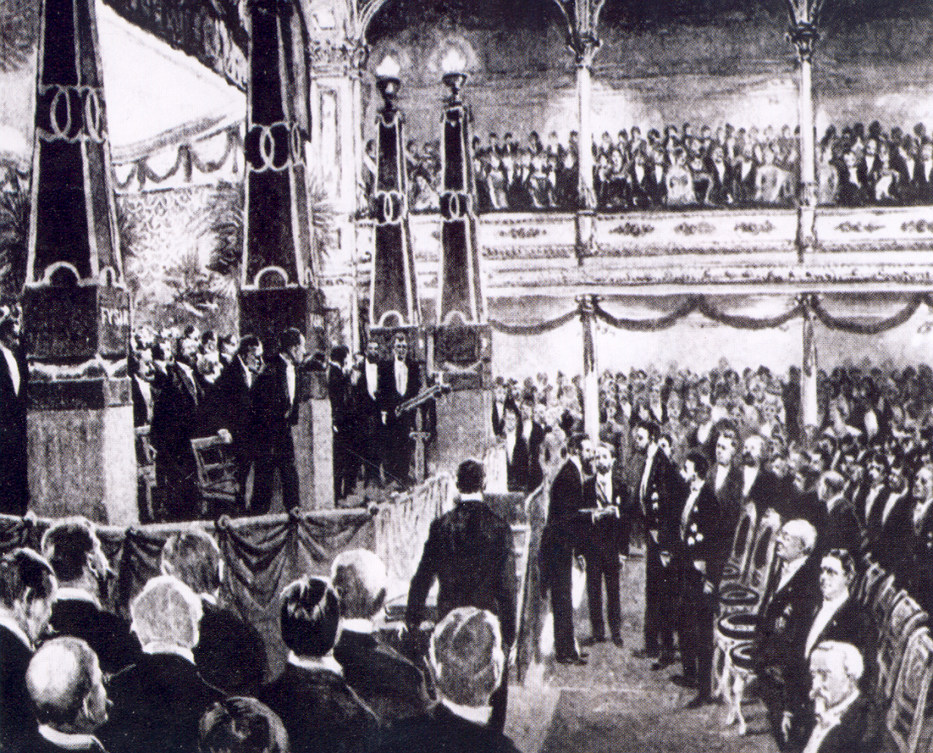
"in recognition of the extraordinary
services he has rendered by the discovery
of the remarkable rays subsequently named
after him"
1901
Wilhelm Conrad Röntgen

Slide 18
HOW ?

Slide 19
The Nobel Committee for Physics
5 members (3 years, max. 9 years)
Chairperson, max. 3 years
Adjoint members (1-4, change each year)
Secretary (no time limit)

Slide 20
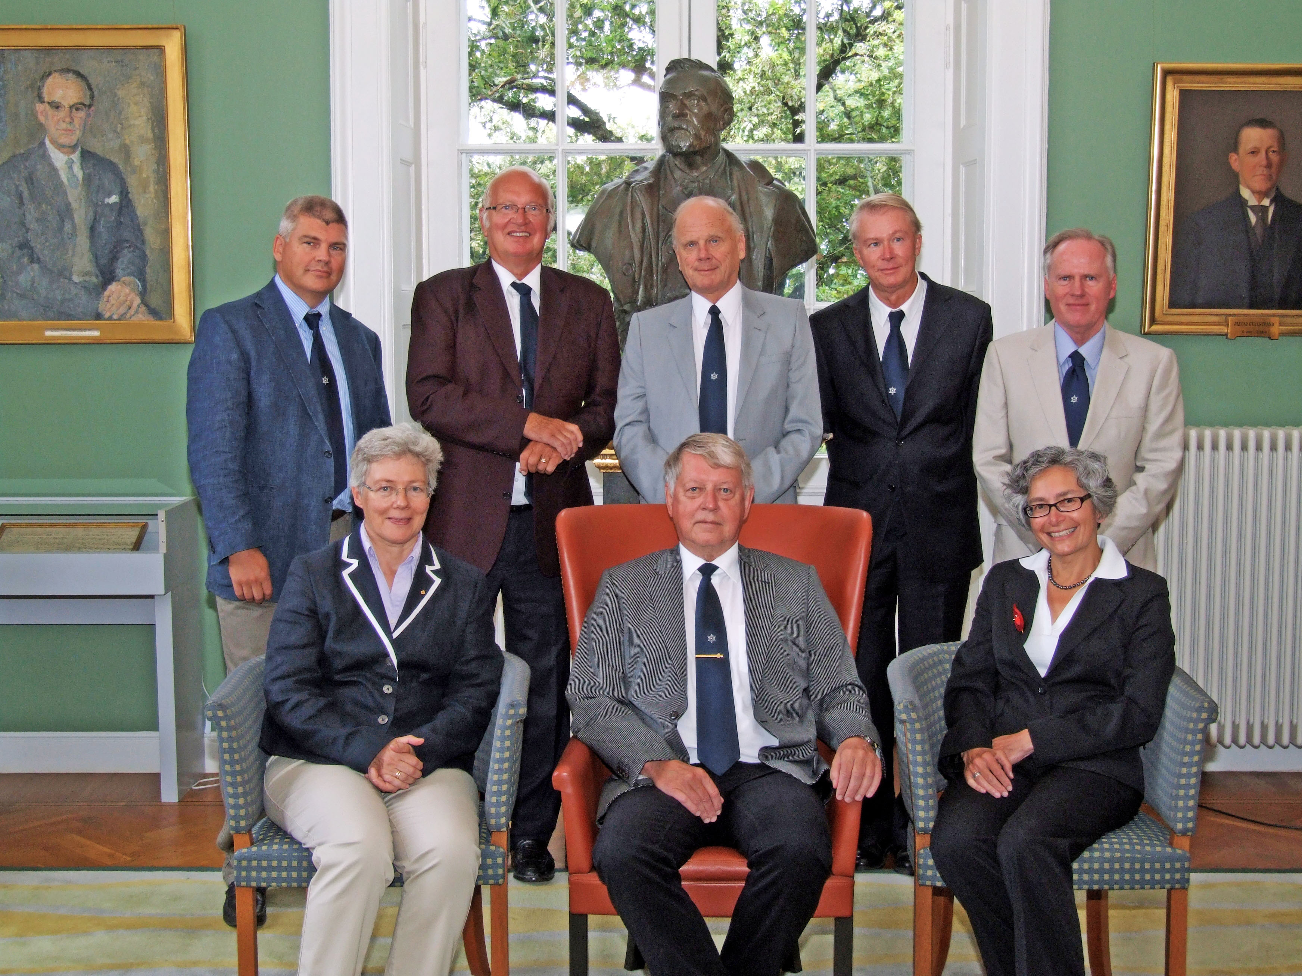

Slide 21
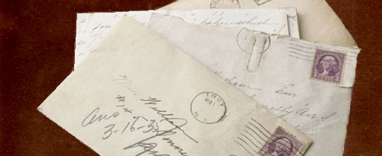
September 2011
Nomination for the Nobel Prizes
Each year the respective Nobel Committees send individual invitations to thousands of members of academies, university professors, scientists from numerous countries, previous Nobel Laureates, members of parliamentary assemblies and others, asking them to submit candidates for the Nobel Prizes for the coming year. These nominators are chosen in such a way that as many countries and universities as possible are represented over time.

Slide 22
Invitations to nominate (sharp deadline, February 1):
Members of KVA
The Nobel Committee
Earlier Nobel Laureates
Professors of Physics in the Nordic Countries
Professors of Physics at selected Universities (changes every year)
Selected scientists

Slide 23
2012
2012-02-01
Nominations examined
Nomintions shall be in the hands of the Committee latest at 24.00 on January 31

Slide 24
2012
2012-02-01
Nomineringar granskas
2012-02-29
Experts are selected
The Committte examines the nominations in detail during February and at its next meeting experts are proposed. These are then discussed with the Physics Class. Letters to experts are sent out shortly after the meeting.

Slide 25
2012
2012-02-01
Nominations examined
2012-02-29
Experts are selected
Durig the spring the Committees for Physics, Chemistry and Medicine meets.
2012-04-20
Deliberations Chemistry and Medicine

Slide 26
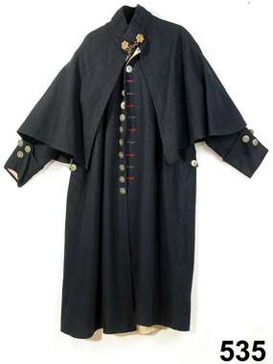
2012
2012-02-01
Nominations examined
2012-02-29
Experts are selected
The Committee studies the reports. Discussions about the main lines of writing the ”Kapprocken”. Meeting with Class III
2012-04-20
Deliberations Chemistry and Medicine
2012-06-04-05
Hearing and meeting with Class III

Slide 27
2012
2012-02-01
Nominations examined
2012-02-29
Experts are selected
Summer holidays
2012-04-20
Deliberations Chemistry and Medicine
Well……
2012-06-04-05
Hearing and meeting with Class III

Slide 28
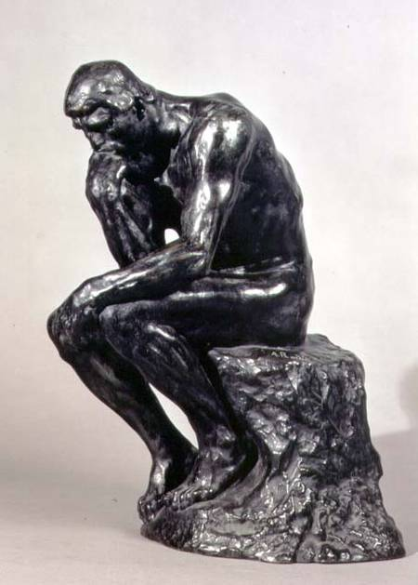
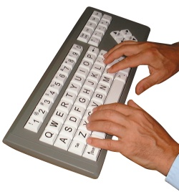
2012
2012-02-01
Nominations examined
2012-02-29
Experts are selected
2012-04-20
Deliberations Chemistry and Medicine
2012-06-04-05
Hearing and meeting with Class III
2012-08-07-08
The Committee meeting

Slide 29
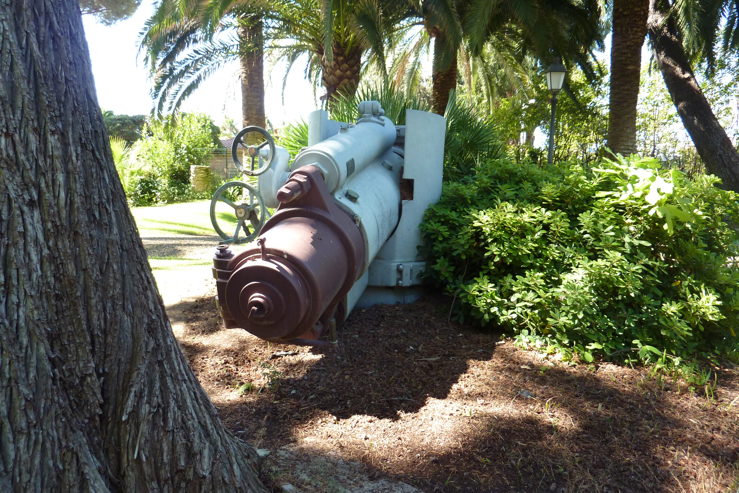
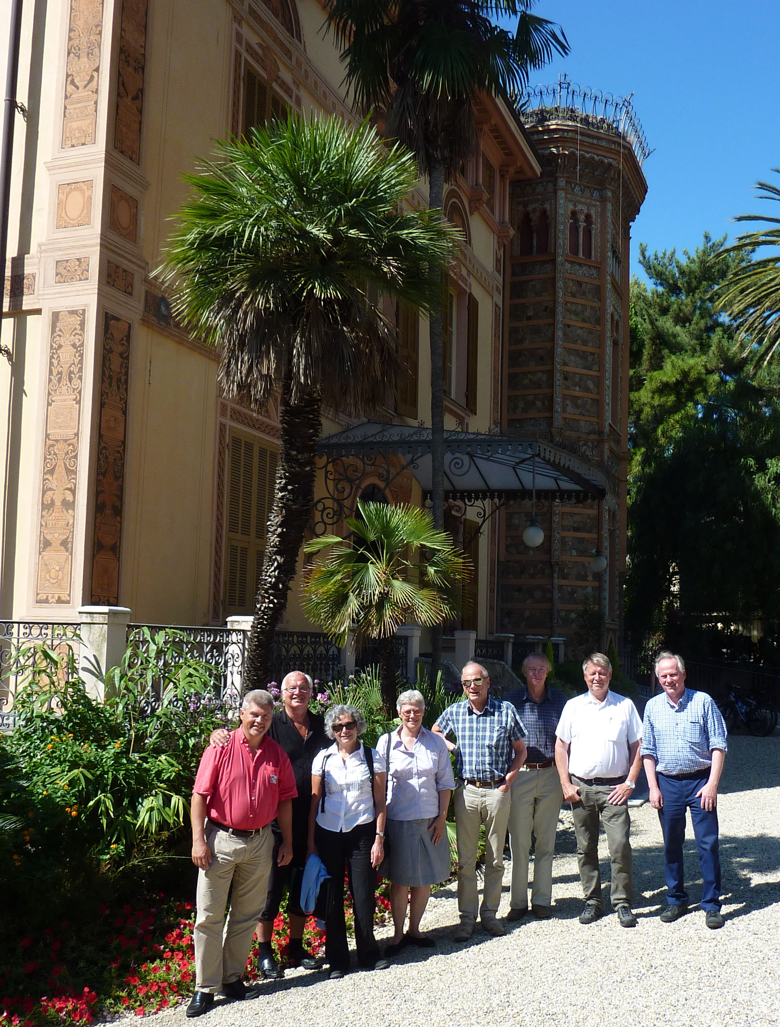
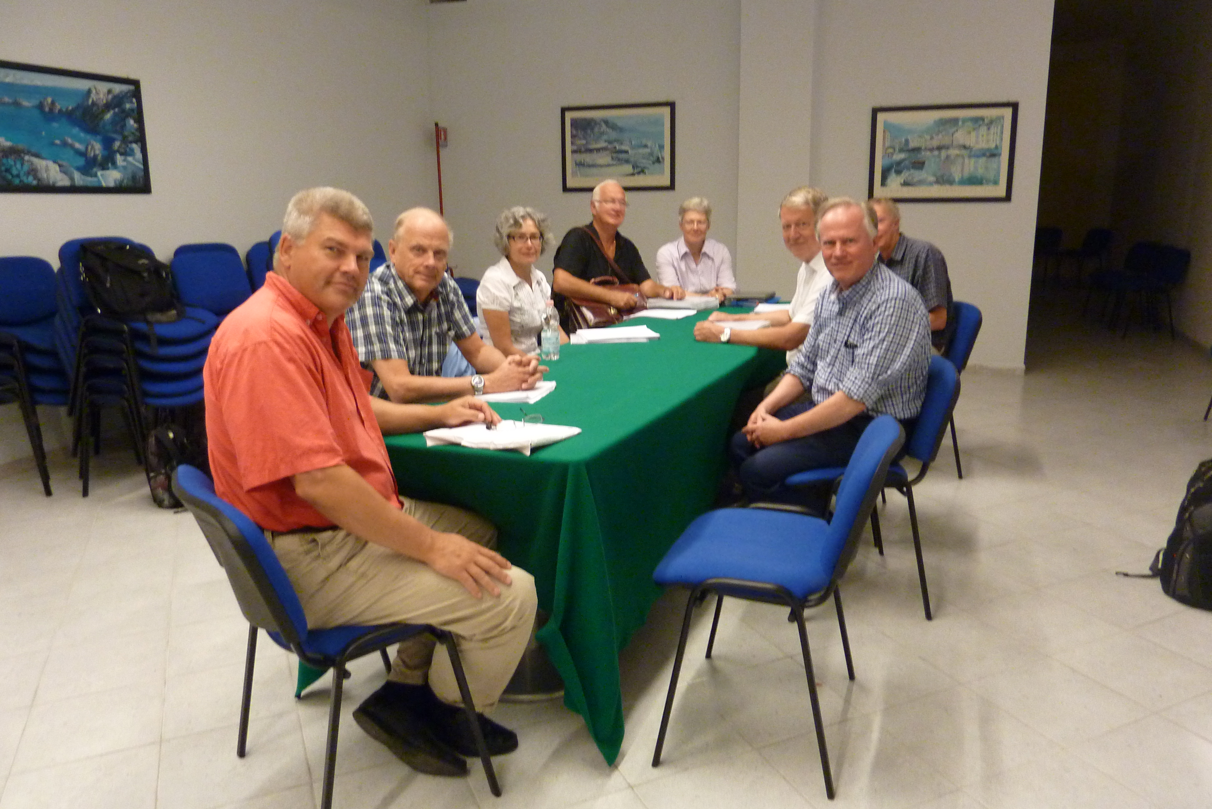
San Remo

Slide 30
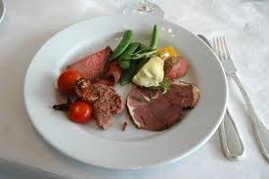
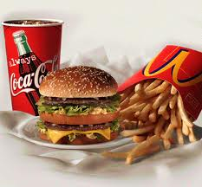
2012
2012-02-01
Nominations examined
2012-02-29
Experts are selected
2012-04-20
Deliberations Chemistry and Medicine
2012-08-23
The final suggestion
2012-06-04-05
Hearing and meeting with Class III
2012-08-07-08
The Committee meeting

Slide 31
2012
2012-02-01
Nominations examined
2012-02-29
Experts are selected
2012-04-20
Deliberations Chemistry and Medicine
2012-09-12
Presentation for Class III
2012-08-23
The final suggestion
2012-06-04-05
Hearing and meeting with Class III
2012-08-07-08
The Committee meeting

Slide 32
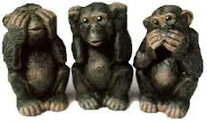
2012
2012-02-01
Nominations examined
2012-02-29
Experts are selected
2012-09-26
Final meeting with Class III
2012-04-20
Deliberations Chemistry and Medicine
2012-09-12
Presentation for Class III
2012-08-23
The final suggestion
2012-06-04-05
Hearing and meeting with Class III
2012-08-07-08
The Committee meeting

Slide 33
2012
2012-02-01
Nominations examined
2012-10-09
Presentation for KVA
2012-02-29
Experts are selected
2012-09-26
Final meeting with Class III
2012-04-20
Deliberations Chemistry and Medicine
2012-09-12
Presentation for Class III
2012-08-23
The final suggestion
2012-06-04-05
Hearing and meeting with Class III
2012-08-07-08
The Committee meeting

Slide 34
2012
2012-02-01
Nominations examined
2012-10-09
Presentation for KVA
2012-02-29
Experts are selected
2012-09-26
Final meeting with Class III
2012-04-20
Deliberations Chemistry and Medicine
2012-09-12
Presentation for Class III
2012-08-23
The final suggestion
2012-06-04-05
Hearing and meeting with Class III
2012-08-07-08
The Committee meeting

Slide 35
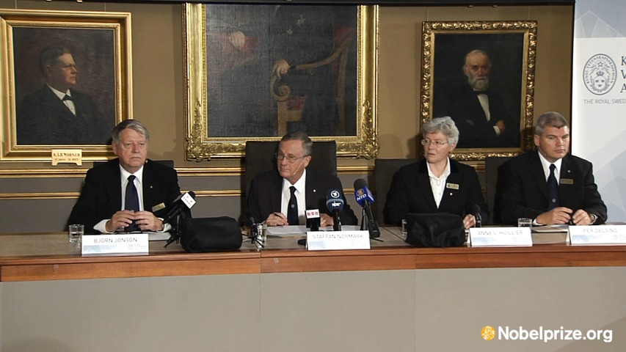
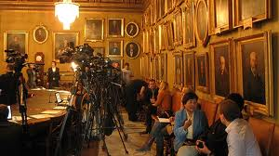
Press Conference

Slide 36
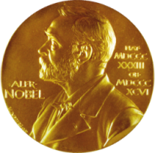
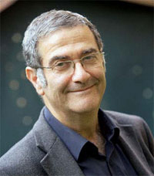
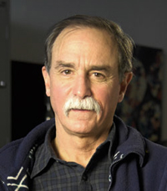
Nobelpriset i fysik 2012
Serge Haroche Collège de France and École Normale Supérieure, Paris, France
David J. Wineland National Institute of Standards and Technology (NIST) and University of Colorado Boulder, CO, USA
“For ground-breaking experimental methods that enable measuring and manipulation of individual quantum systems.”

Slide 37
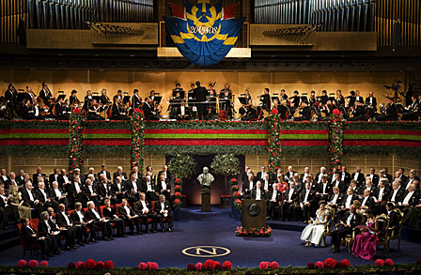

Slide 38
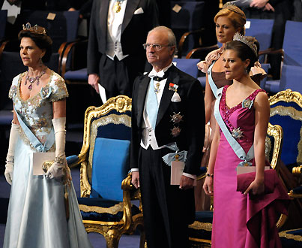
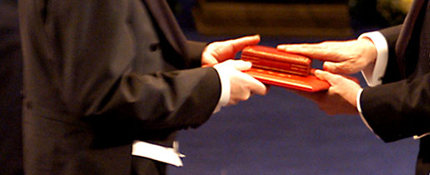

Slide 39
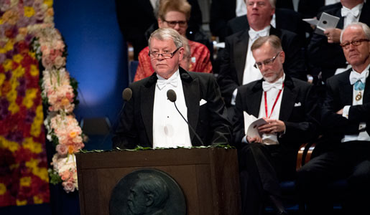
Your Majesties, Your Royal Highnesses, Ladies and Gentlemen, In his epilogue at the Master’s Degree Celebration in Lund 1820, Professor Esaias Tegnér – also a famous poet and author – said This is Man’s wonderful ability: to be able to grasp the inner essence of phenomena, not what they appear to be, but what they mean, and the reality that we see with our eyes is a symbol only of something higher.
What is it that our eyes see? It is light. Everything we see around us – colours, shapes, and objects – comes from light that strikes our eyes………

Slide 40
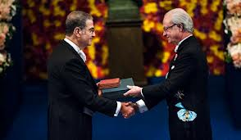
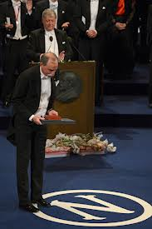
Professeur Haroche, au nom de l’Académie Royale des Sciences de Suède, j’ai le privilège de vous transmettre mes plus chaleureuses félicitations pour votre travail exceptionnel. Je vous demande maintenant de bien vouloir vous avancer pour recevoir votre prix Nobel des mains de Sa Majesté le Roi.
Professor Wineland, on behalf of the Royal Swedish Academy of Sciences it is my privilege to convey to you my warmest congratulations for your outstanding work. I now ask you to step forward to receive your Nobel Prize from the hands of His Majesty the King.

Slide 41
“Inventas vitam juvat
excoluisse per artes”
“inventions enhance life which is beautified through art.”

Slide 42
The Banquet - City Hall of Stockholm

Slide 44
10 000 000 SEK =
1 125 000 EUR

Slide 47
...independent of the value which, after a possible confirmation, may be attributed to the theory of relativity and gravitation give the prize, which for 1921......
...for his contributions to the theoretical physics and especially for his discovery of the law for the photoelectric effect.

Slide 48
11 July 1923

Slide 49
Nobel Prizes in Physics
Nobel Prize in Physics has been awarded 106 times to a total of 194 Nobel Prize winners from 1901 to 2012. John Bardeen is the only Nobel Laureate who has been awarded the Nobel Prize in Physics twice, in 1956 and 1972. This means that a total of 193 people so far have received the Nobel Prize in physics.
Only two women have so far received the Nobel Prize in Physics, Marie Curie (1903) and Maria Goeppert Mayer (1963)
47 fysikpris har utdelats med en pristagare. 30 fysikpris har delats av två pristagare. 29 fysikpris har delats mellan tre pristagare.

