Slide 1
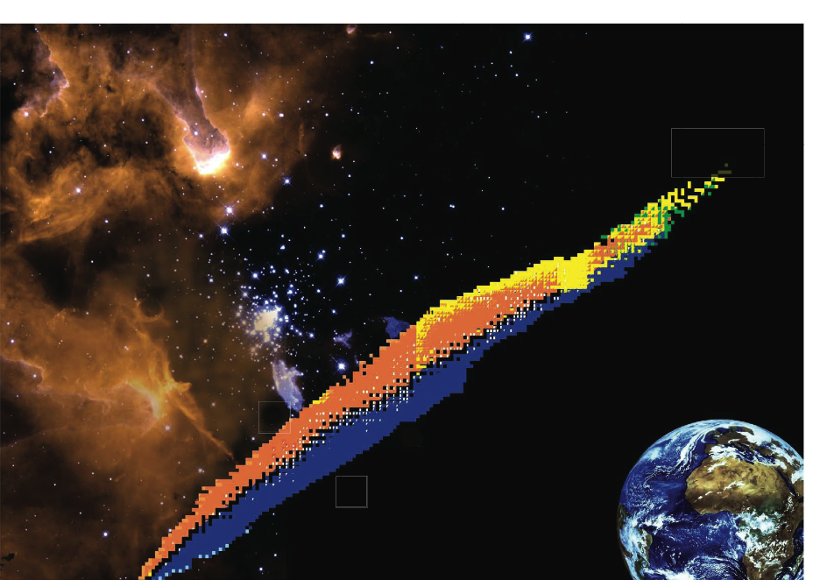
The 8th International Workshop on
DIRECT REACTIONS WITH EXOTIC BEAMS
DREB 2014
Darmstadt, June 30 – July 4, 2014
Picking Flowers in the Nuclear Landscape

Slide 2

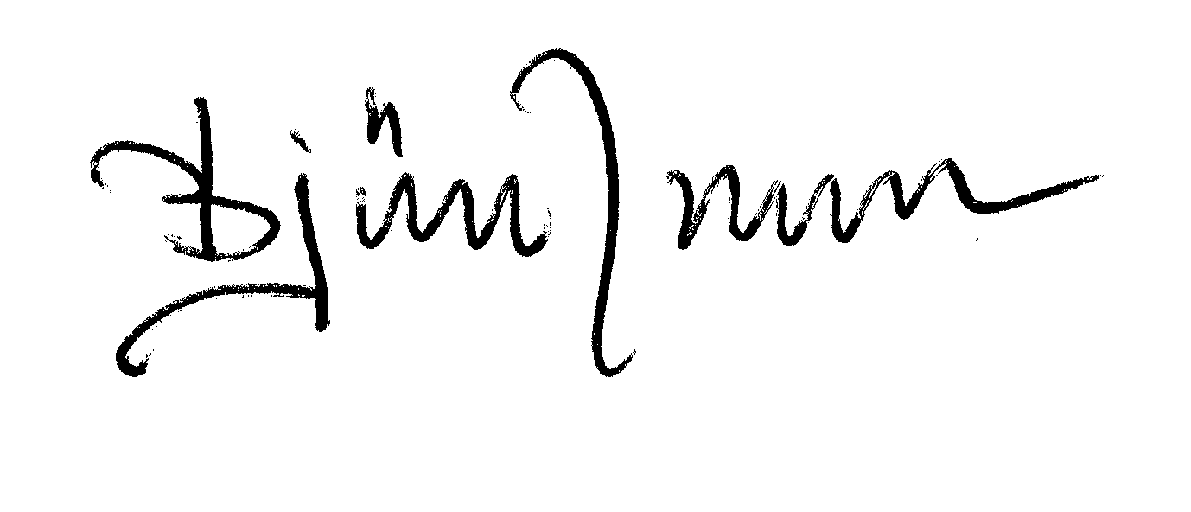
The name Keynote Speaker comes from the idea of a key note in music, which sets the tone for an a capella song. In much the same way, a keynote speaker can set either a positive tone for your event, if the speaker is a good one, or a negative tone, if the speaker does not quite work out.
Your Keynote Speaker may use humor, audience participation, show funny clips, or even sing.

Slide 3

Direct Reactions
with
Exotic Beams
Let us see where it all started……
Once upon a time there
was a young team.....

Slide 4
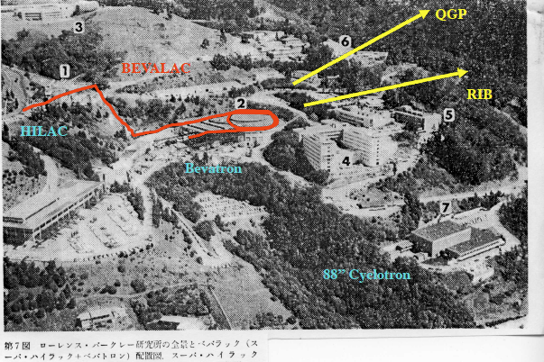
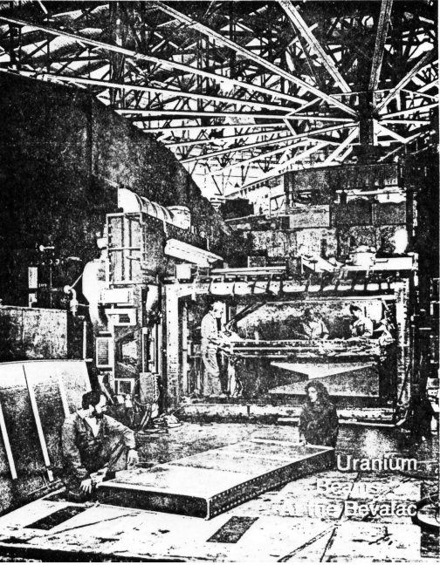
..at the Bevatron…
..setting up an experiment at Berkeley….

Slide 5
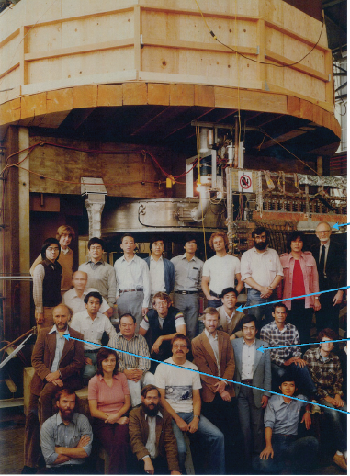
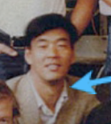
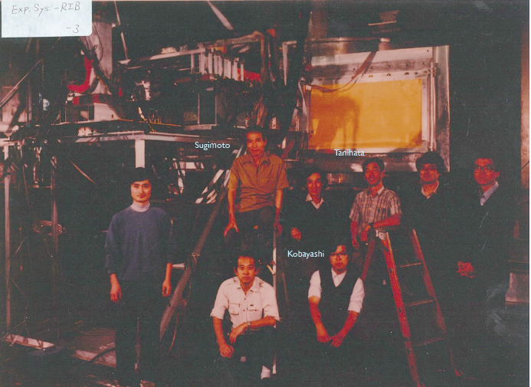
..using the super-conducting dipole HISS…..
not
…working day and night..
..is here today..
..and one of them..

Slide 6
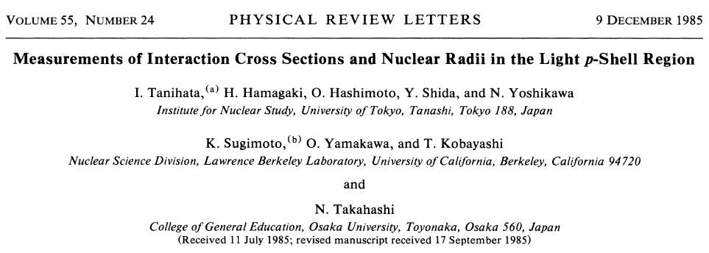
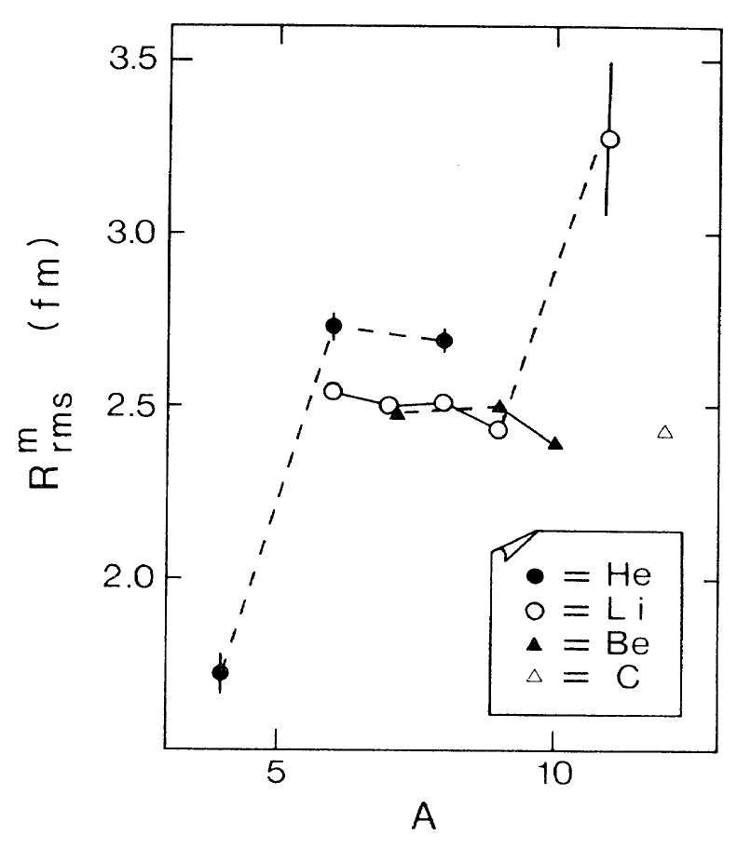

≈

Slide 7


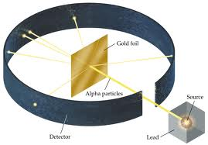
LOGO
BEAM
Beam
Energy
Equipment
Some Results
Reference

Slide 8

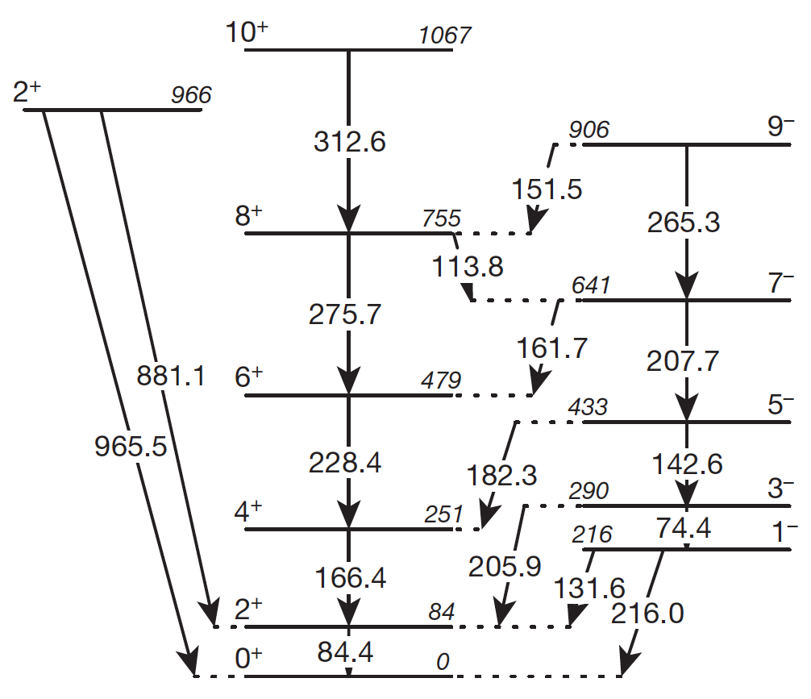
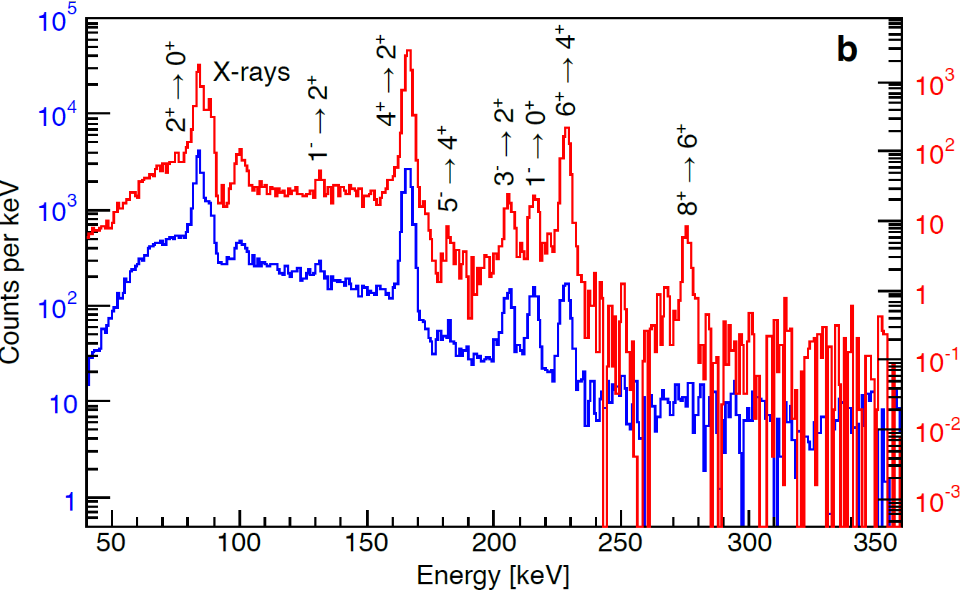
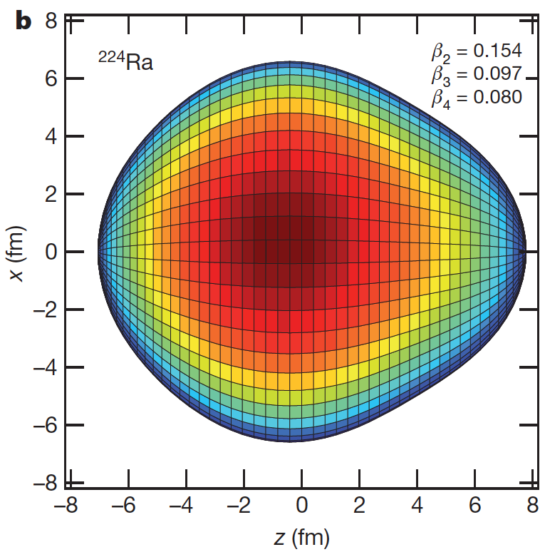
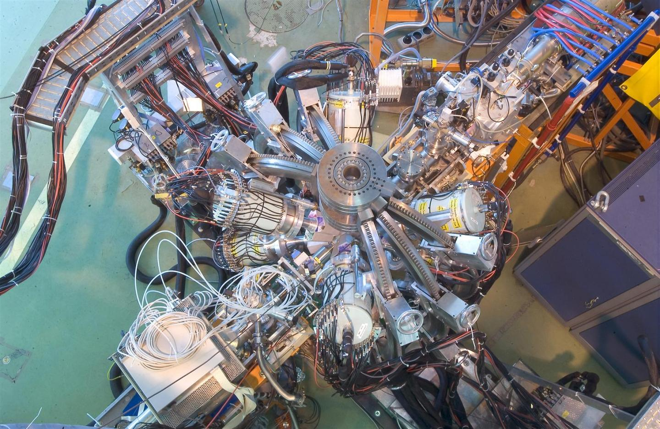
²²⁴Ra
3.66 d
Pear-shaped nuclei
2.83 MeV/u
¹²⁰Sn
⁶⁰Ni
MINIBALL
EDM
L.P. Gaffney et al. PRC 89 (14) 035806
53
Notes:
Z = 34 (Se), 56 (Ba) and 88. Static deformation in the intrinsic frame. This is important for the search of atomic electric-dipole moments. Non-zero EDM would indicate T or CP invariance due to physics beyond the standard model. These drops of nuclear matter do not have the same center of mass and center of charge which favors the search for static EDM and other new physics.

Slide 9
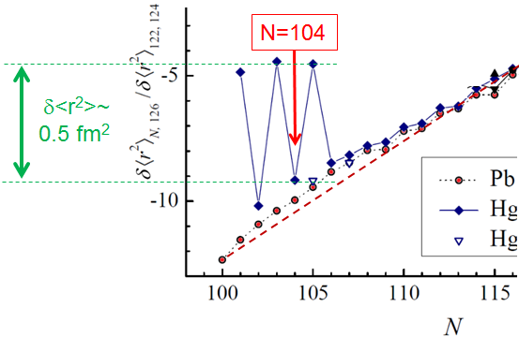
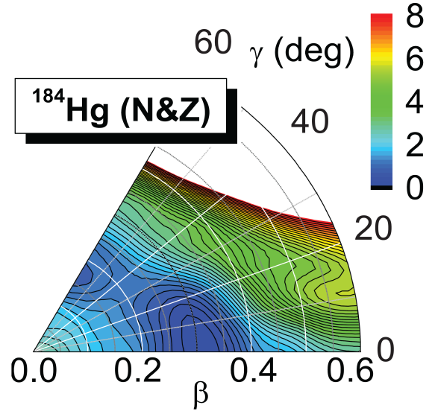
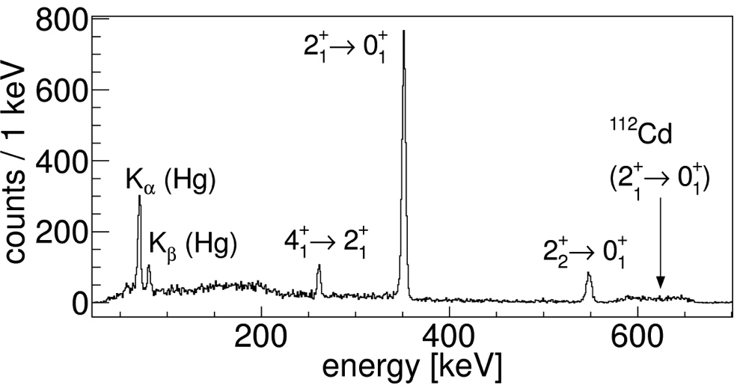
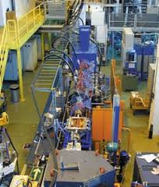
¹⁸²Hg
10.83 s
Shape Coexistence
2.85 MeV/u
4⁺₁
37(1) ps
¹⁸²⁻¹⁸⁸Hg
2⁺₂
E0
E2/M1
352
42(2) ps
2⁺₁
0⁺₂
E0
0⁺₁
¹⁸²Hg
REX-ISOLDE
¹¹²Cd
N. Bree et al. PRL 112 (14) 162701
70
Notes:
Otten. ¹⁸⁶Pb. Coulomb excitation with Sn, Ag and Cd targets for even-even isotopes. Magnitudes and relative signs of E2 matrix elements that couple ground states and low lying states. The ground states of 182, 184Hg are slightly deformed and OBLATE while the deformation for the second 0+ state has a larger PROLATE deformation. The data can be interpreted within a two-state mixing model. The presence of two different structures in the light even-mass Hg isotopes that coexists is firmly established.

Slide 10
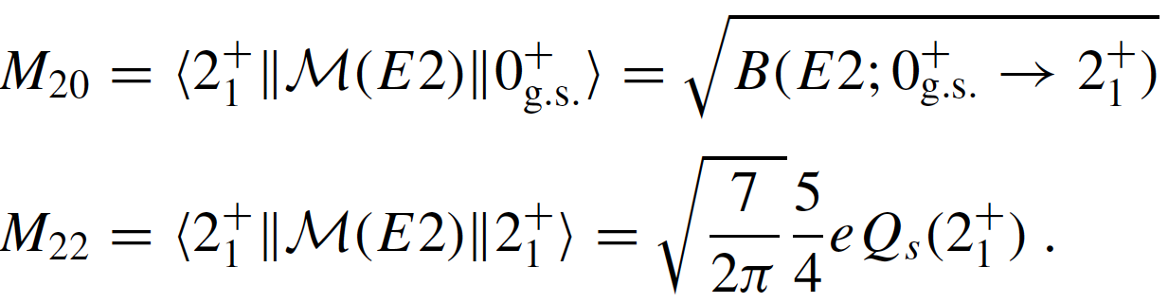
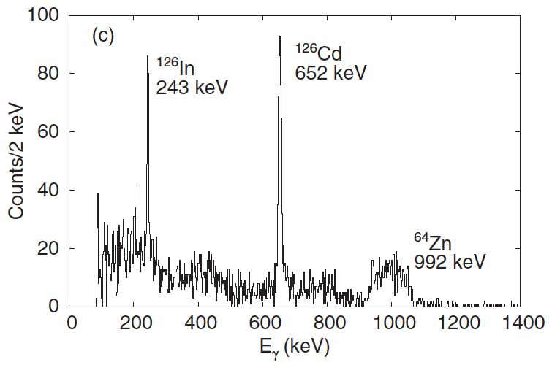

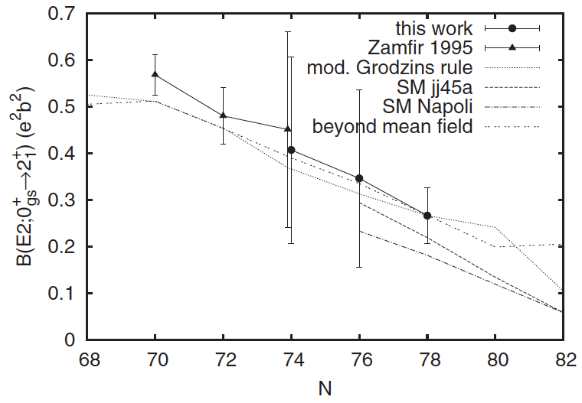
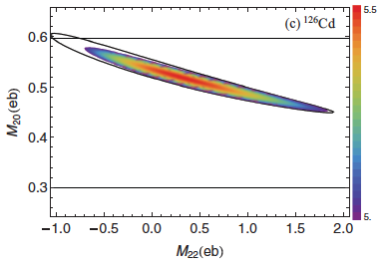
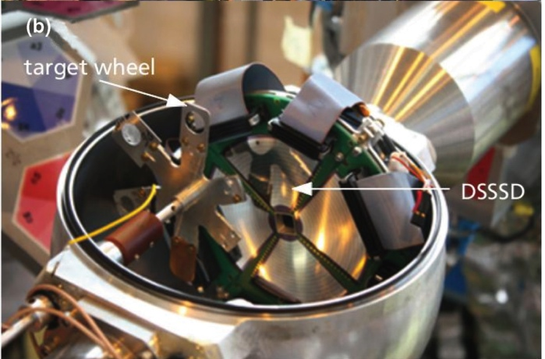
¹²⁶Cd
0.515 s
Safe Coulomb Excitation
b(θ)≥ R₁+R₂+5 fm
2.85 MeV/u
⁶⁴Zn
S. Ilieva et al. PRC 89 (14) 014313
53
Notes:
Reduced transition probabilities and limits for the quadrupole moments of the first excited 2+ state. Coulomb excitation cross-section depends on the Rutherford cross section, the reduced transition probability and the spectroscopic quadrupole moment. Impact parameter for safe Coulex. One sigma contour for likelierhood distribution.

Slide 11


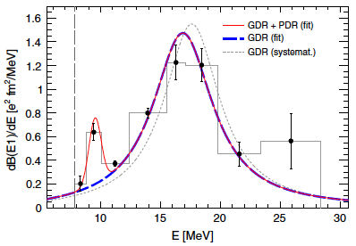

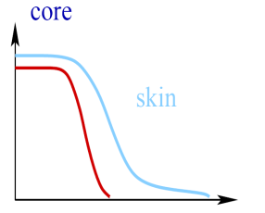
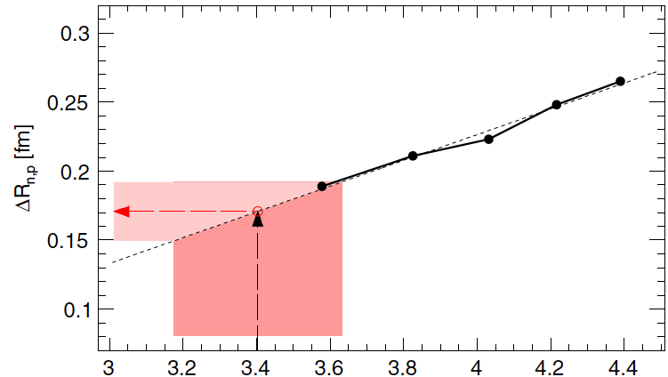
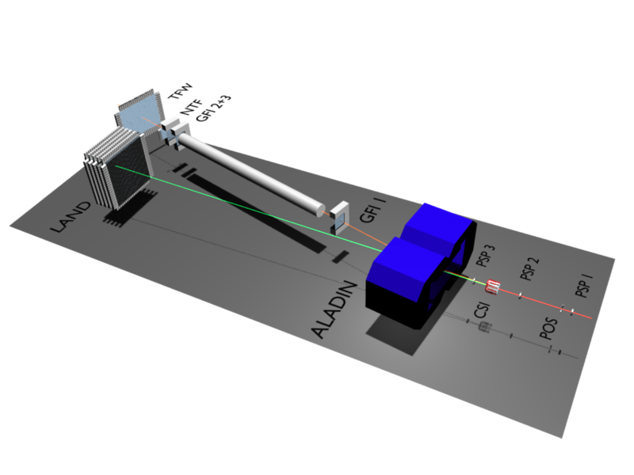
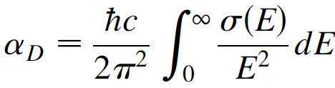
⁶⁸Ni
29 s
Dipole Polarizability
E1 strength
502.7 MeV/u
0.17(2) fm
= 3.40(23) fm³
D.M. Rossi et al. PRL 111 (13) 024503
48
Notes:
E1 strength distribution virtual photons Pb target. Isospin asymmetric part of the EOS, symmetry energy,. One and two neutron-decay channels. First time for and unstable nucleus.

Slide 12
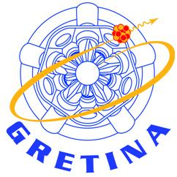
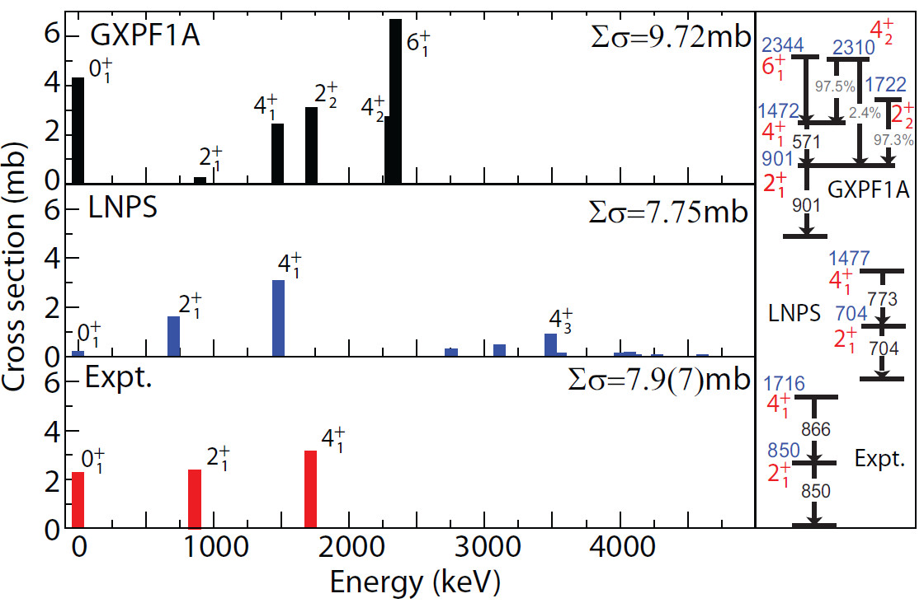
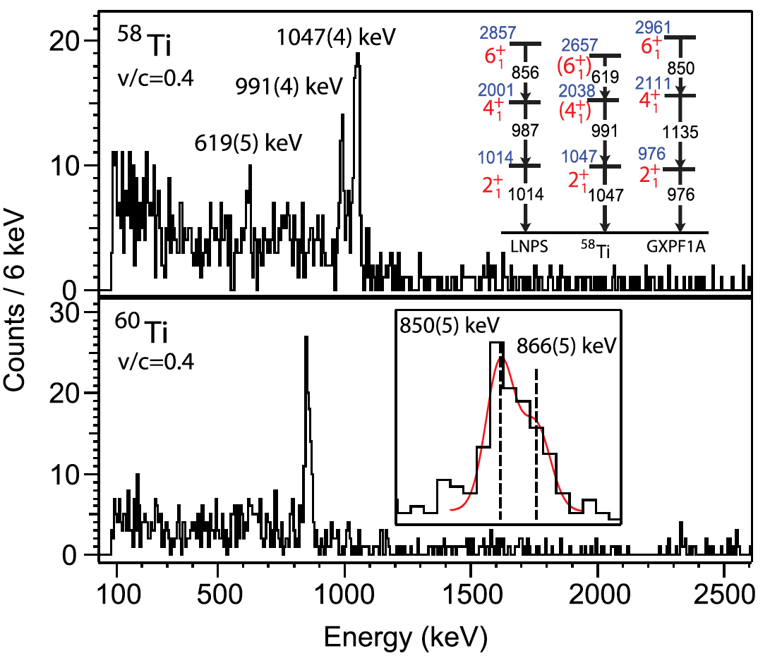
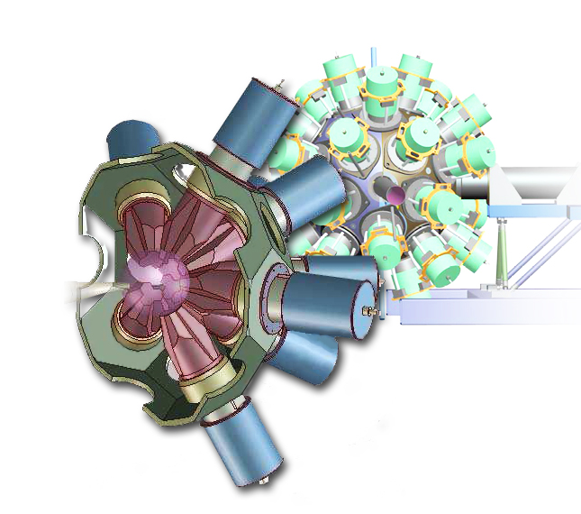
⁶¹V
52.6 ms
Sudden Structural Change near N = 40
⁵⁸Ti
57 ms
⁵⁹Ti
27.5 ms
⁶⁰Ti
22.4 ms
90 MeV/u
⁹Be(⁶¹V,^{58,60}Ti+γ)X
⁶⁰Ca?
A.Gaade etal., PRL 112 (2014) 112503
31
Notes:
Effective shell model interaction with the largest model space available predict f_{5/2}, d_{5/2}, g_{9/2} degenerate – essentially no N=40 gap. Peak at 850 keV found to be a doublet thanks to GRETINA’s coincidence efficiency. ^{58,60}Ti most neutron-rich benchmarks for calculations of the potentially doubly-magic ⁶⁰Ca. The 2+ state has twice the excitation energy than the N=38 isotone ⁶²Cr signaling a steep decrease in collectivity. Sensitivity to ph strength.

Slide 13

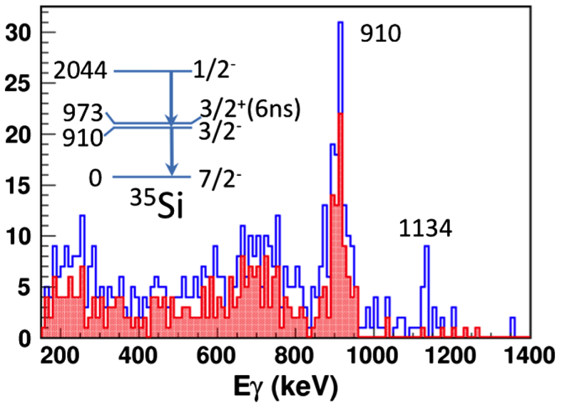
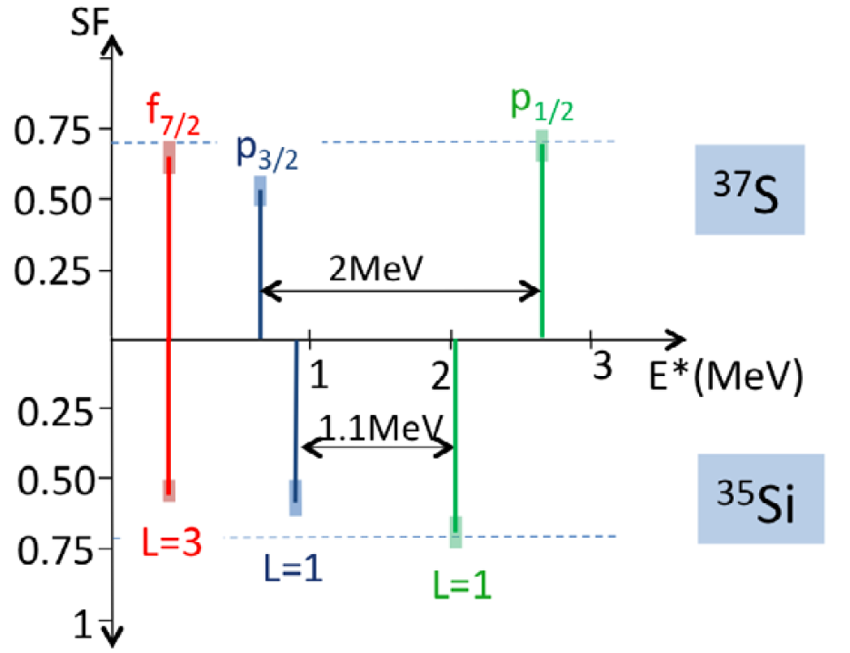
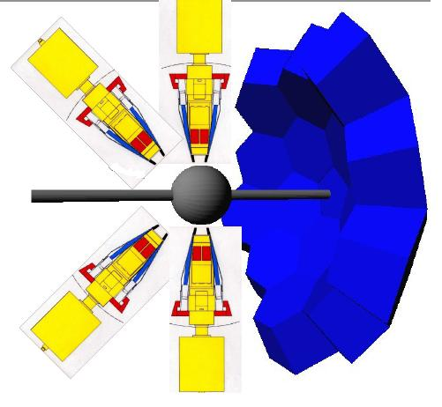

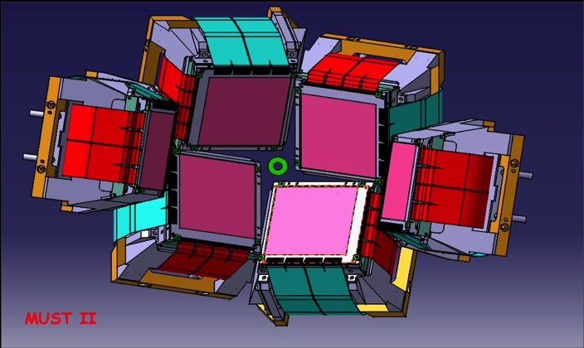
³⁴Si
2.77 s
³⁵Si
0.78 s
Two-Body
Spin-Orbit Force
20.5 MeV/u
³⁵Si v.s ³⁷S
³⁴Si(d,p)³⁵Si
p_{3/2} - p_{1/2}
-25 %
f_{7/2} – f_{5/2}
380 keV
G. Burgunder et al., PRL 112 (14) 042502
33
Notes:
Two-Body neutron-neutron monopole term. Cleanest extraction. . By comparing the spectroscopic information on the ³⁵Si and ³⁷S isotones, a reduction of the p_{3/2}-p_{1/2} spin-orbit splitting by about 25% is proposed, while the f_{7/2}-f_{5/2} spin-orbit splitting seems to remain constant. These features, derived after having unfolded nuclear correlations using shell model calculations, have been attributed to the properties of the two-body spin-orbit interaction, the amplitude of which is derived for the first time in an atomic nucleus.

Slide 14

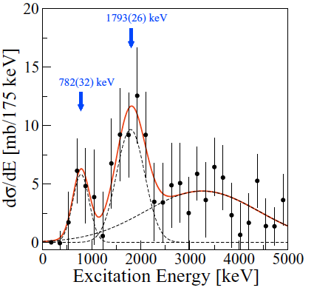
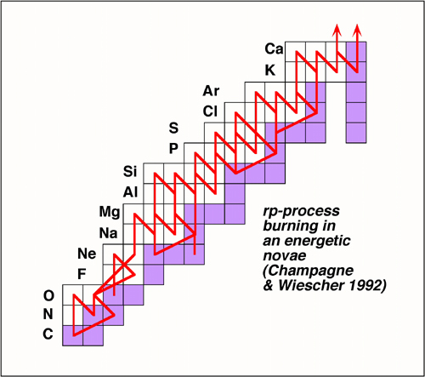
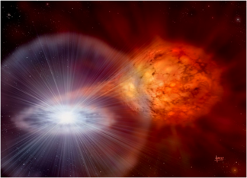
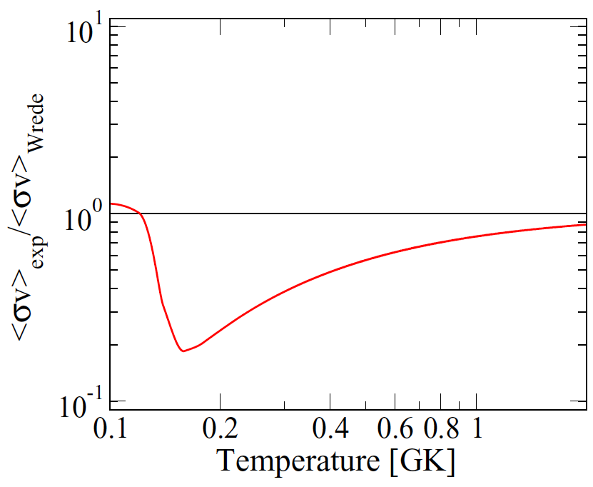
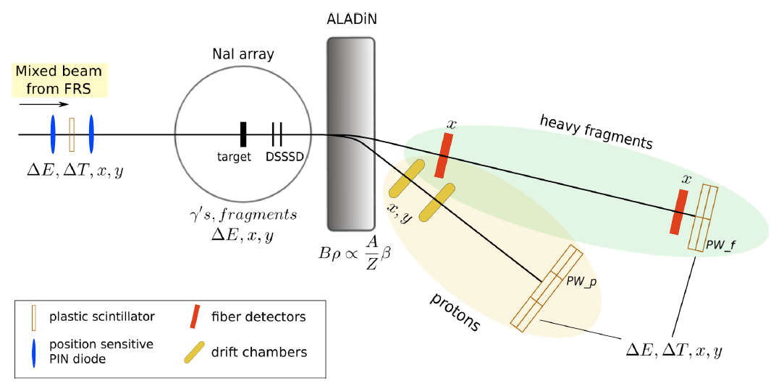
³¹Cl
150 ms
Thermonuclear Reaction Rate
rp process
S_{p}=296 keV
650 MeV/u
Type I X-ray burst
³⁰S(p,γ)³¹Cl
C. Langer et al., PRC 89 (14) 035806
43
Notes:
Determine the capture rate at astrophysical conditions. Depends on the ³¹Cl structure. The experimental determination of the state at 782 keV, suggested to be a ½⁺ state. IMME by Wrede et al.

Slide 15

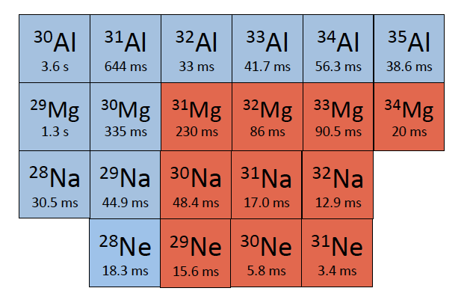
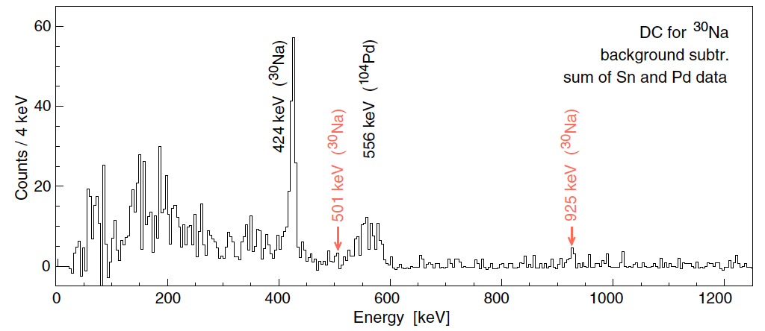
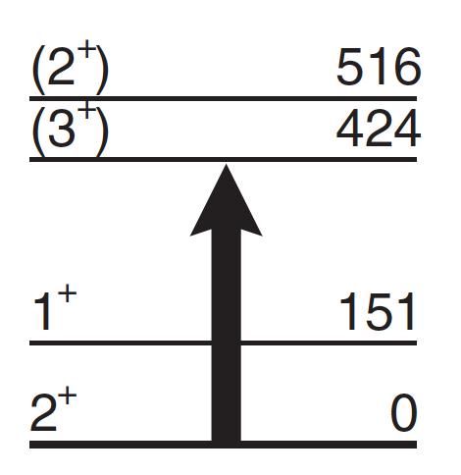
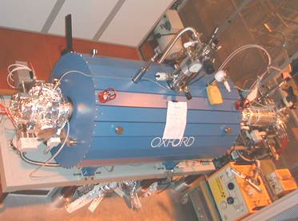
The Island of Inversion
²⁹Na
44.9 ms
³⁰Na
48.4 ms
2.85 MeV/u
PhysRevC.82.054301.png
³⁰Na
N = 18 19
REXEBIS
³⁰Na
(2p2h) deformed
ground-state configuration
39
M. Seidlitz et al., PRC 89 (14) 024309
Notes:
The measured B(E2) values support the idea that ²⁹Na contains a significant intruder mixture already at N=18 while N=19 have almost pure 2p2h configuration. Pd and Sn targets.

Slide 16
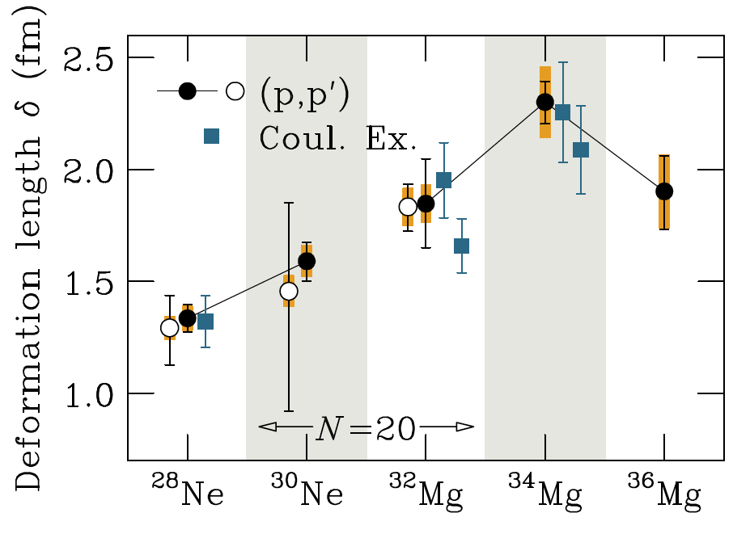
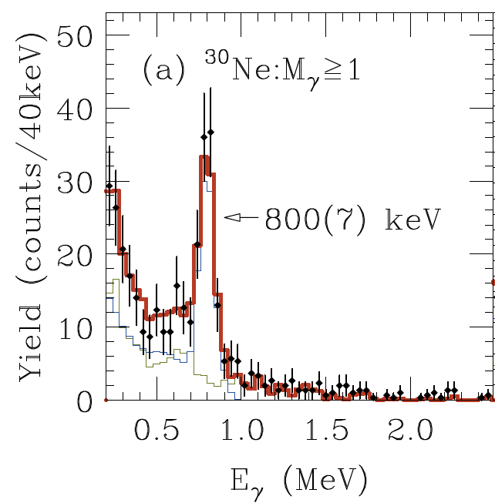
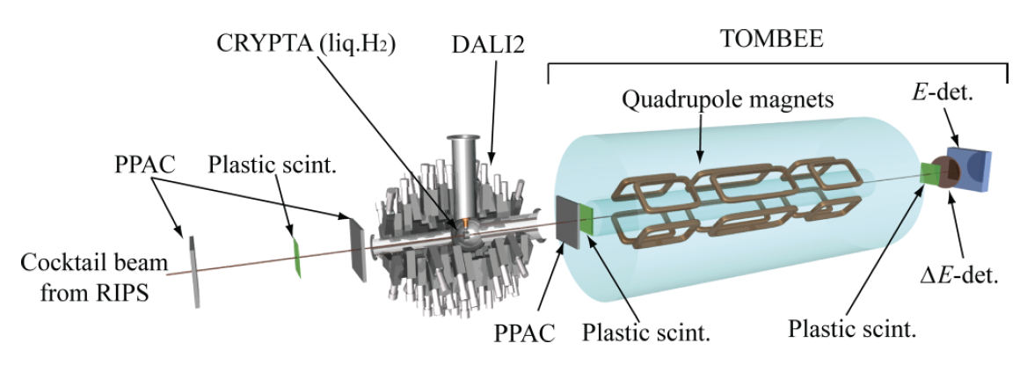
²⁸Ne
18.9 ms
²⁹Ne
14.8 ms
³⁰Ne
7.3 ms
Quadrupole collectivity
N=20
³⁴Mg
20 ms
³⁵Mg
70 ms
³⁶Mg
3.9 ms
44.0 – 53.5 MeV/u
S. Michimasa et al., PRC 89 (14) 054307
27
Notes:
36Mg the neutron-rich edge of the IOI.

Slide 17

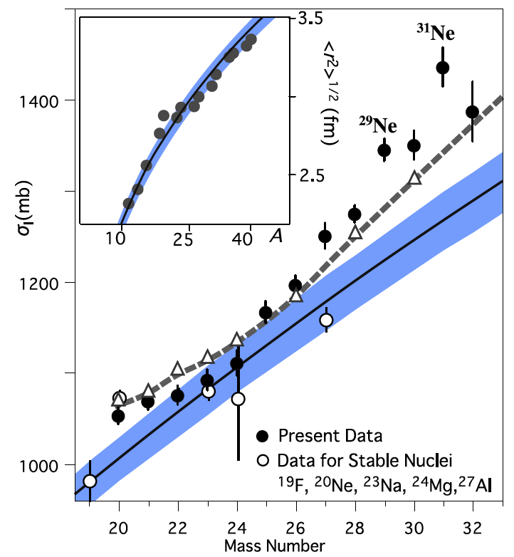
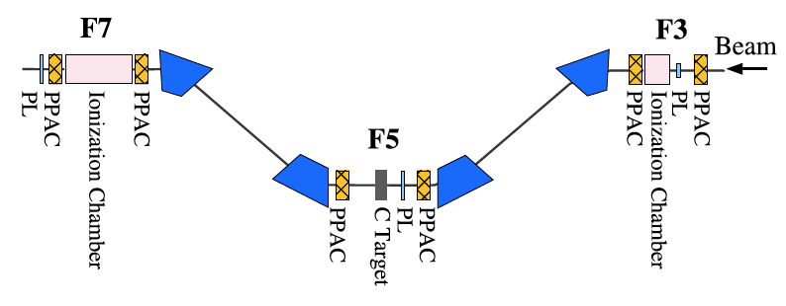
³¹Ne
0.78 s
Interaction Cross Sections, σ_{I}
240 MeV/u
K. Riisager, Phys. Scr. T 152 (13) 014001
l=0
l=1
53
M. Takechi et al., PLB 707 (12) 357
Notes:
Low l orbit 0 or 1. Nilsson orbits.

Slide 18




³¹Ne
0.78 s
p -Wave Halo
230 MeV/u
³⁰Ne core
Strongly deformed although N=21
Deformation β~0.5
2⁺
I^{π} = 3/2⁻
p-wave halo (C²S~0.3)
T. Nakamura et al., PRL 112 (14) 142501
27
Notes:
Note the very low binding energy. On June 18 there is a PRL paper describing a similar deformed halo in
³⁷Mg, which you shall hear more about during this conference.

Slide 19




Unbound Nuclei
²⁴F
0.34 s
²⁵F
50 ms
²⁶F
10.2 ms
²⁷F
4.9 ms
²⁸F
unbound
²⁹F
2.6 ms
³⁰F
unbound
³¹F
>260 ns
²³O
82 ms
²⁴O
61 ms
²⁵O
unbound
²⁶O
unbound
442 MeV/u
82 MeV/u
E_{r} = 768 keV
0d_{3/2} neutron
E_{r} ≈ 150 keV
123
21
C. Caesar et al., PRC 88 (13) 034313
E. Lunderberg et al., PRL 108 (12) 142503
Notes:
For ²⁵O there is a peak at 768 keV.

Slide 20





…hint….
« vaut le voyage »

Slide 21






²⁷F
4.9 ms
Two-neutron radioactivity ?
²⁶O
unbound
L.V. Grigorenko et al.,
PRL 111 (13) 042501
Decay energy 1 keV
16
Z. Kohley et al., PRC 88 (13) 034313
Notes:
Neutron velocity smaller than fragment velocity. This implies that the neutron is emitted after the 26O travelled through the target.

Slide 22




²⁴F
0.34 s
²⁵F
50 ms
²⁶F
10.2 ms
²⁷F
4.9 ms
²⁸F
unbound
²⁹F
2.6 ms
³⁰F
unbound
³¹F
>260 ns
²³O
82 ms
²⁴O
61 ms
²⁵O
unbound
²⁶O
unbound
²⁸O
unbound
²⁹F: 13 pps
NeuLAND@RIKEN.

Slide 23






¹⁹O
26.9 s
¹⁹O(d,p)²⁰O
6.61 MeV/u
FWHM ~ 175 keV
24
C.R. Hoffman et al., PRC 88 (13) 034313
Notes:
Charged particles are identified by mas-to-charge ratios from the cyclotron period. In the homogenous field of the magnet the lab. Energy and the corresponding distance from the target after one single cyclotron orbit z give a complete kinematic determination of the reaction. ATLAS @ Argonne. Measured cross sections, angular distributions, spectroscopic factors, T=1 diagonal two-body matrix elements.

Slide 24



59 MeV/u
Heavy Be isotopes
¹⁴Be
4.84 ms
¹⁵Be
unbound
C
D - polyethylene
¹⁵Be
l=2
Bgr
E_{r}=1.8(1) MeV
14
J. Snyder et al., PRC 88 (13) 031303(R)

Slide 25


¹⁷B
5.08 ms
53 MeV/u
Dineutron Decay of ¹⁶Be
¹⁶Be
unbound
¹⁶Be
18
A. Spyrou et al., PRL 108 (12) 102501

Slide 26

¹⁶Ne
unbound
¹⁷Ne
109.2 ms
500 MeV/u
59
J. Marganiec et al., submitted
20
K.W. Brown et al., arXiv

Slide 27


¹⁵Ne
unbound
¹⁶Ne
unbound
¹⁷Ne
109.2 ms
500 MeV/u
H.T. Fortune, PLB 718 (13) 1342
T_{z} = -5/2
A/Z = 1.5
H.T. Fortune, PLB 718(13) 1342
F. Wamers et al., PRL 112 (14) 132502
59
Notes:
It was interesting that Fortune made a simple parameterization of mirror pairs with N=8,10 and Z=8,10. He found a linear relationship between the s-wave content and the energy differences between 2p and 2n separation energies. He predicted with this that ¹⁵Ne was unbound with of 2.68 MeV. This is close to the value obtained and may be used to estimate the s-wave content to 63 %.

Slide 28





¹⁴Be
4.35 ms
Nuclear Matter Density
Distribution
700 MeV/u
R_{m}=3.25(11) fm
IKAR
S. Ilieva et al., NPA 875 (12) 8
24
Notes:
The setup was the active target IKAR. Glauber multiple scattering theory. Different parameterizations were used.
Here I show the Sum Of Gaussians parameterization.

Slide 29





¹⁴B
12.5 ms
35 MeV/u
¹³Be
unbound
=
s
d
s
C(¹⁴Be,¹²Be+n)
d
d
26
G. Randisi et al., PRC 89 (14) 034320

Slide 30

¹²Be
21.49 ms
¹³Be
unbound
¹⁴Be
4.35 ms
Yu. Aksyutina et al.,
PRC 87 (13) 064316
Y. Kondo et al.,
PLB 690 (10) 245
59
?
35
Yu. Aksyutina et al., PLB 718 (14) 1309

Slide 31


¹²Be(d,p)¹³Be
¹¹Be(t,p)¹³Be

Slide 32







⁹Li
179 ms
¹⁰Li
unbound
¹¹Li
8.5 ms
Momentum Profile Function
p_{n1}= -(p_{9Li}+ p_{n2})
(0d_{5/2})²
11(2) %
Yu. Aksyutina et al., PLB 718 (14) 1309

Slide 33


Halo Nuclei

Slide 34



⁹Li
179 ms
¹⁰Li
unbound
¹¹Li
8.5 ms
E_{CM}=23.1 MeV
E_{CM}=28.1 MeV
J.P. Fernández-García et al., PRL 110 (13) 262701
25
25
M. Cubero et al., PRL 109 (12) 262701
Notes:
Strong reduction of the Rutherford cross section below the Coulomb barrier. The reduction is
Mainly due to Couloumb coupling to low lying dipole state in the 11Li continuum. First order
semiclassical perturbation theory of Coulomb excitation to extract the slope of the B(E1)

Slide 35






⁸He(d,p)⁹He
⁸He
109 ms
⁹He
unbound
15.4 MeV/u
⁸He+n
Johansson et al., NPA 842 (2010) 15
½⁺ at 180(85) keV
35
T. Al Kalanee et al., PRC 88 (13) 034301
Notes:
Angular distribution shows the ½⁺ state and thus a parity inversion.
Single neutron coupled to the 2⁺ state in ⁸He.

Slide 36




⁸He(t,p)¹⁰He
⁸He
119 ms
⁹He
unbound
¹⁰He
unbound
0⁺
2⁺
0⁺ , 1⁻, 2⁺
L.V. Chulkov et al.,
PLB 720 (14) 344
Johansson et al., NPA 847 (2010) 66
26
S.I. Sidorchuk et al., PRL 108 (12) 202502
Notes:
Coherent superposition of a 1⁻ and 2⁺ state on top of the 0⁺ tail. This is debated.
It was shown that the data is compatible without a 1⁻ state.

Slide 37

¹¹Li
8.5 ms
¹¹Li(d,³He)¹⁰He
50 MeV/u
⁶He+4n
⁸He+2n
…importance of ⁸He
core excitations in ¹⁰He..
σ_{exp}/σ_{obs}= 0.10(2)
48
Courtesy Adrien Matta

Slide 38




Slide 39


²⁸⁸115
⁴⁸Ca
4.3 10¹⁹ y
²⁴⁹Bk
330 d
²⁹⁴117
⁴⁸Ca
4.3 10¹⁹ y
²⁴³Am
7370 a
²⁸⁸115
10.7(1)
0.16( )
²⁸⁴113
3
2
51
10.3(1)
0.92( )
D. Rudolph et al.,
PRL 111 (13) 112502
²⁸⁰Rg
16
12
10.15(1)
4.8( )
²⁷⁶Mt
8
6
10.10(1)
0.70( )
²⁷²Bh
13
9
9.21(1)
10.9( )
J. Khuyagbaatar et al.,
PRL 112 (14) 172501
²⁶⁸Db
21
15
26( ) h
59
4
3

Slide 40









Slide 41



XX = 1205/40
Reference
xx

