Slide 1
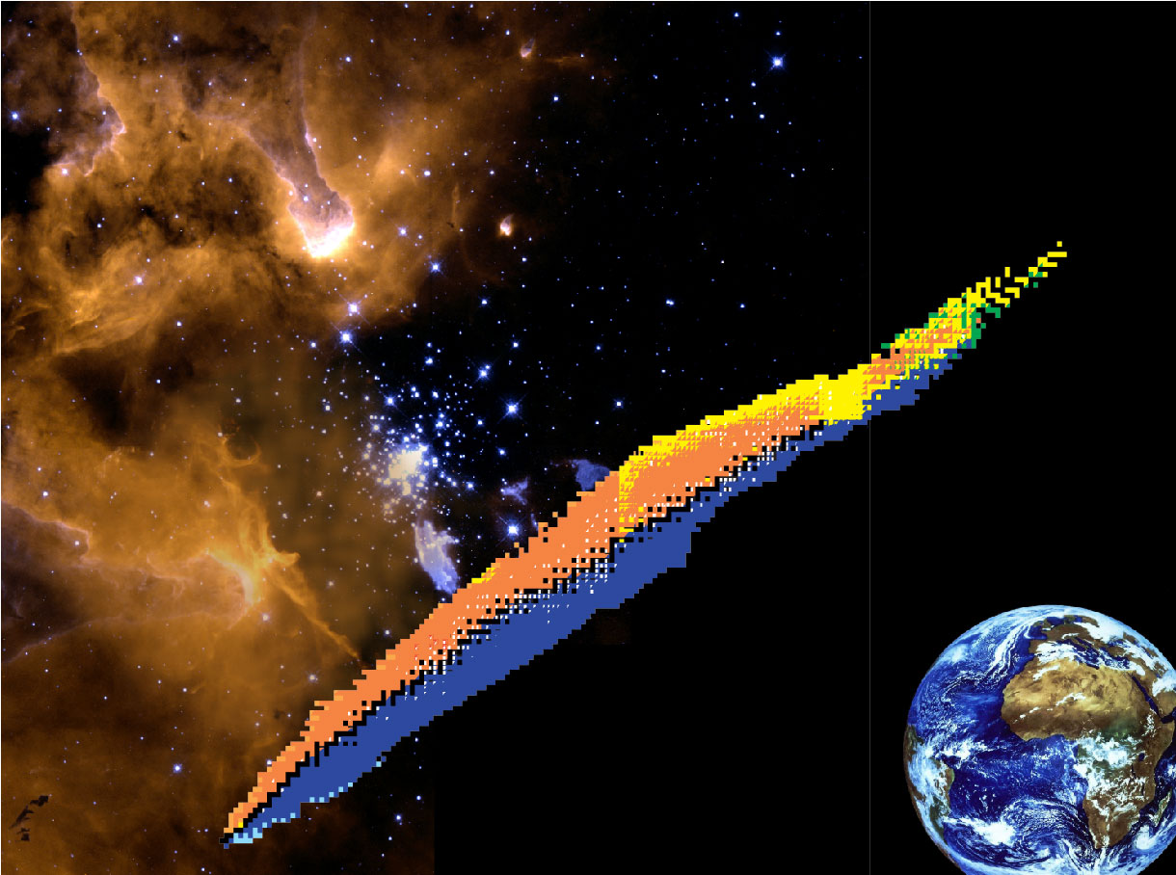


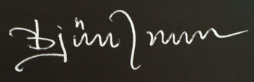
Exotic Nuclei:
Past, Present, and Future
Björn Jonson
Chalmers University of Technology
Göteborg, Sweden
March 29,2018

Slide 2
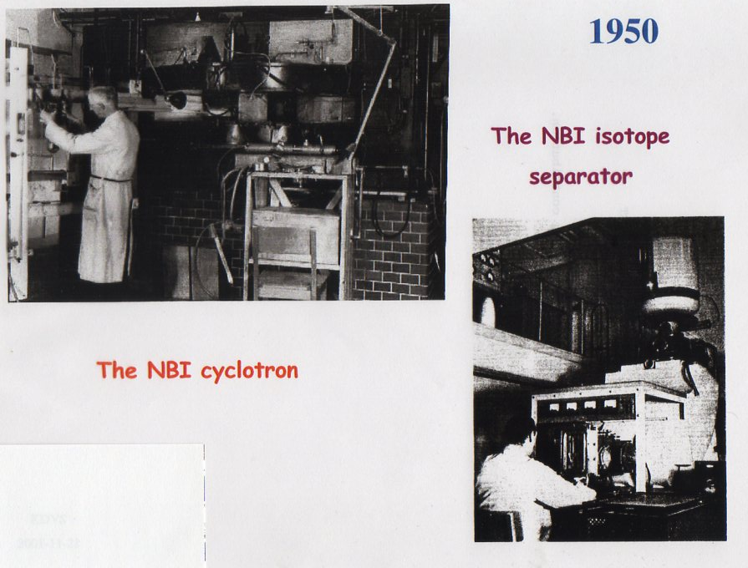
1948
Prehistory
The Niels Bohr Institute
Copenhagen, Denmark

Slide 3
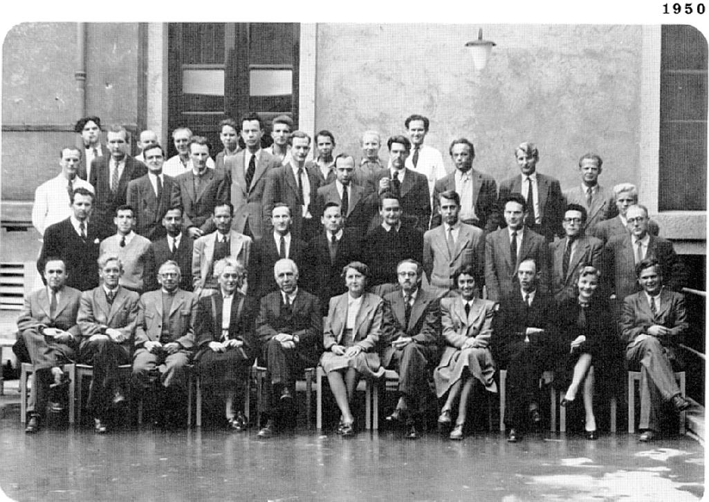
Prehistory
The Niels Bohr Institute
Copenhagen, Denmark
Otto Kofoed-Hansen
Karl-Ove Nielsen
Niels Bohr

Slide 4
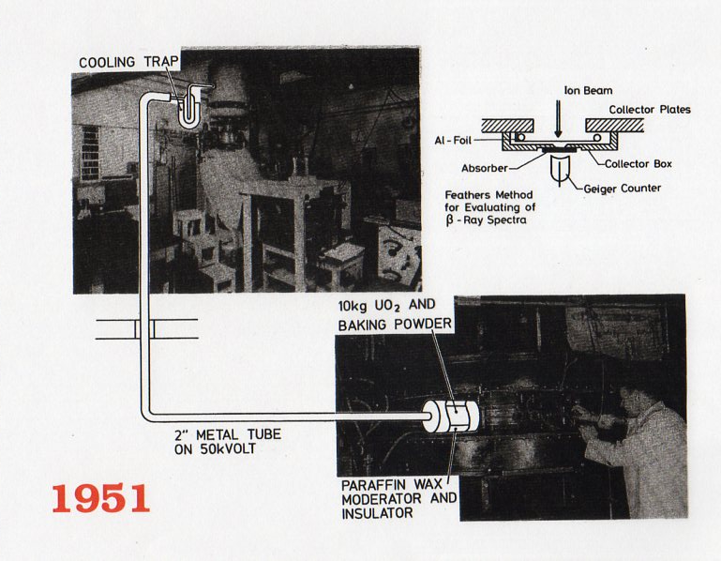
Isotope Separator On Line

Slide 5
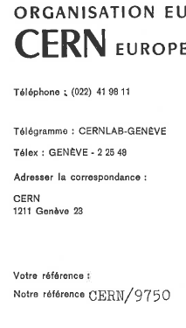
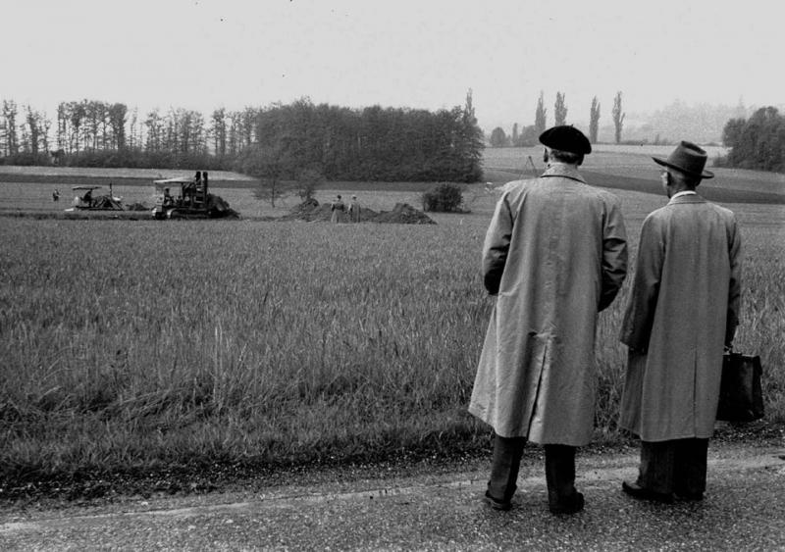
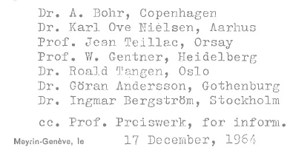
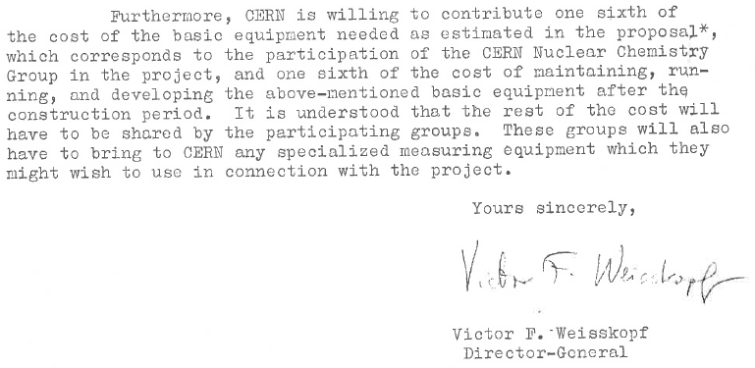
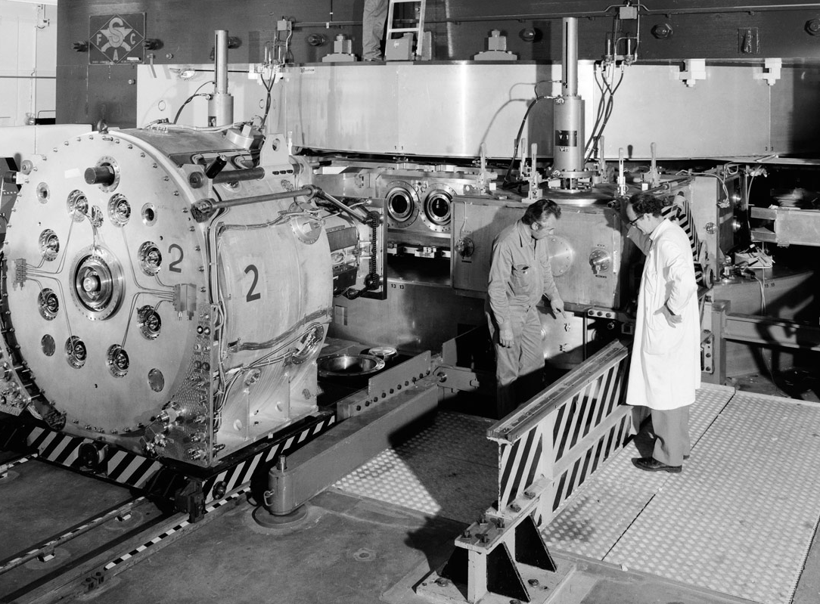
Letter from the
Director General at CERN
W.F. Weisskopf
to the
ISOLDE Community
Meyrin, Genève, Switzerland
September 29, 1954
600 MeV p
CERN SC

Slide 6
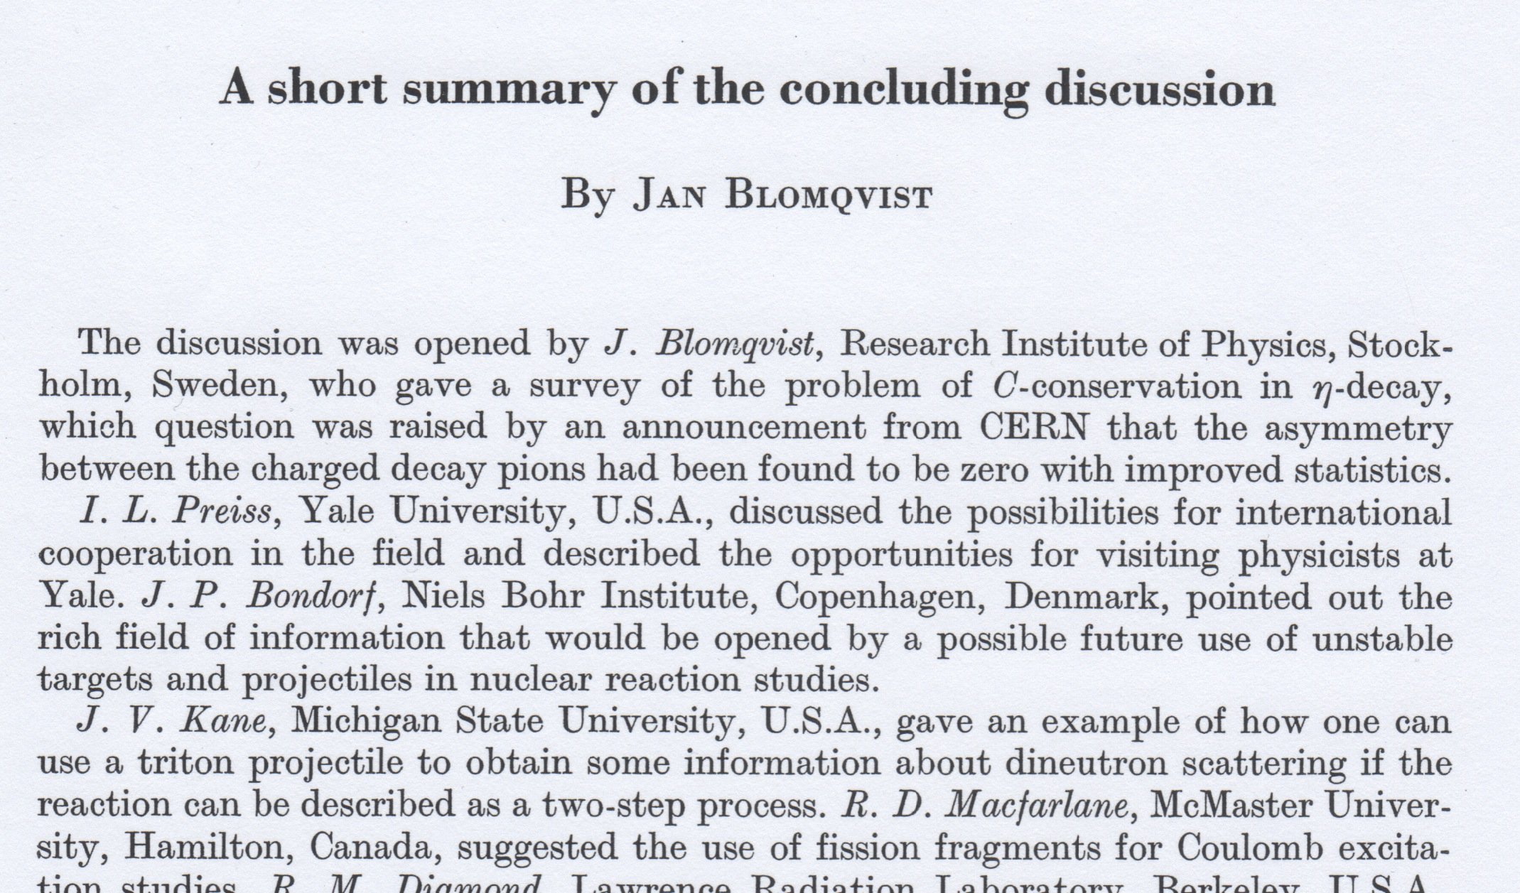
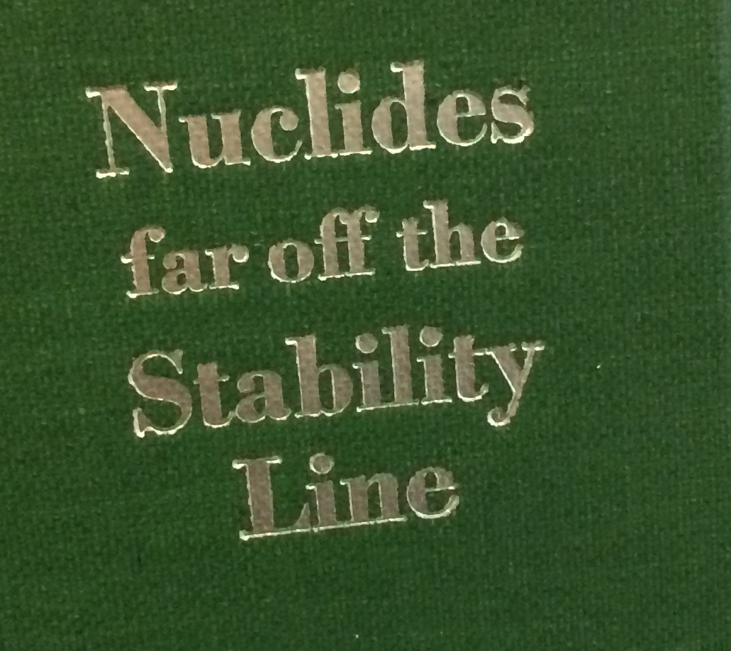
27/8 1966
Lysekil, Sweden,
August 21-27 1966

Slide 7
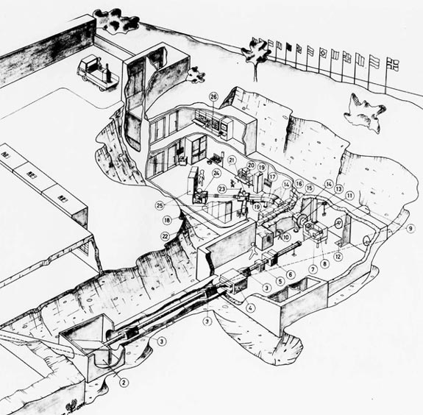
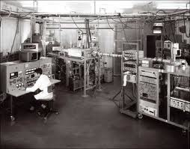
1967
G. Droz

Slide 8
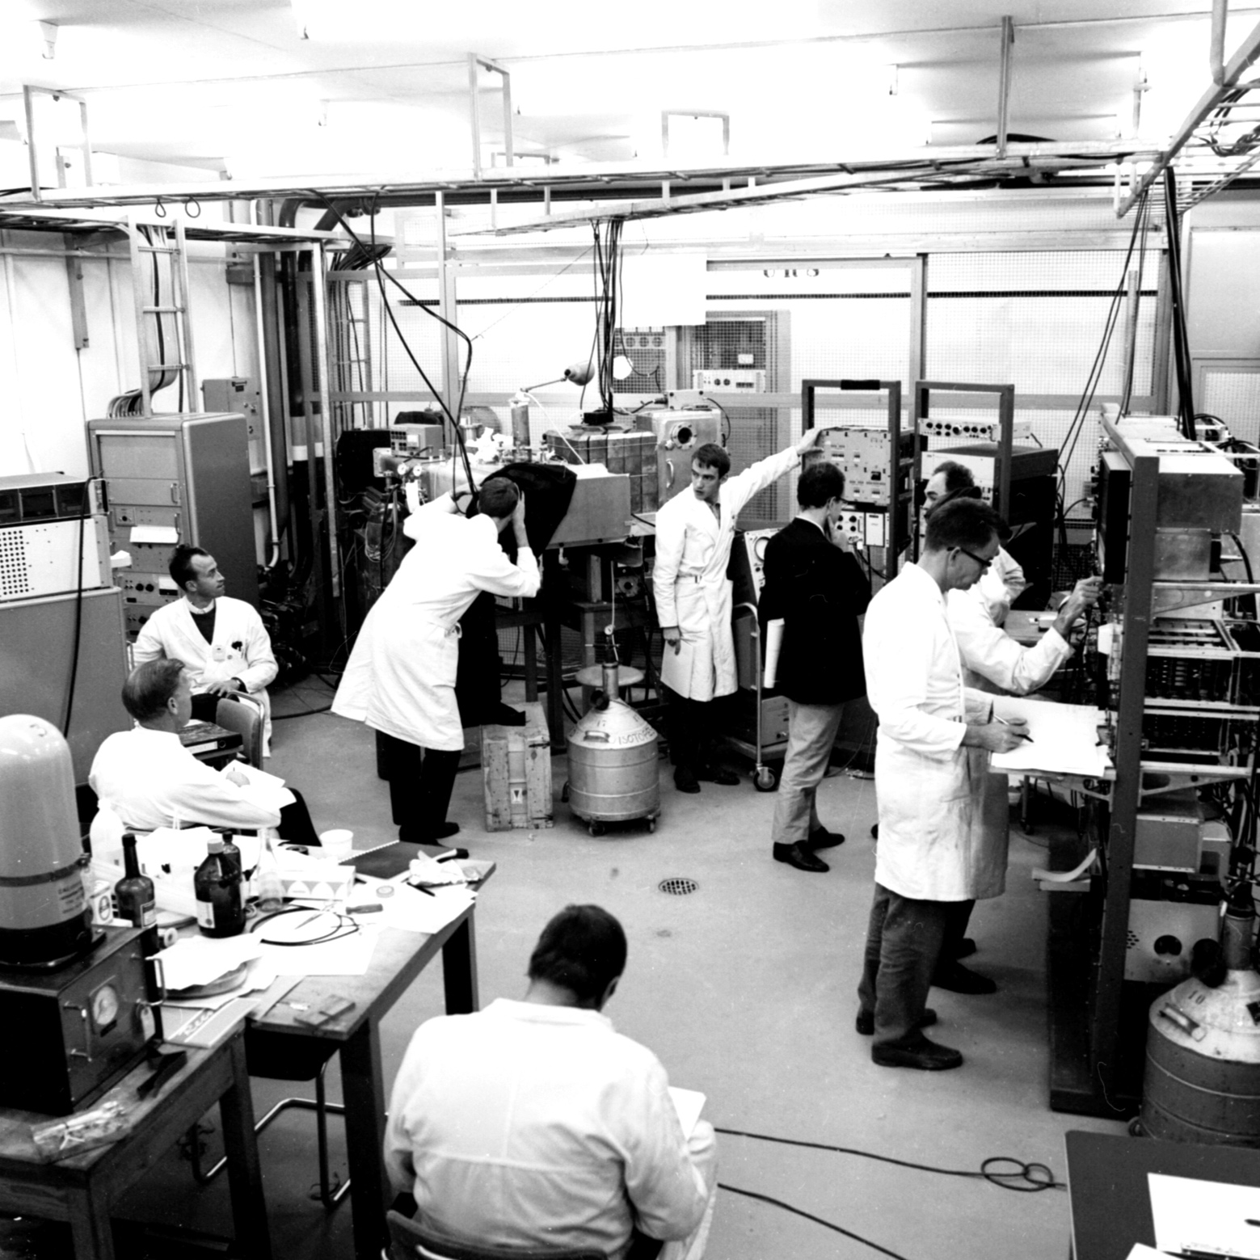
The first
experiment at
ISOLDE
On
October 16
1967

Slide 9
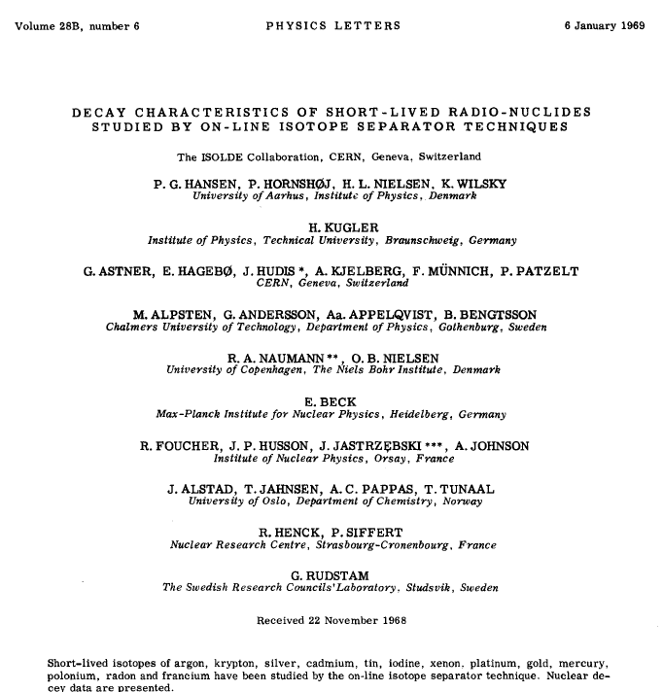
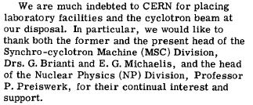
Ar, Kr, Ag
Cd, Sn, I
Xe, Pt, Au
Hg, Po, Rn, Fr

Slide 10

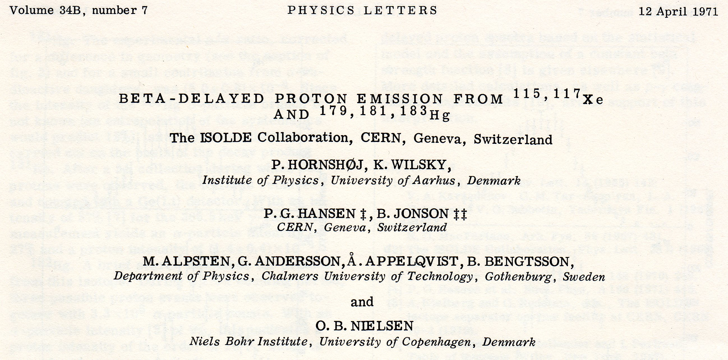
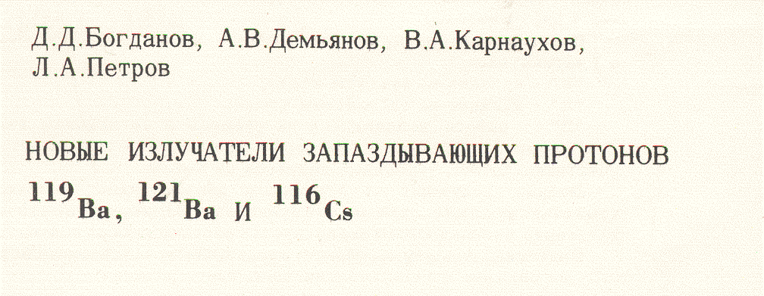
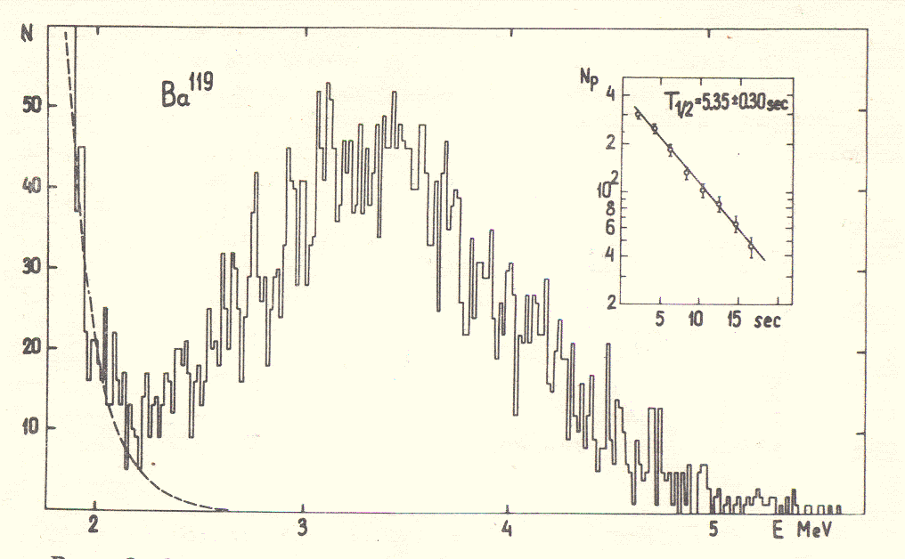
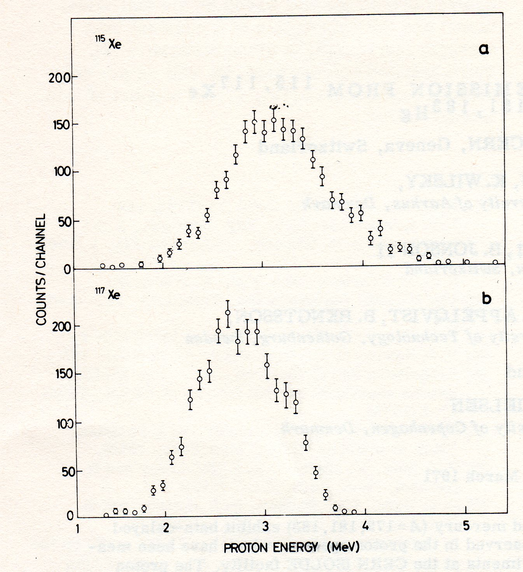
Beta-delayed proton emission

Slide 11
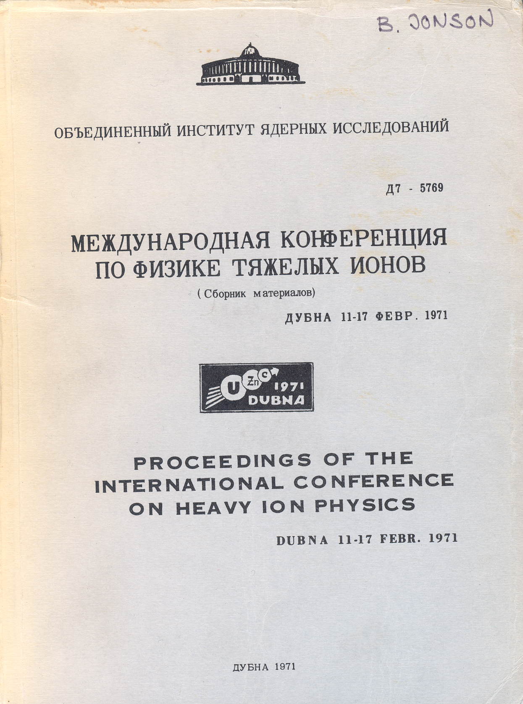
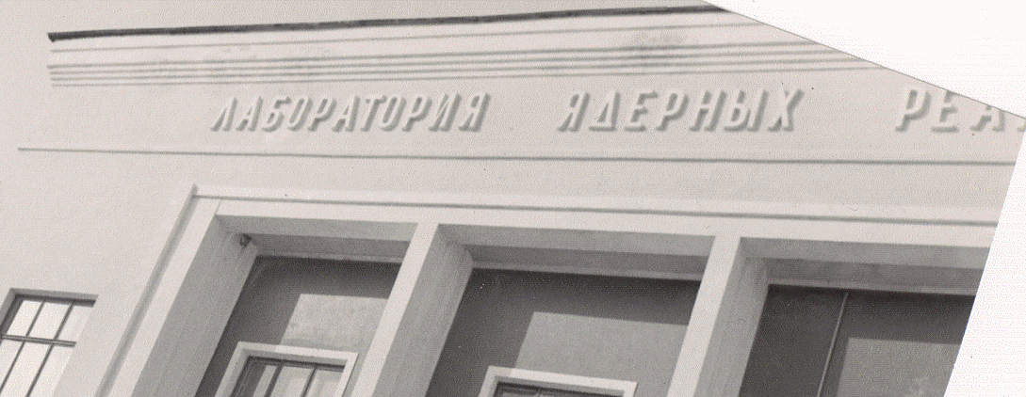
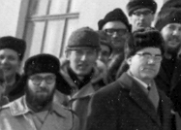
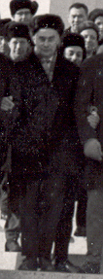

G.N. Flerov
Yu.Ts. Oganessian
B. Jonson

Slide 12
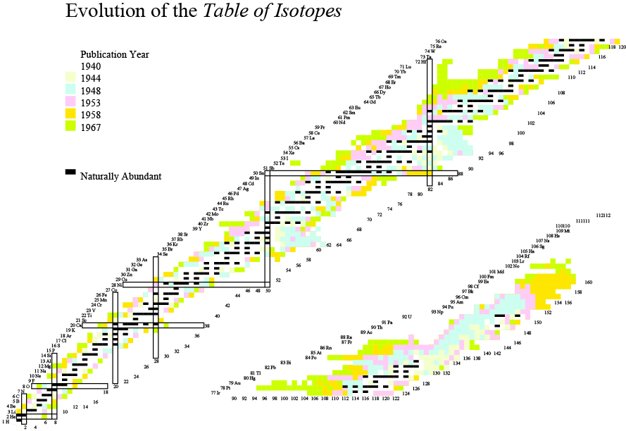
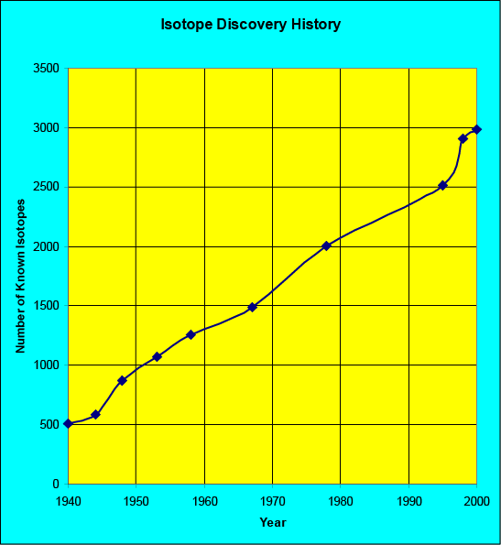
1957

Slide 13
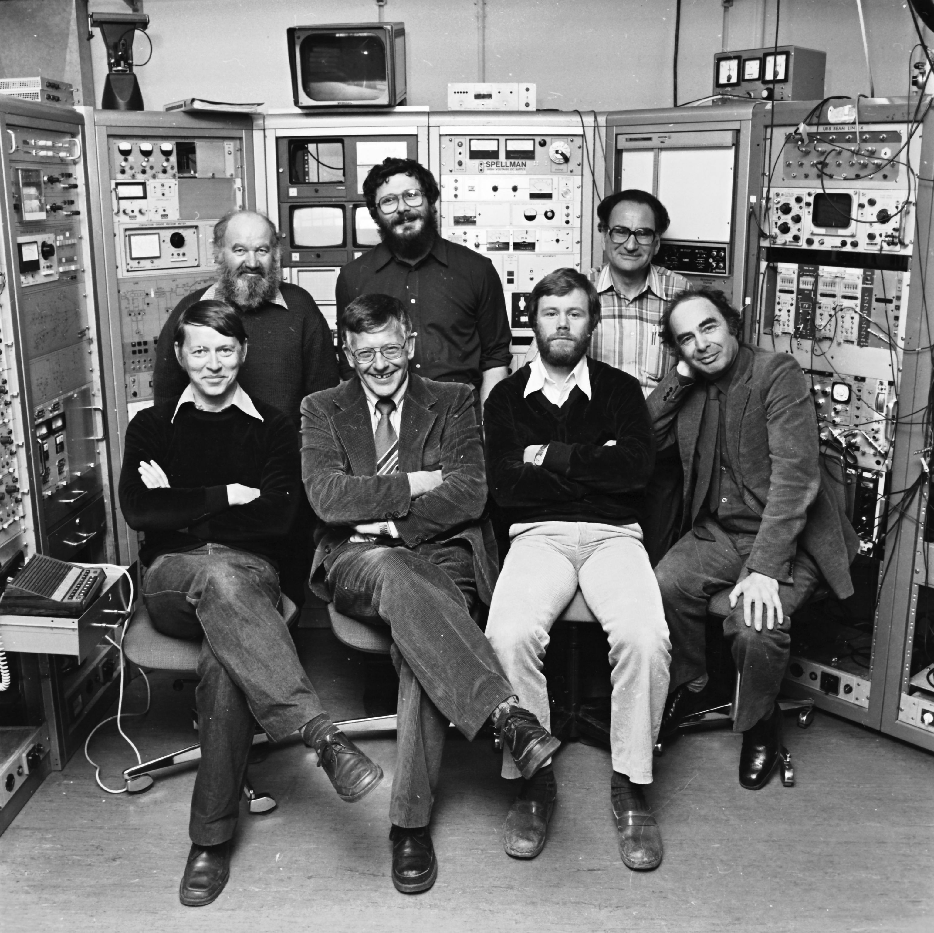
P.G. Hansen
A.M. Poskanser

Slide 14
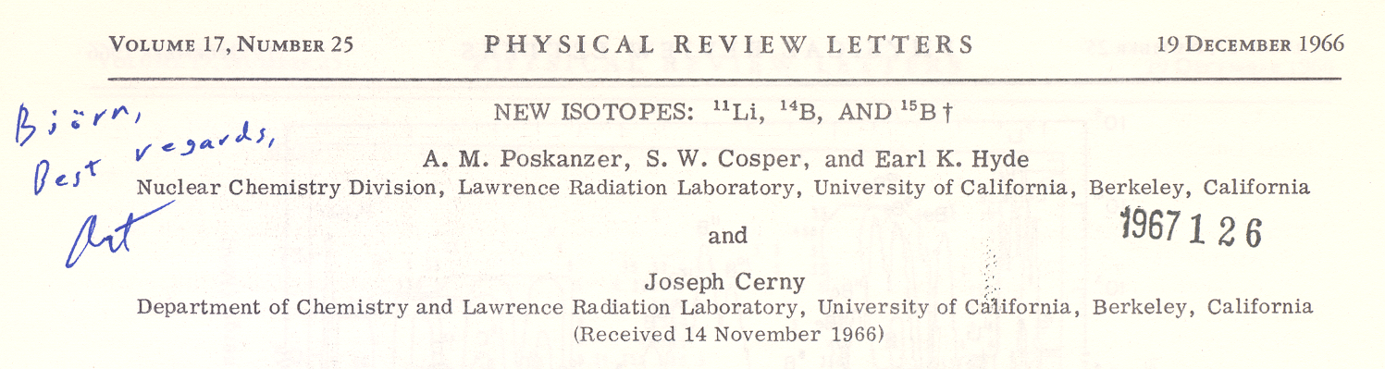
Open delayed-particle channels in the ¹¹Li beta decay
20.6
3/2⁻
1996
¹¹Li
1966
17.916
1983
⁹Li+d
15.721
⁸Li+t
10.59
1980
8.82
1979
8.982
⁸Be+3n
7.315
⁹Be+2n
0.320
1974
½⁻
γ
0.320
0.504
(MeV)
¹⁰Be+n
½⁺
¹¹Be
¹¹Be

Slide 15
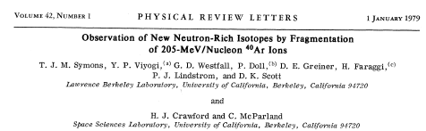
..we questioned the applicability of high energy heavy ion accelerators to this field. Our experience at the Bevalac leads us to believe that this question does indeed have a positive answer. If the physics interest justifies it, then high energy heavy ion beams can certainly be expected to play a role in the study of nuclei at the limits of stability…..
T J M Symons, 4th International Conference on
Nuclei Far From Stability, Helsingor 1981

Slide 16
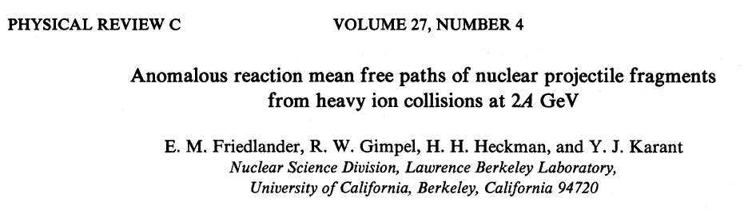
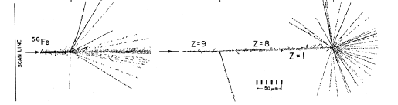
1.8 GeV/u ⁵⁸Fe
Anomalons ?

Slide 17
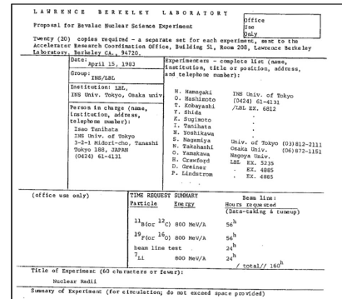
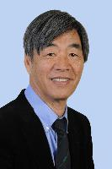
Isao Tanihata
INS Univ. of Tokyo
3-2-1 Midori-cho, Tanashi
Tokyo 188, JAPAN
Nuclear Radii

Slide 18
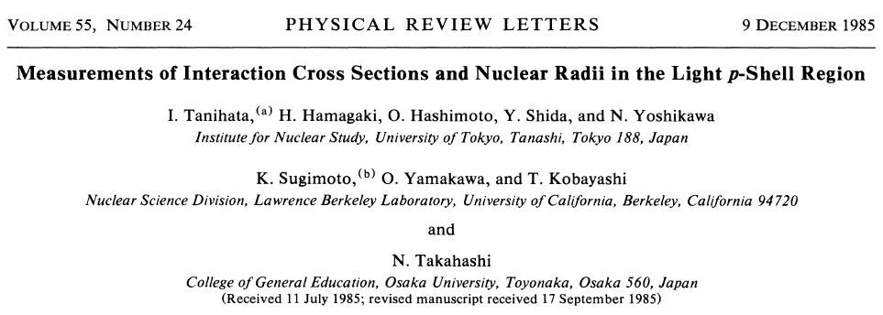
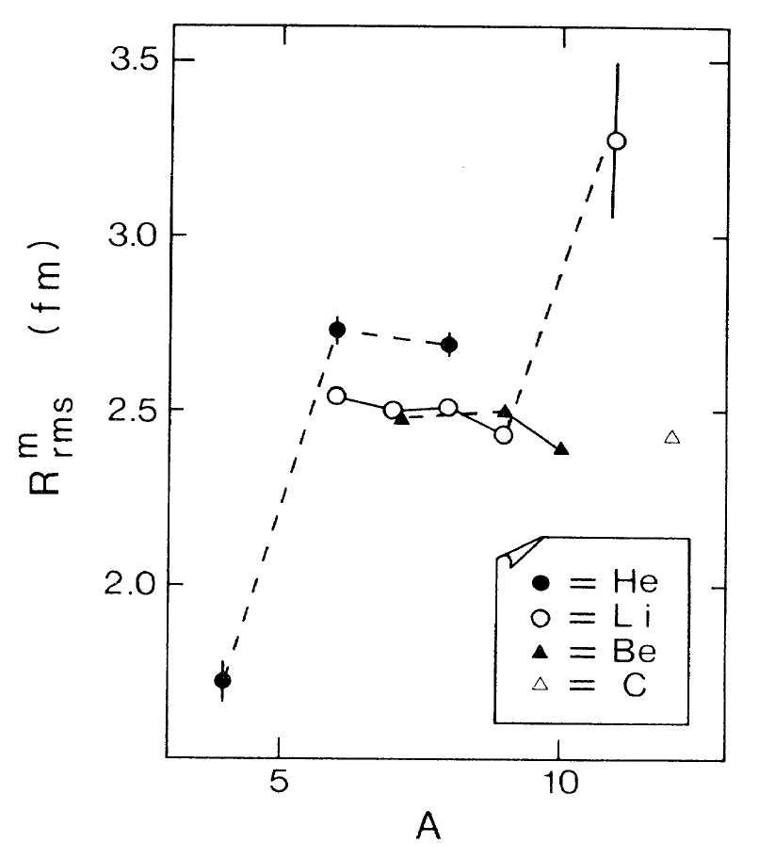

Slide 19
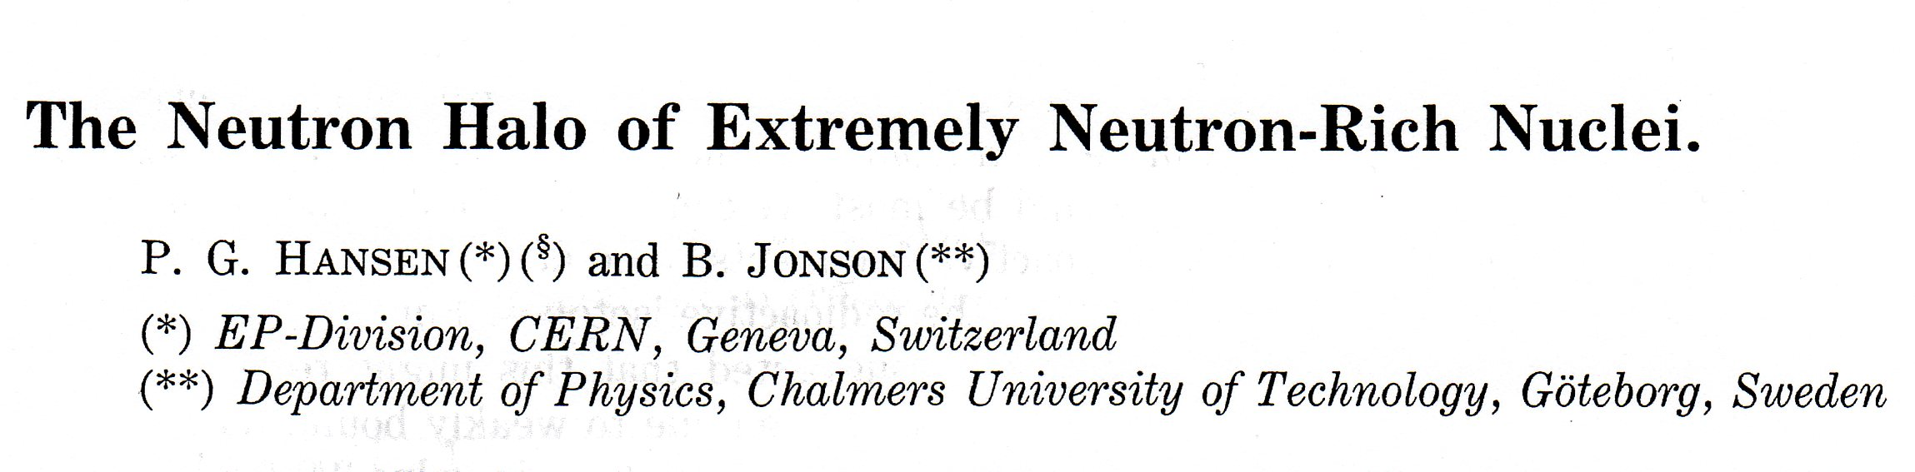
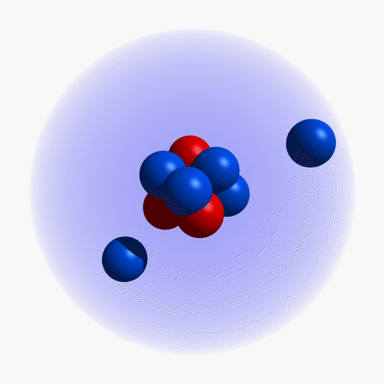
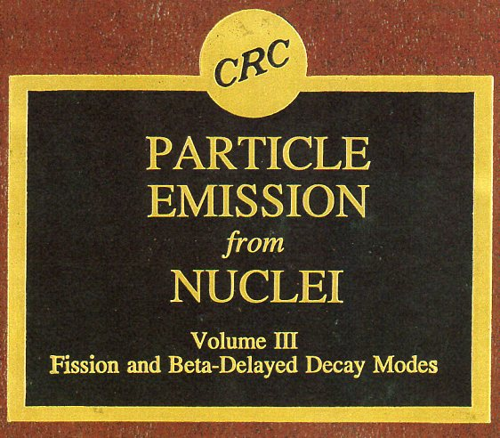
BETA-DELAYED PARTICLE EMISSION FROM LIGHT NEUTRON-RICH NUCLEI
P.G. Hansen and B. Jonson

Slide 20
¹¹Be
13.8 s
¹²Be
23.6 ms
¹³Be
806 ms
¹⁴Be
4.35 ms
⁹Li
179 ms
¹⁰Li
806 ms
¹¹Li
8.5 ms
⁶He
806 ms
⁷He
806 ms
⁸He
119 ms
⁹He
806 ms
V_{nn}
N=8
V_{Cn}
V_{Cn}
Bound
Unbound

Slide 21
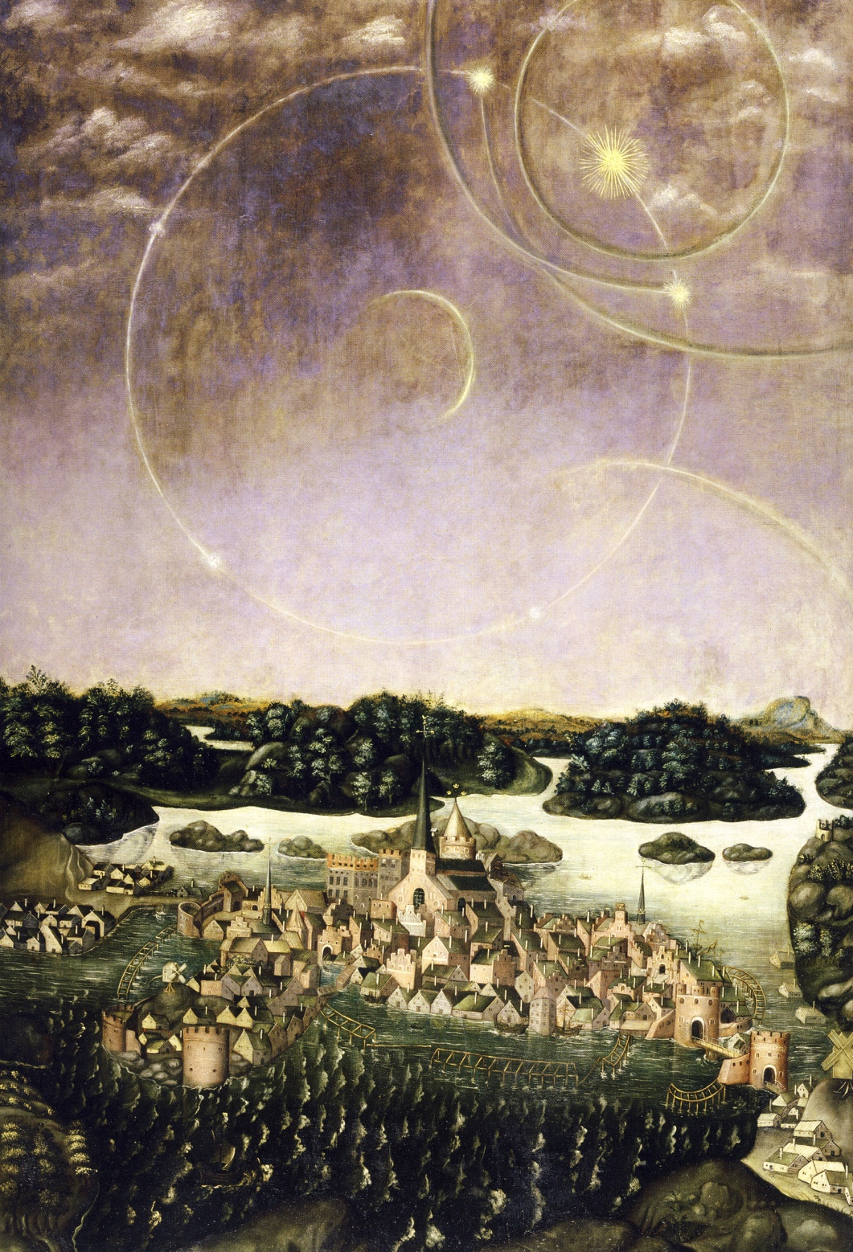

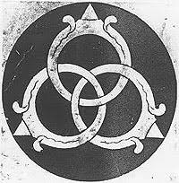
Stockholm,
April 20, 1535
VÄDERSOLS
TAVLAN
The Sun Dog Painting
Borromean nucleus
Urban Målare,
Storkyrkan, Stockholm
Jacob Heinrich Elbfas, 1636
M.V. Zhukov et al.,
Phys. Rep. 231 (1993) 151

Slide 22

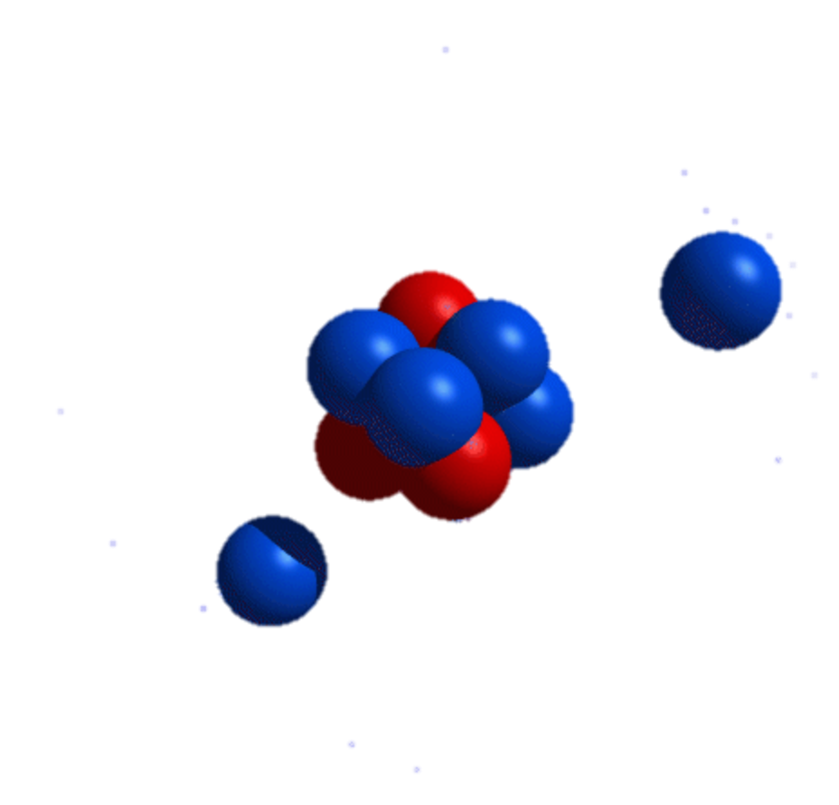
GANIL, GSI, ISOLDE, JINR, MSU, RIKEN

Slide 23
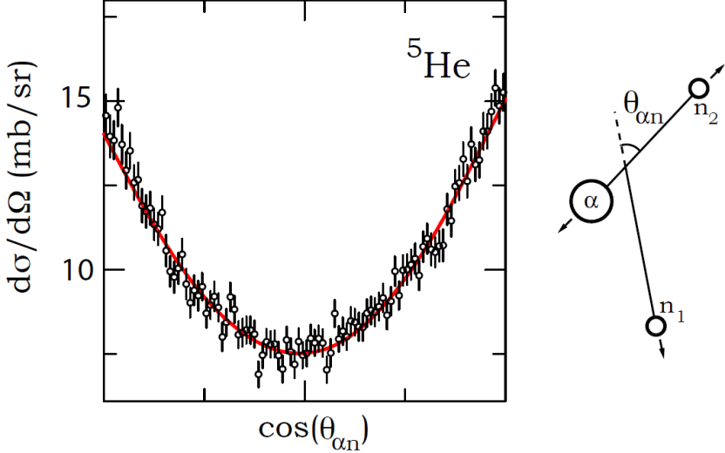
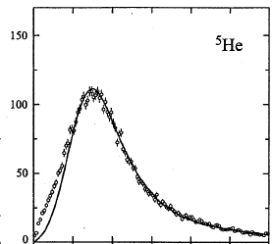


³He
⁴He
⁵He
unbound
⁶He
808 ms
⁷He
unbound
⁸He
119 ms
⁹He
unbound
¹⁰He
unbound
K. Markenroth et al., NPA 679 (2001) 462
L.V. Chulkov et al., PRL 79 (1997) 201
W(θ_{αn}) = 1 + 1.5cos²(θ_{αn})
(p_{1/2})² ~ 7 %
L.V. Chulkov, G. Schrieder, Z. Phys A359 (97) 231

Slide 24
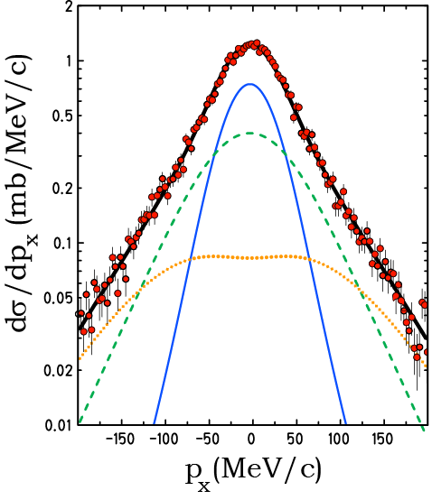
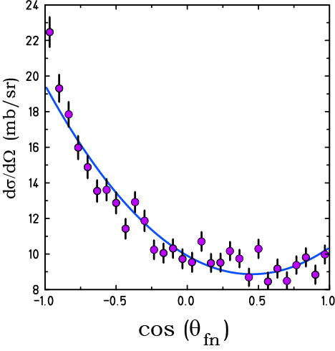
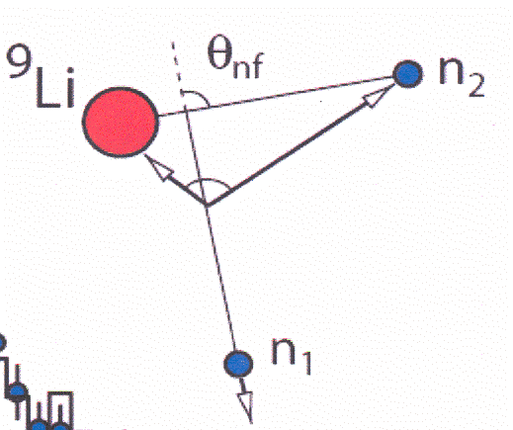
GSI, 287 MeV/u ¹¹Li
s
p
d
p_{n1}=-(p_{n2}+p_{9Li})
W(θ_{nf}) = 1-1.03cos (θ_{nf}) + 1.41cos²(θ_{nf})
Simon, et al., Nucl. Phys. A791 (2007) 267.

Slide 25
¹⁵F
unbound
¹⁶F
unbound
¹⁷F
64.8 s
¹⁸F
109.7 m
¹⁹F
²⁰F
11 s
²¹F
4.16 s
¹²O
unbound
¹³O
8.58 ms
¹⁴O
70.6 s
¹⁵O
2.03 m
¹⁶O
¹⁷O
¹⁸O
¹⁹O
27.1 s
²⁰O
13.5 s
¹¹N
unbound
¹²N
20.4 m
¹³N
20.4 m
¹⁴N
¹⁵N
¹⁶N
7.13 s
¹⁷N
4.17 s
¹⁸N
0.63 s
¹⁹N
329 ms
Z
⁹C
125 ms
¹⁰C
19.3 s
¹¹C
20.4 m
¹²C
¹³C
¹⁴C
5730 y
¹⁵C
2.45 s
¹⁶C
0.747 s
¹⁷C
193 ms
¹⁸C
92 ms
⁸B
770 ms
⁹B
unbound
¹⁰B
¹¹B
¹²B
20.20 ms
¹³B
17.33 ms
¹⁴B
13.8 ms
¹⁵B
10.4 ms
¹⁶B
unbound
¹⁷B
5.1 ms
⁷Be
⁸Be
unbound
⁹Be
¹⁰Be
1.6 10⁶ y
¹¹Be
13.8 s
¹²Be
23.6 ms
¹³Be
unbound
¹⁴Be
4.35 ms
¹⁵Be
unbound
¹⁶Be
unbound
⁶Li
⁷Li
⁸Li
840 ms
⁹Li
179 ms
¹⁰Li
unbound
¹¹Li
8.5 ms
¹²Li
unbound
¹³Li
unbound
³He
⁴He
⁵He
unbound
⁶He
808 ms
⁷He
unbound
⁸He
119 ms
⁹He
unbound
¹⁰He
unbound
¹H
²H
⁵H
unbound
⁷H
unbound
³H
12.323 y
⁷H
n
10.25 m
N

Slide 26
Momentum Profile Function
Yu. Aksyutina et al.,
PLB 718 (2013) 1309

Slide 27
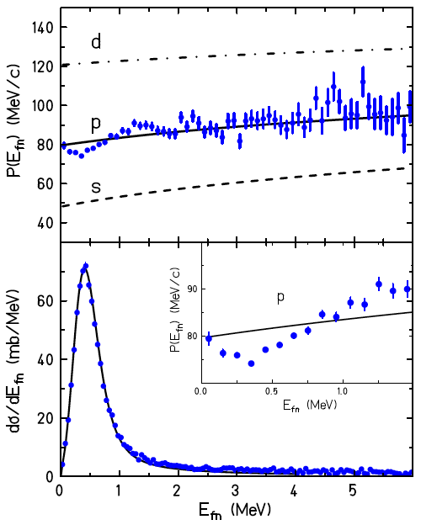
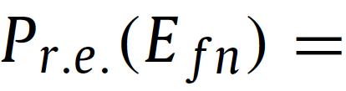
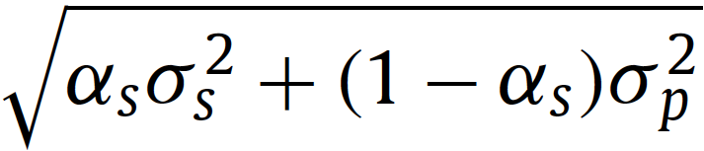




Slide 29


(0d_{5/2})²
11(2) %
Aksyutina et al.
PLB 718 (2013) 1309

Slide 30


RIKEN
69 MeV/u ¹⁴Be, Lq H target
Y. Kondo et al., PLB 690 (2010) 245

Slide 31

Yu. Aksyutina et al.,
Phys. Rev. C 87 (2013) 064316
GSI
304 MeV/u ¹⁴Be, Lq H target

Slide 32

¹⁴B(p,2p)¹³Be
500 MeV/u

Slide 33
¹⁴B
12.5 ms
¹²Be
21.49 ms
¹³Be
unbound

Slide 34
Dripline nuclei as stepping stones towards the unbound
⁷Be
⁸Be
unbound
⁹Be
¹⁰Be
1.6 10⁶ y
¹¹Be
13.8 s
¹²Be
23.6 ms
¹³Be
unbound
¹⁴Be
4.35 ms
⁶Li
⁷Li
⁸Li
840 ms
⁹Li
179 ms
¹⁰Li
unbound
¹¹Li
8.5 ms
¹²Li
unbound
¹³Li
unbound
⁴He
⁵He
unbound
⁶He
808 ms
⁷He
unbound
⁸He
119 ms
⁹He
unbound
¹⁰He
unbound
⁷H
unbound
¹¹Li: Neutron knock-out reaction -> ¹⁰Li
Proton knock-out reactions -> ^{9,10}He
¹⁴Be: Neutron knock-out reaction -> ¹³Be
Proton knock-out reactions -> ^{12,13}Li
⁸He: Neutron knock-out reaction -> ⁷He
Proton knock-out reaction -> (⁷H)

Slide 35




Slide 36
⁶Li
⁷Li
⁸Li
840 ms
⁹Li
179 ms
¹⁰Li
unbound
¹¹Li
8.5 ms
¹²Li
unbound
¹³Li
unbound
Yu. Aksyutina et al. PLB 666(2008) 430
Forssén et al. Nucl. Phys. A 673(2000) 143
Notes:
Correlated background originating in the initial state

Slide 37



Goldanskii, Nucl. Phys. 19 (1960) 482
⁴⁸Ni
June 12, 2000
⁴⁵Fe
J. Giovinazzo et al., PRL 99 (2007) 102501
¹⁹Mg
I. Mukha et al., PRL 99 (2007) 182501
K. Miernik et al., PRL 99 (2007) 192501

Slide 38

Comparison of energy-angular correlations from the 2p decay of ⁴⁵Fe in the Y system, theoretically predicted in 2003*)
and measured in 2007**) .
*) L.V. Grigorenko, M.V. Zhukov,
PRC 68(2003)054005
**) K. Miernik et al.,
PRL 99 (2007) 192501

Slide 39

…..the end
Shutdown of the CERN SC
19 December 1990 12:00

Slide 40




Daniel Simon 1937–2011
26 May, 1992

Slide 41

The ISOLDE PSB Facility
1992

Slide 42
2001

Slide 43



¹²Be(d,p)¹³Be
¹¹Be(t,p)¹³Be

Slide 44



Slide 45


DERICA
Dubna Electron – Radioactive Ion Collider fAcility

Slide 46




Slide 47





Slide 48

THE FUTURE IS OURS TO CREATE
Thank You

