Slide 1

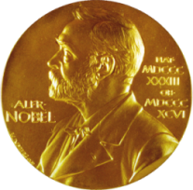
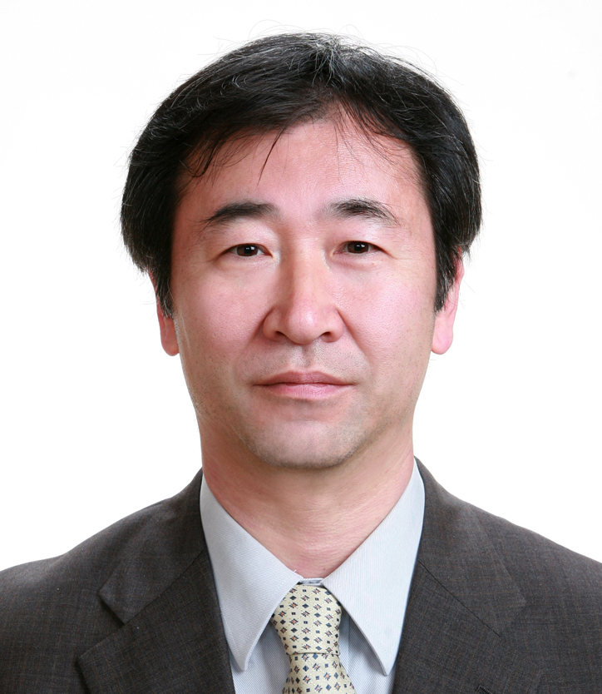
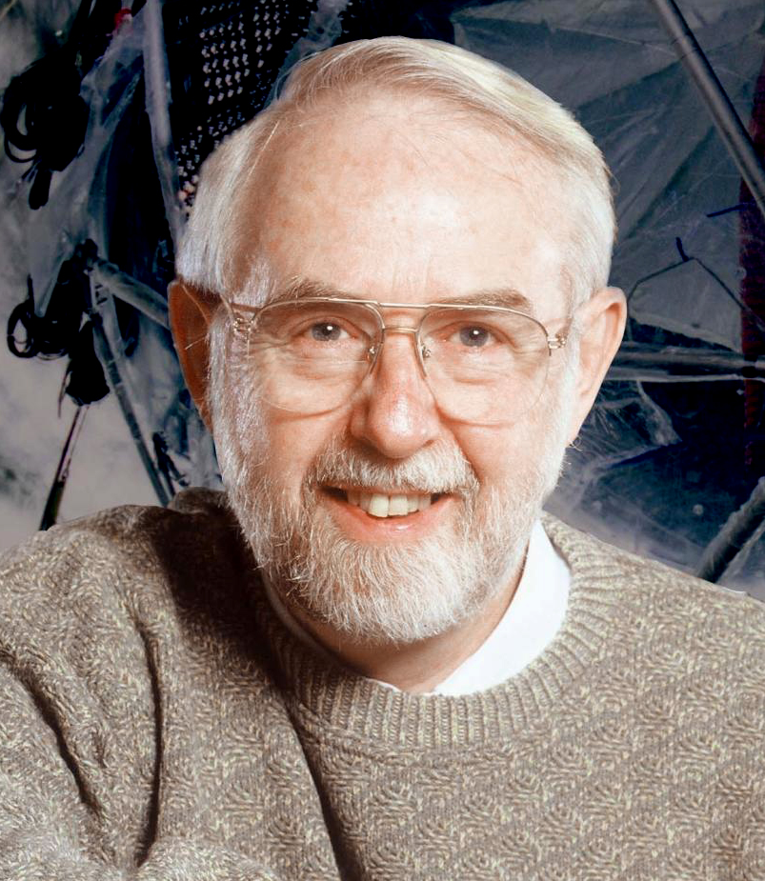
The Nobel Prize in Physics
2015
Takaaki Kajita
Super-Kamiokande
Collaboration
University of Tokyo, Kashiwa, Japan
Born in 1959 (age 56), Higashimatsuyama,
PhD 1986, Univ. of Tokyo, Japan
Arthur B. McDonald
Sudbury Neutrino Observatory
Collaboration
Queen’s University, Kingston, Kanada
Born in 1943 (age 72), Sydney, Kanada
PhD 1969, Caltech, Pasadena, CA, USA
… for the discovery of neutrino oscillations, which shows that neutrinos have mass

Slide 2
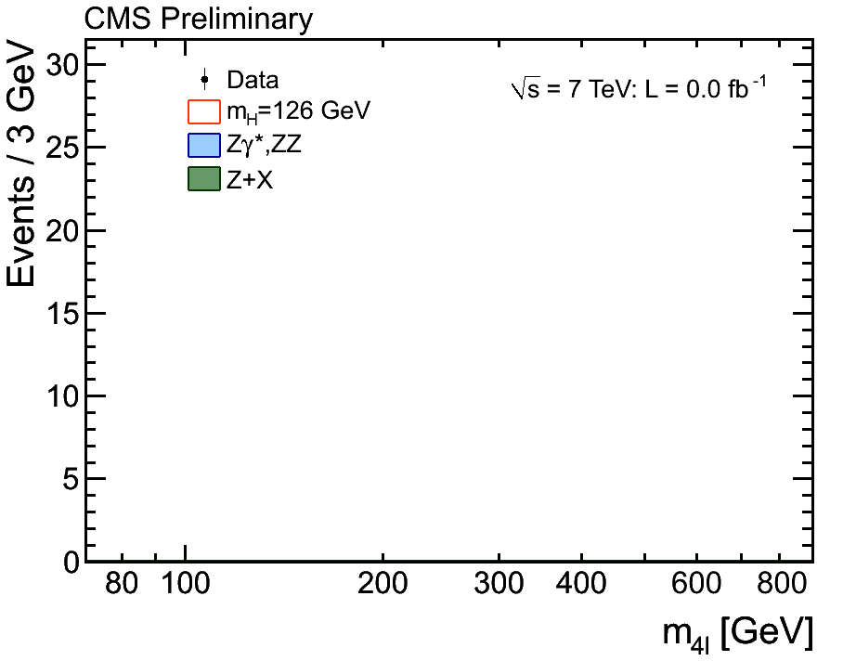
CERN 2012

Slide 3
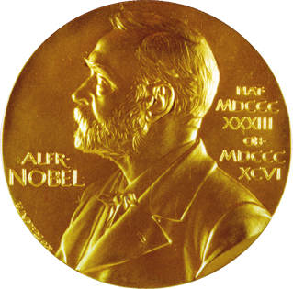
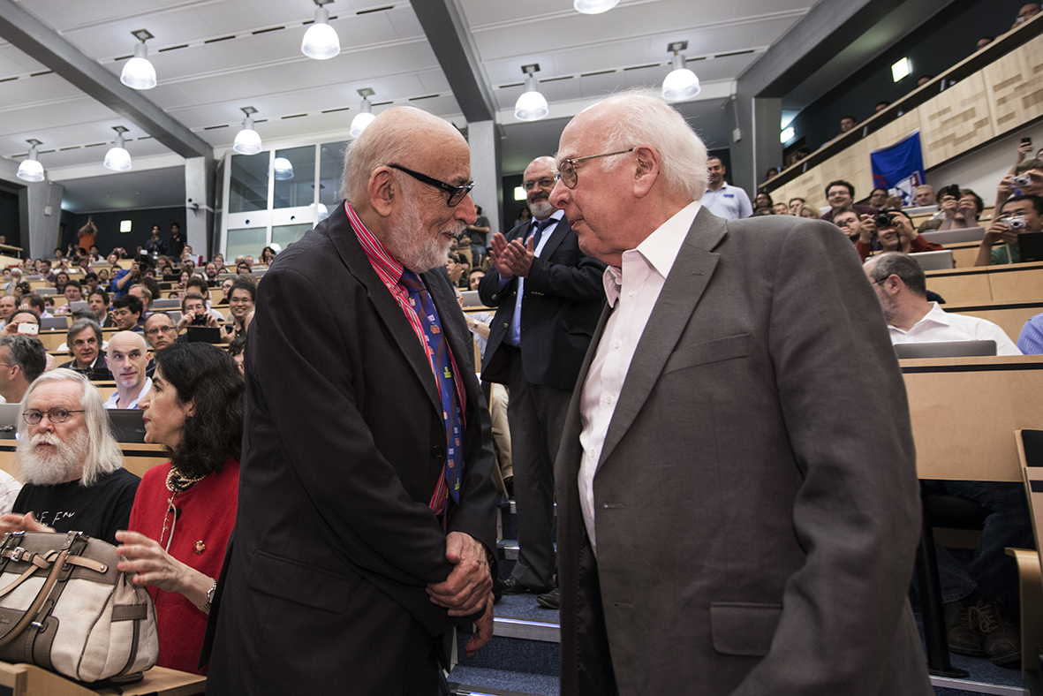
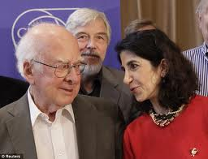
The Nobel Prize in Physics
2013
Rolf-Dieter Heuer
François Englert
Université libre de Bruxelles, Belgium
Peter W. Higgs
University of Edinburgh,
UK
Fabiola Gianotti
“For the theoretical discovery of a mechanism that contributes to our understanding of the origin of mass of subatomic particles, and which recently was confirmed through the discovery of the predicted fundamental particle, by the ATLAS and CMS experiments at CERN’s Large Hadron Collider.”

Slide 4
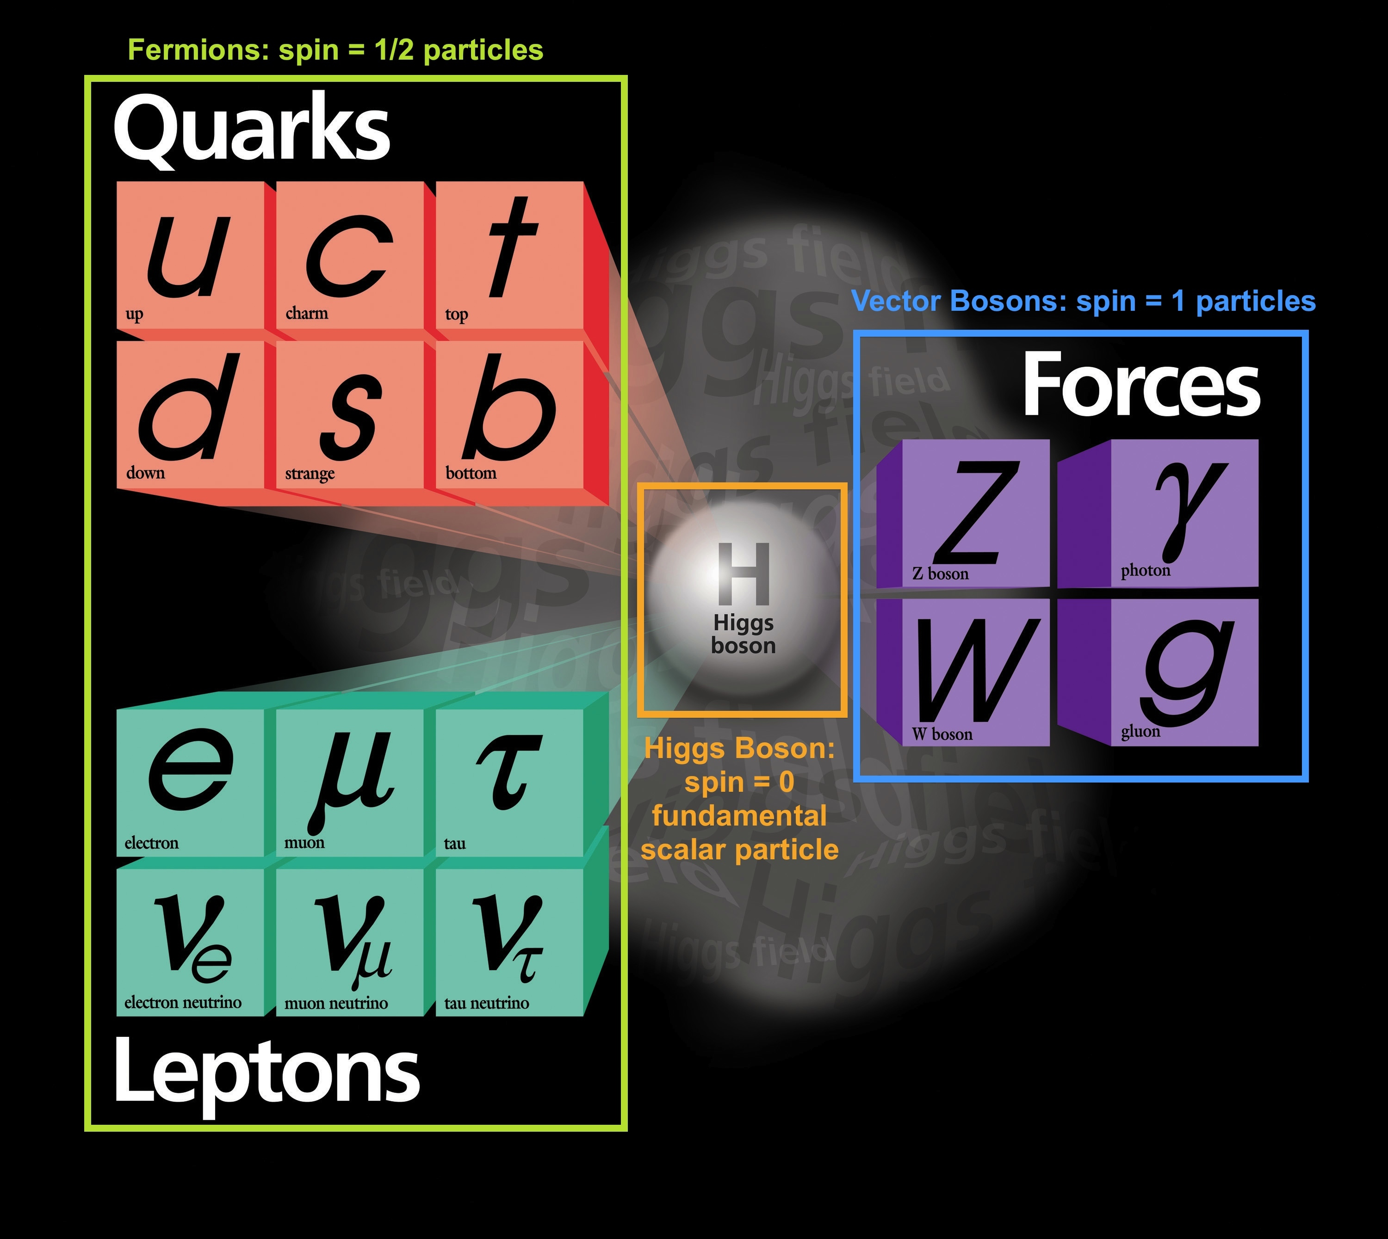
THE STANDARD MODEL
Neutrinos with mass:
beyond…

Slide 5
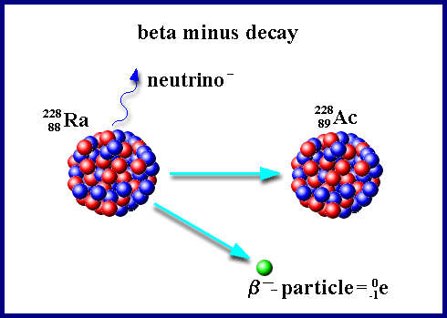
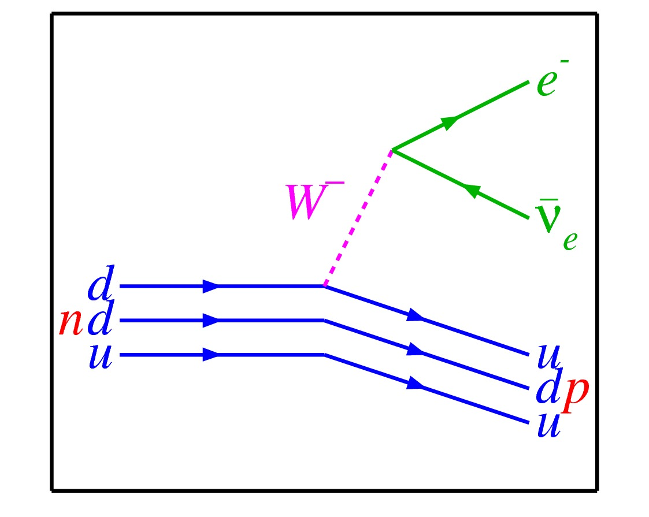
Neutrino Anti-neutrino
The neutrino is an elementary particle
Common in our surroundings (and in the universe)
Known from decays of radioactive isotopes
There are three kinds of neutrinos
ν_{e}, ν_{μ}, ν_{τ}
flavours

Slide 6
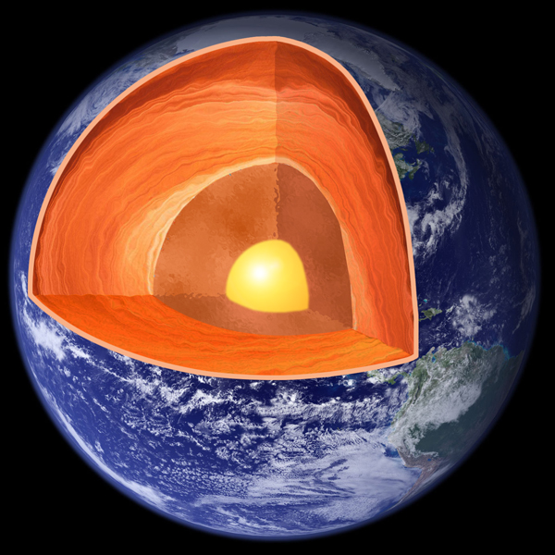
Geo-neutrinos
At the surface of Earth ~ 6×10⁶ cm⁻² s⁻¹
From decays of naturally occuring radioactive isotopes:
²³⁸U, ²³⁵U, ²³²Th, ⁴⁰K

Slide 7
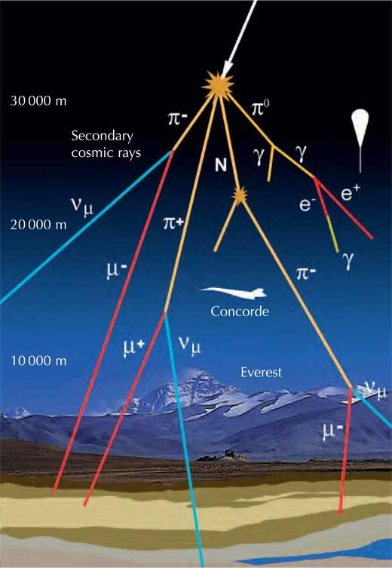
Atmospheric neutrinos
Neutrinos from nuclear reactors, humans, animals…
⁴⁰K in muscles
~ 5000 ν/s

Slide 8
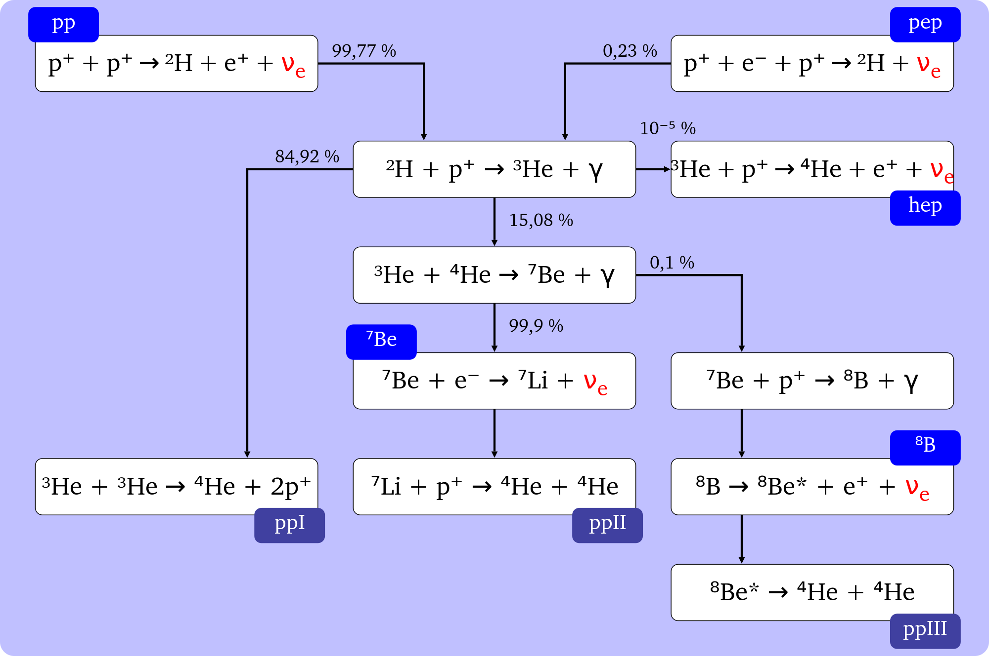
Solar Neutrinos

Slide 9
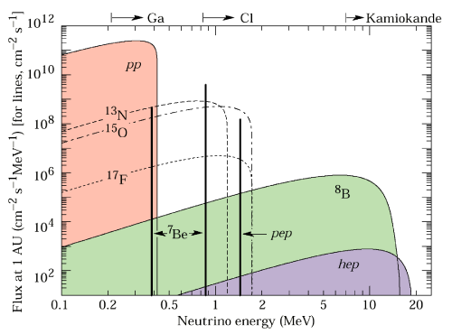
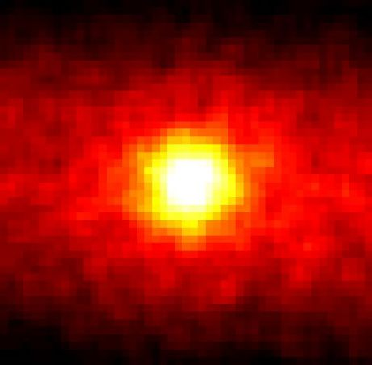
Solar Neutrinos
Rate: 6.5x10¹⁰ cm⁻²s⁻¹

Slide 10
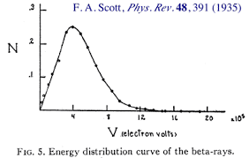
Chadwick, J.;
Intensitätsverteilung im magnetischen Spektrum der β-Strahlen von Radium B + C / The Intensity Distribution in Magnetic Spectrum of β-Rays of Radium B + C
Verhandl. Dtsch. phys. Ges. 16 (1914) 383;
²¹⁴Pb and ²¹⁴Bi
F.A. Scott, Phys. Rev. 48, 39 (1935)

Slide 11
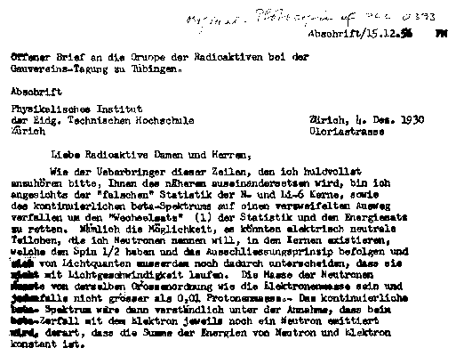
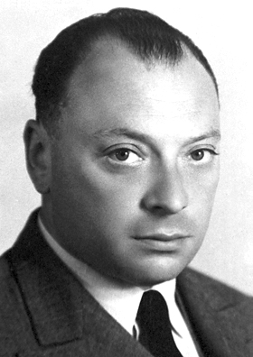
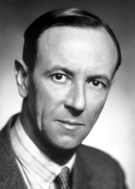
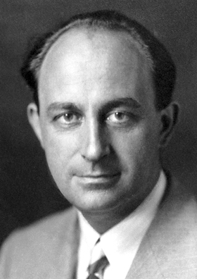
1930
W. Pauli
Neutron
1932
J. Chadwick
Discovers the neutron
1933
E. Fermi
Neutrino

Slide 12
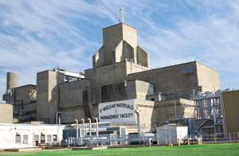
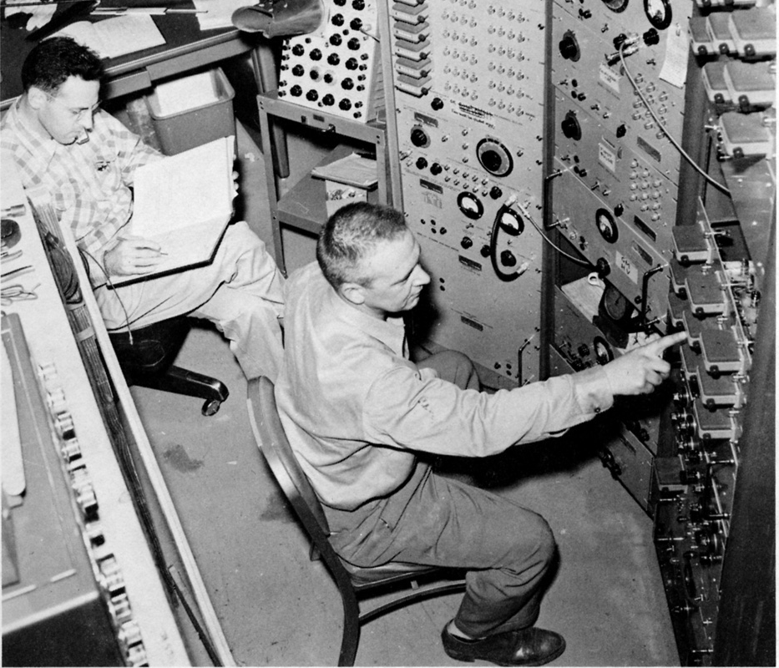
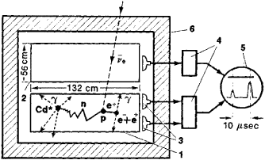
Savannah River Reactor,
South Carolina
F. Reines & C.L. Cowan
CdCl₂
e⁺ + e⁻ 2x511 keV γ
n + Cd ~ 8 MeV γ
1995
F. Reines said, "...the most tiny quantity of reality ever imagined by a human being".

Slide 13
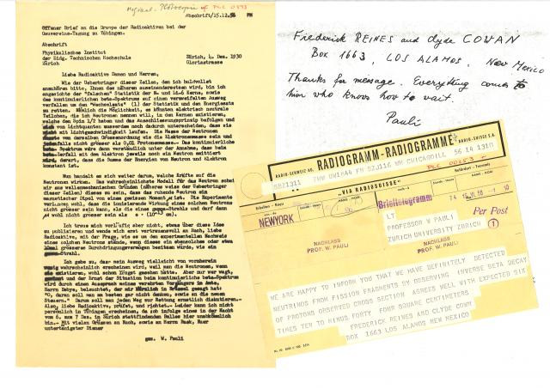

Slide 14
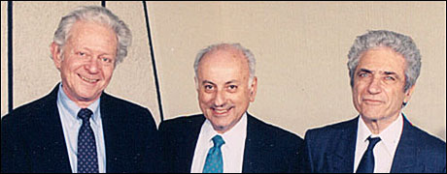
…for the neutrino beam method and the demonstration of the doublet structure of the leptons through the discovery of the
muon neutrino
L.M. Lederman, M. Schwartz, J. Steinberger
1988
X

Slide 15
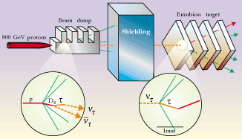
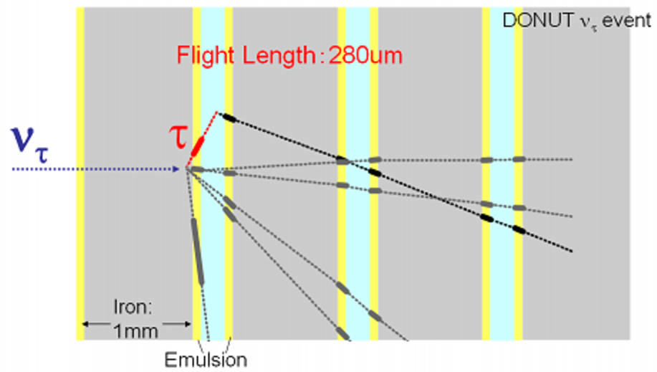
DONUT (Direct Observation of Nu Tau)
K.Kodama et al. Phys. Lett. B504, 218 (2001)

Slide 16
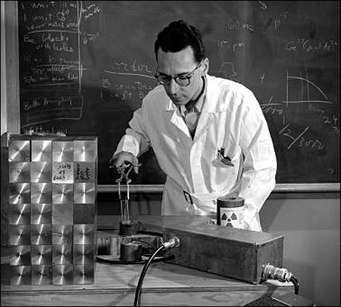
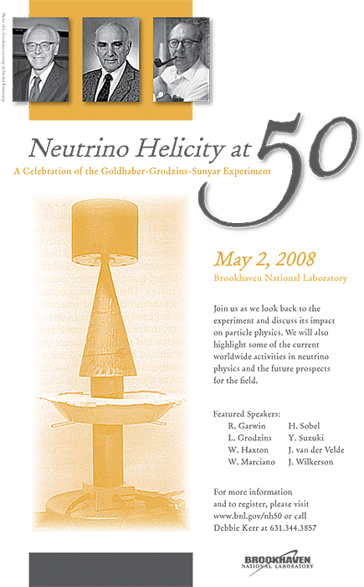
HELICITY
1958
^{152m}Eu
M. Goldhaber, L. Grodzins, A.W. Sunyar,
Phys. Rev. 109, 1015 (1958)
ν helicity = -1
lepton number

Slide 17
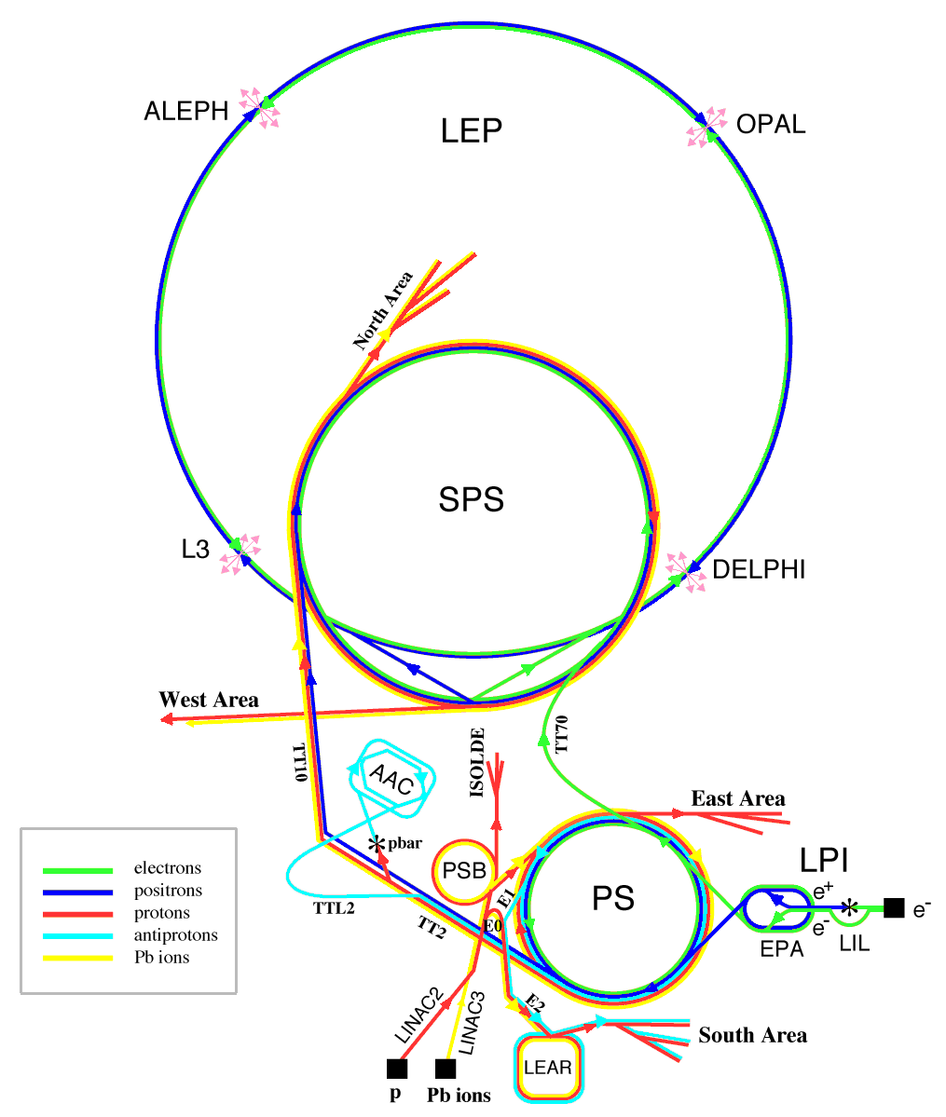
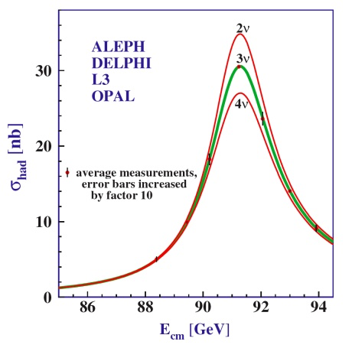
Number of Neutrino Types
Invisible Z⁰ width
N_{ν} = 2.9840 ± 0.0082

Slide 18
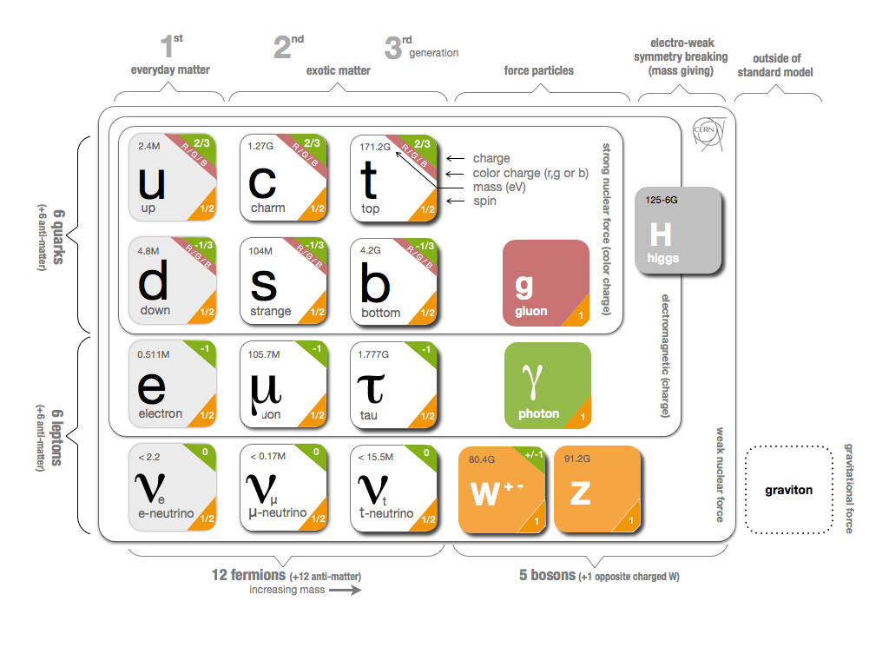
neutrinos and the standard model
The weak force distinguishes LEFT from RIGHT
Only left-handed ν (right-handed ) have been observed
Neutrinos
- left-handed
- massless
partners of e, μ and τ
3 lepton doublets
weak interactions links to
flavour

Slide 19
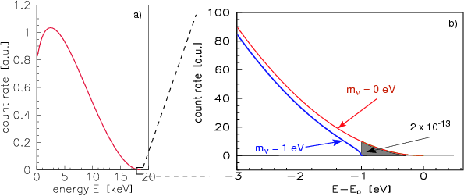
Neutrino mass from tritium beta decay
m_{νe} < 2 eV << m_{e}
m_{νμ} << m_{μ}
m_{ντ} << m_{τ}

Slide 20
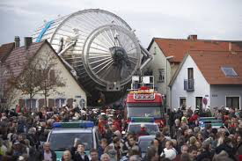
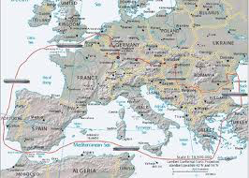
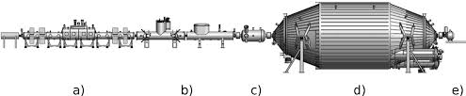

Deggendorf to Karlsruhe
m_{ν} : 0.1 – 2 eV

Slide 21
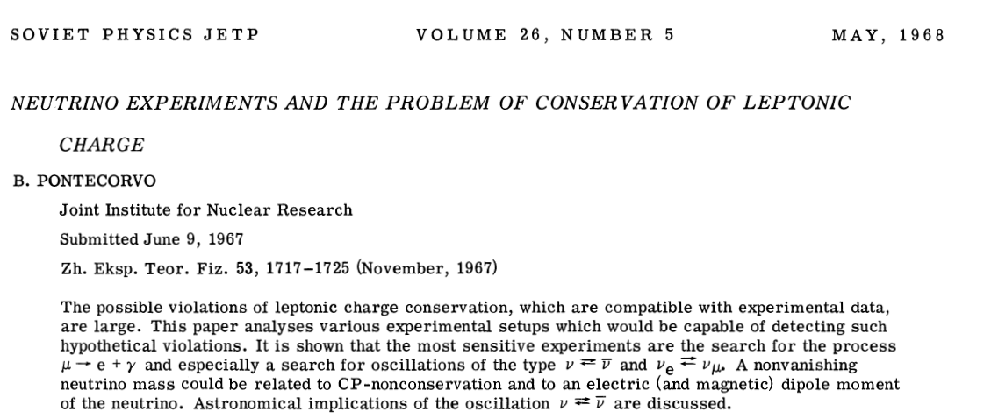
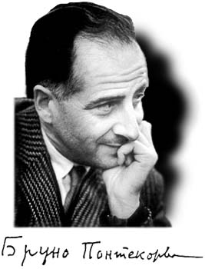
Gribov, Pontecorvo, PLB 28, 493 (1969)

Slide 22
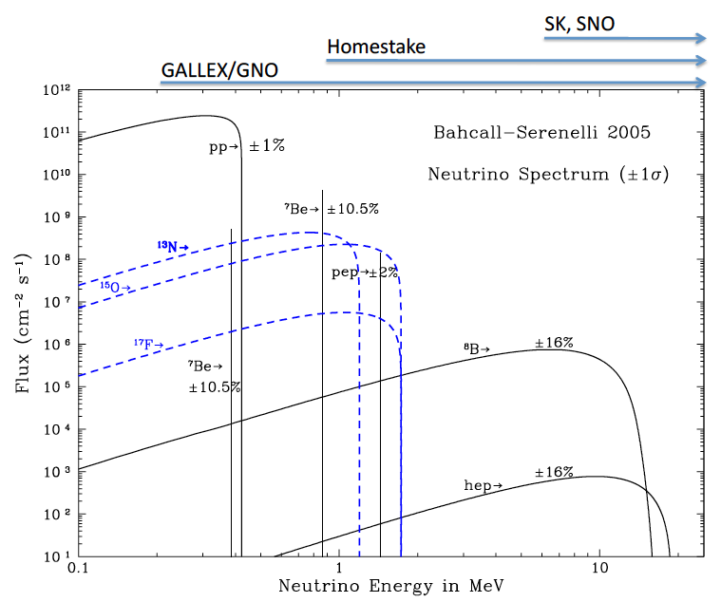
Solar Neutrino Detection
Threshold energy 0.814 MeV

Slide 23
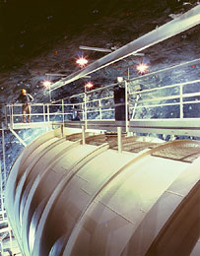
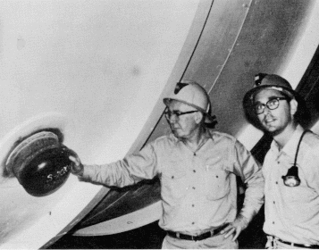
R. Davis Jr
Homsstake Gold Mine
Lead, South Dakota
2002
Cl₂C=CCl₂
1 atom/2 days
³⁷Ar T_{1/2}=35 d
25 years
2.56±0.16(stat) ±0.16(sys) SNU
8.5±0.9 SNU

Slide 24
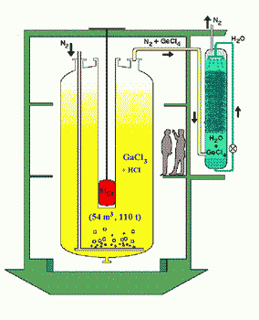
GALLEX
SAGE
Threshold energy 0.233 MeV
~50 % of SSM prediction

Slide 25

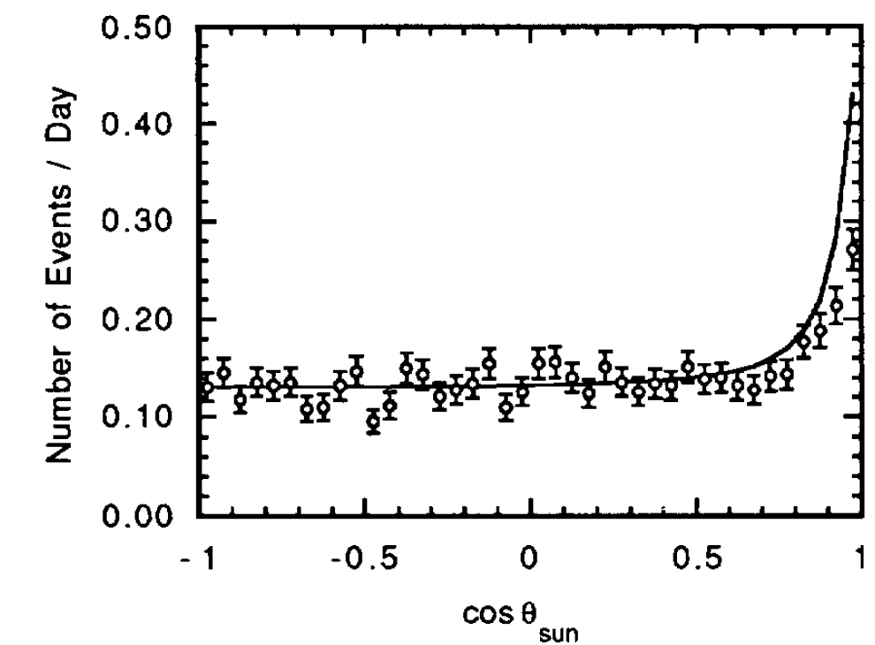
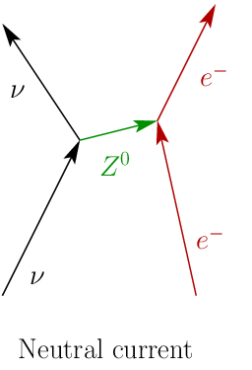
KAMIOKA NUCLEON DECAY EXPERIMENT
Mozumi Mine near Kamioka
CHERENKOV LIGHT
gives
DIRECTION & ENERGY

Slide 26
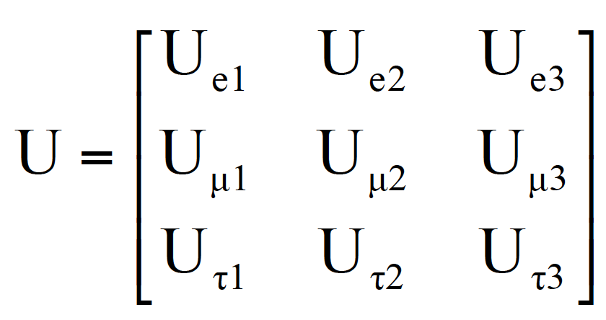
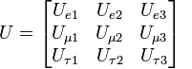
neutrino oscillations
flavour eigenstates ν_{e} , ν_{μ} , ν_{τ} ≠ masseigenstates ν₁ , ν₂ , ν₃
unitary mixing matrix
i = 1,2,3
α = e, μ, τ
The mass eigenstates propagate with different speeds
The probability

Slide 27
Two-neutrino oscillation hypothesis
t ≈ L/c

Slide 28
Atmospheric neutrinos in Kamiokande
R = (N_{μ} /N_{e} )_{obs} /(N_{μ} /N_{e} )_{theor}
R ≈ 0.6 KAMIOKANDE

Slide 29
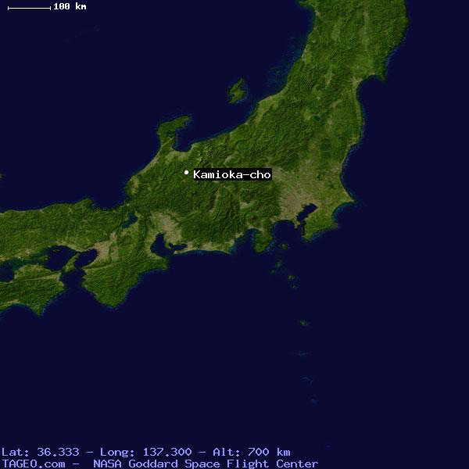
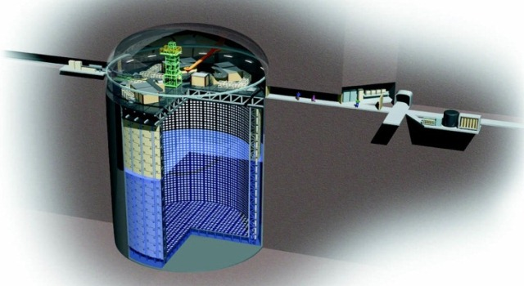
Super-Kamiokande
1000 m underground
50 kt ultra-pure H₂O
11 000 PMTs
ν_{μ} and ν_{e} distinguished
ν_{τ} in general not identified

Slide 30
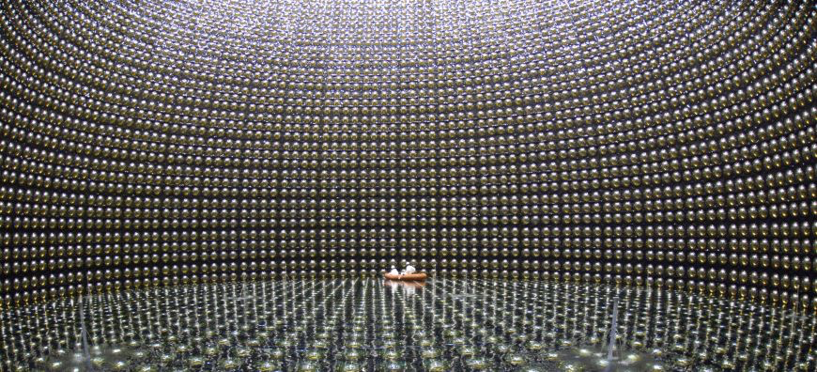
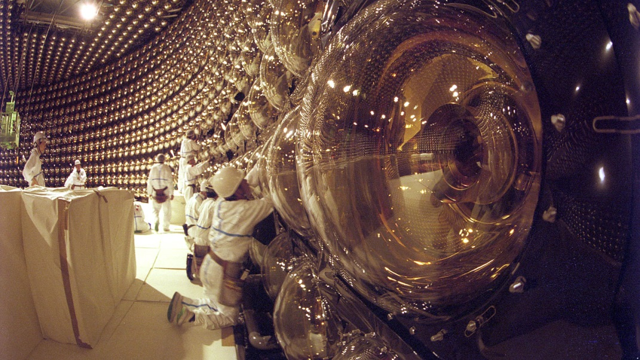


Slide 31


neutrinos in Super-Kamiokande
ν_{μ} and ν_{e} are produced in the
atmosphere by cosmic rays
travel towards SK,
isotropically from all directions
neutrinos can traverse the
Earth without interacting

Slide 32

neutrino oscillations?
μ
μ
π
ν_{μ}
ν_{μ}
short distance
☞
weak
interaction
μ
τ
looong distance
π
☞
ν_{μ}
ν_{τ}
weak
interaction
The ν_{μ} intensity oscillates with distance (time)

Slide 33

1063 MeV ν_{μ} strikes free proton at rest and produces 1032 MeV μ

Slide 34


12000 km
500 km
12 km

Slide 35

12000 km
20 km

Slide 36


ν_{μ}
P(ν_{μ}
ν_{τ} )
L/E=500 km/GeV
Δm₂₃ = 2.44.10⁻³ eV²
Θ₂₃=41^{ο}

Slide 37


November 12, 2001

Slide 38


Neutrino observatory pioneer - in 1984 Herb Chen of UC Irvine first pointed out the advantages of using heavy water as a detector for solar neutrinos. He died in 1987, long before the Sudbury Neutrino Observatory became operational.
G.T. Ewan
Herb Chen 1984 Phys. Rev. Lett. 55 1534.

Slide 39


Slide 40


Sudbury Neutrino Observatory
2090 m underground
1000 t ultra-pure D₂O
9500 PMTs
can pick out ν_{e}
counts all flavours

Slide 41

With D₂O SNO measures
Φ_{tot} = Φ(ν_{e}) + Φ(ν_{μ}) + Φ(ν_{τ})
Φ(ν_{e})
ν_{e}, ν_{μ}, ν_{τ} but more likely
for ν_{e}
x=e,μ,τ
only ν_{e}
x=e,μ,τ

Slide 42

solar neutrino oscillations
The Sun produces only electron-neutrinos
~65×10⁹ ν cm⁻²s⁻¹ at Earth ~ 10 per day observed
false v events – cosmic radiation ~ 3 per hour
the sum consistent with the solar model
first results 2001/2002: evidence for oscillation to ν_{μ} / ν_{τ} neutrinos

Slide 43

ν_{e} changes flavour
- direct observation (7σ)

Slide 44


KamLAND
Anti-neutrinos from 53 reactors
Gando etal. Phys. Rev. D83, 052002 (2011)

Slide 45


matter effects (MSW)
(Mikheyev-Smirnov-Wolfenstein)
ν_{e} has an extra interaction with electrons: additional term
SAGE
GNO
Effective angle
energy dependence
Homestake
7Be
pep
SK,SNO
pp

Slide 46
Detailed analysis of all
solar + reactor data

Slide 47




Neutrino Physics
The Pontecorvo–Maki–Nakagawa–Sakata matrix
Atmospheric
Accelerator
Sun
Reactor
Reactor
ββ decay

Slide 48
Pontecorvo–Maki–Nakagawa–Sakata matrix
Atmospheric
Accelerator
Reactor
Solar
Reactor
Double Beta Decay
SNO++
¹⁵⁰Nd

Slide 49


DAYA BAY EXPERIMENT

Slide 50




Slide 51



Θ₁₃ = 8.8º
Notes:
Also RENO in Soth Korea and Double Chooz in France
+DAEδLUS

Slide 52
Pontecorvo–Maki–Nakagawa–Sakata matrix
Atmospheric
Accelerator
Reactor
Solar
Reactor
Double Beta Decay
SNO+
¹³⁰Te
α₁ och α₂ ≠ 0 endast om ν är Majorana-partiklar

Slide 53




Linear alkylbenzene
A 3% loading, correspond to 8 tons of ¹³⁰Te isotope in the detector

Slide 54

Oscillations imply:
1. at least one neutrino type has mass > 0 (Δm² ≠ 0)
2. neutrino flavours mix
The degree of mixing is determined by the parameter θ ≠ 0
profound consequences for
– particle physics
– astrophysics
– cosmology

Slide 55

neutrinos in the universe
Second most common particle in the universe
~ 330 ν/cm³ jf. ~ 410 γ/cm³ (jf. ~ 250×10⁻⁹ p/cm³)
Relic neutrino background
from the early universe ~1.9K
Neutrinos important
for galaxy formation and
the large scale structure of the Universe

Slide 56

Universe Mass Composition
Cosmological data
+ cosmological models

Slide 57
neutrinos in the universe
Possibly the key to understanding why there is more matter than anti-matter in the universe?
If heavy neutrinos exist and CP violation
in the neutrino sector
”lepto-genesis”
lepton asymmetry ⇒ baryon asymmetry
Neutrinos are fundamentally important for
energy transport in stars

Slide 58

OPEN QUESTIONS
Normal or inverted mass scale?
Absolute mass scale?
Why is m_{ν} so small?
Neutrino = anti-neutrino?
Do sterile neutrinos exist?
Do neutrinos violate CP?
Why are the neutrino mixing angles
so different from those of the quarks?

Slide 59

neutrino revolution
The discovery of neutrino oscillations opened the door
to a new exciting and challenging field of research
This resolved 30 year’s of speculation
The fact that neutrinos have non-zero mass has implications
for our understanding of the Universe
Thank you!

Slide 60

The Review of Particle Physics (2015)
K.A. Olive et al. (Particle Data Group),
Chin. Phys. C, 38, 090001 (2014) and 2015 update.

