Slide 1
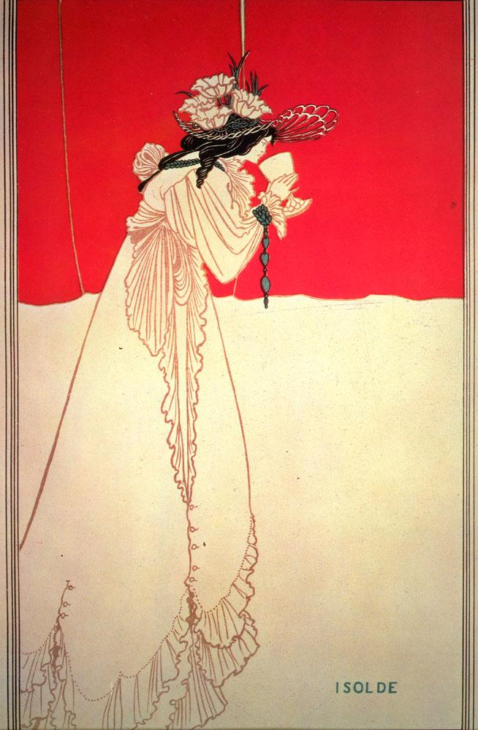

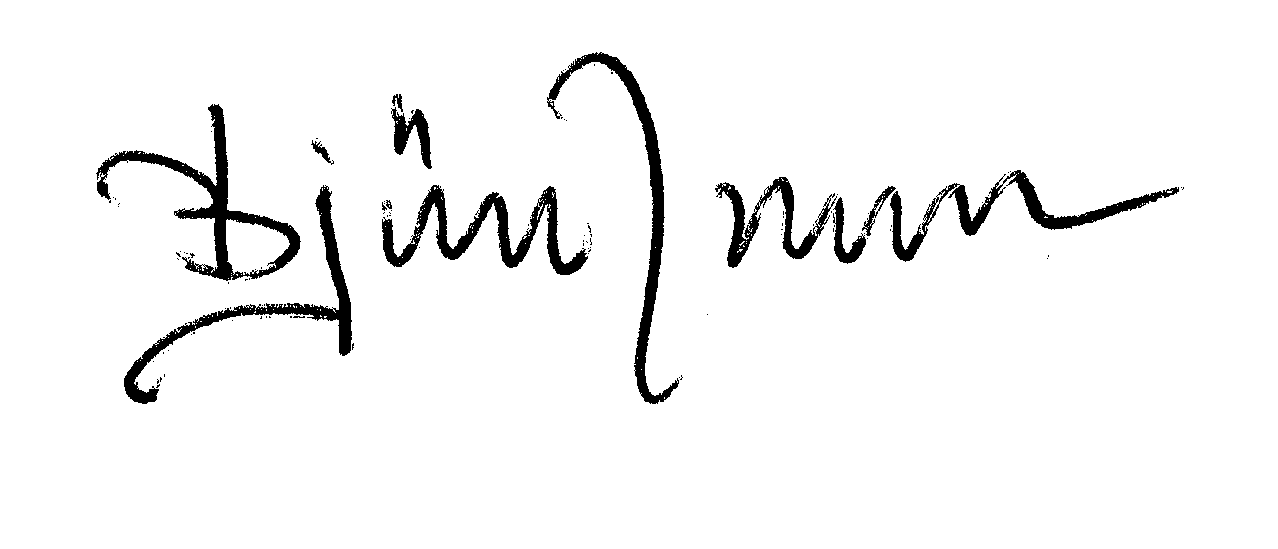
From ISOLDE to
ISOLDE 2
ISOLDE Workshop
"50th Anniversary Edition"
15-17 Dec. 2014
Aubrey Beardsley

Slide 2
From ISOLDE to
ISOLDE 2
ISOLDE Workshop
"50th Anniversary Edition"
15-17 Dec. 2014
Aubrey Beardsley

Slide 3
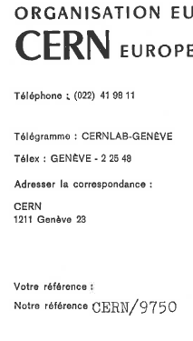
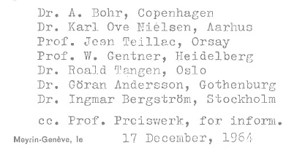
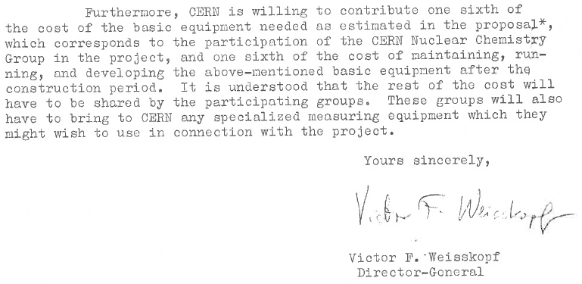
…………

Slide 4
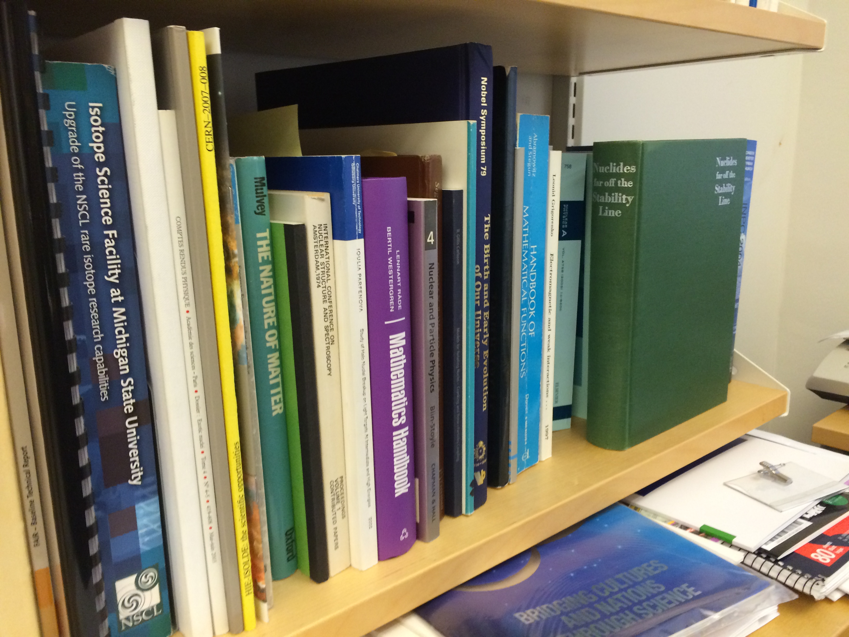
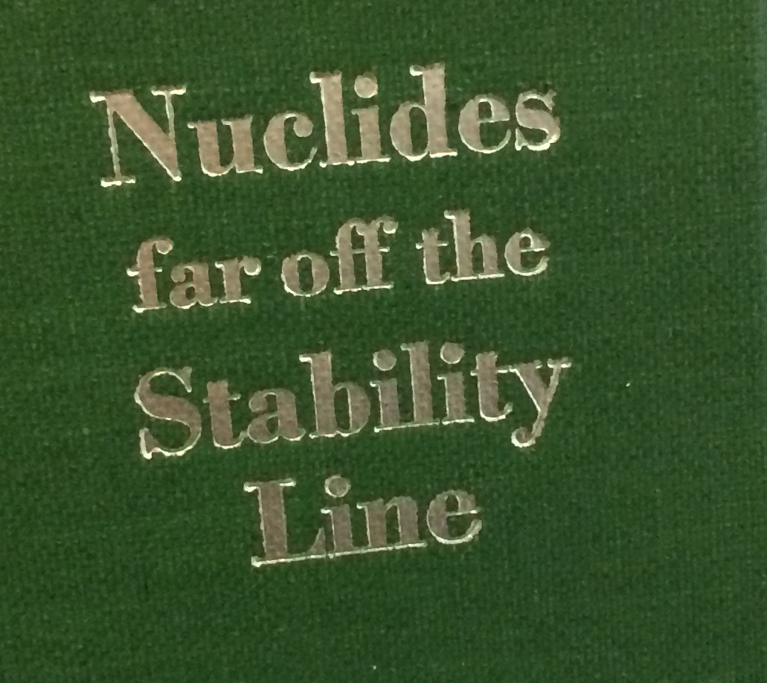
Lysekil, Sweden,
August 21-27 1966

Slide 5
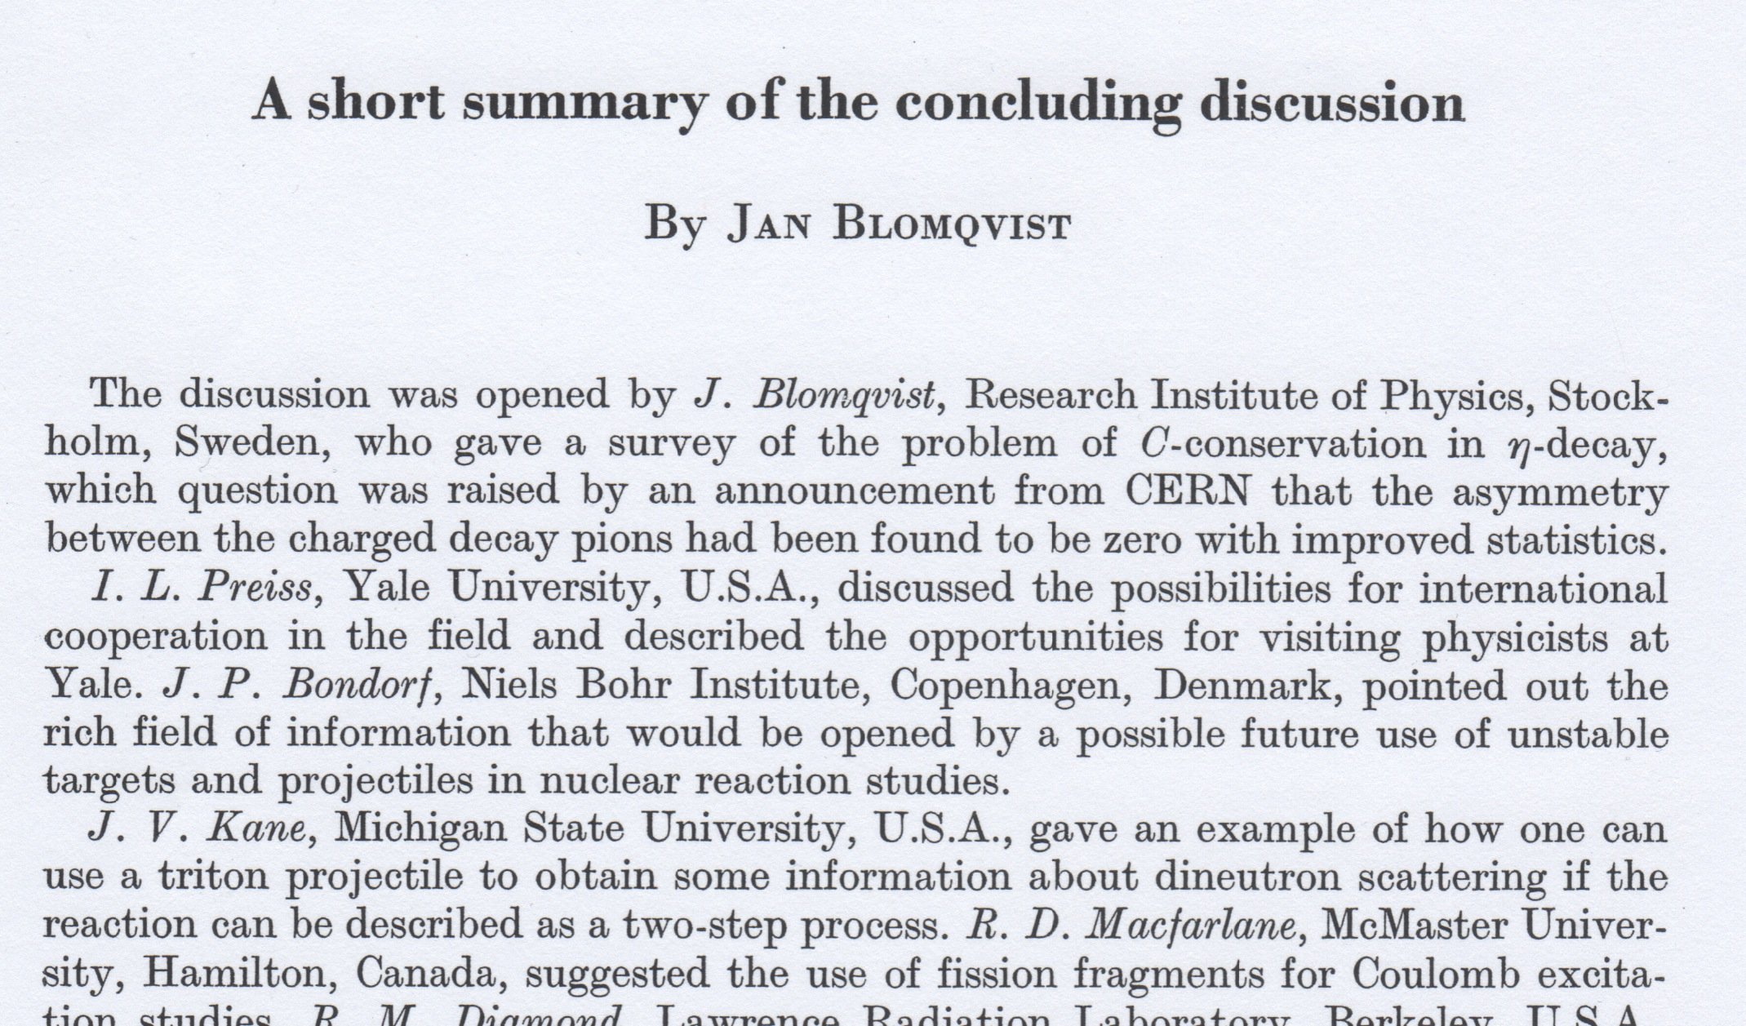
27/8 1966

Slide 6
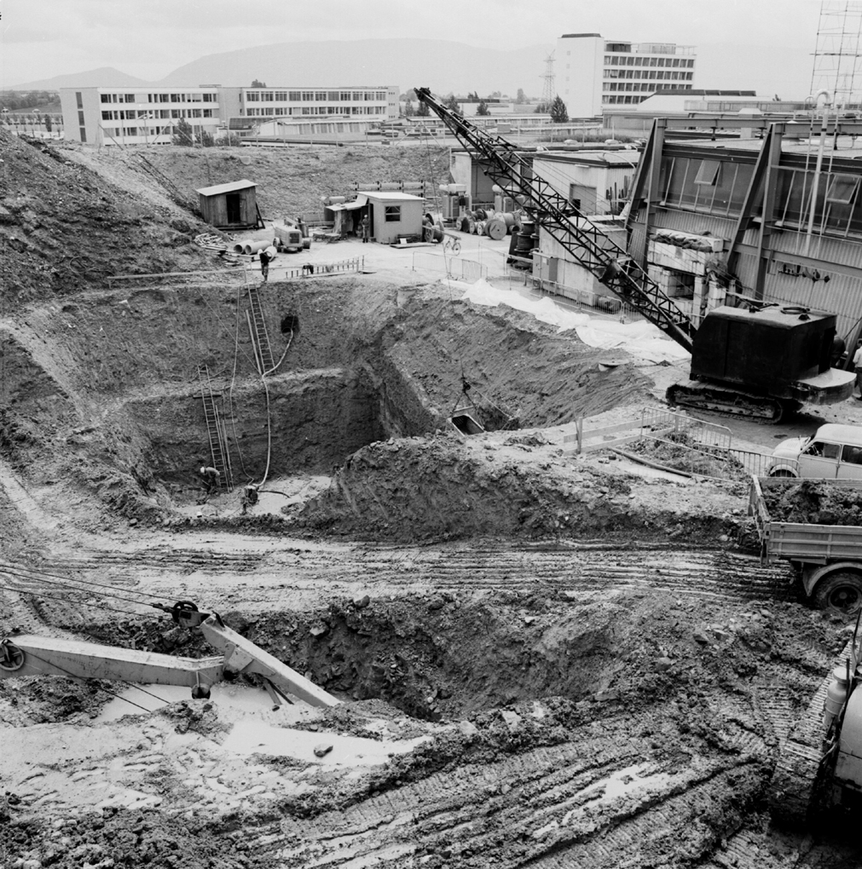
At
the
same time
at CERN
1966

Slide 7
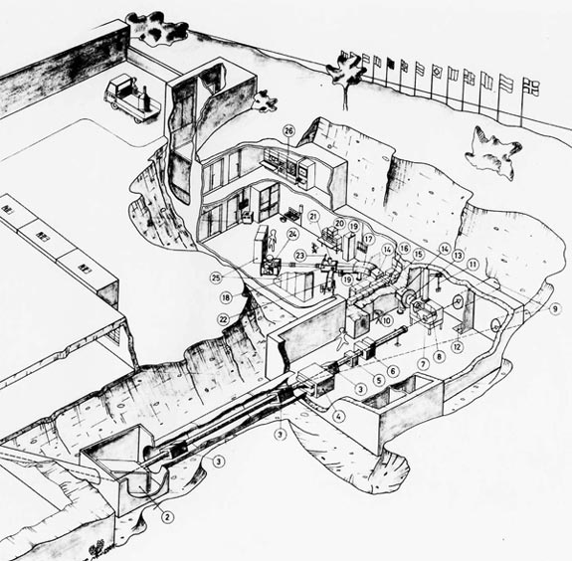
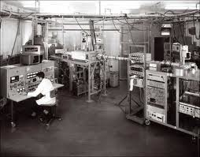
1967
G. Droz

Slide 8
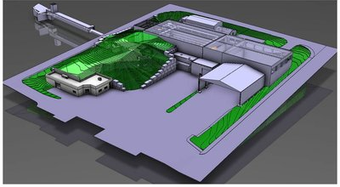

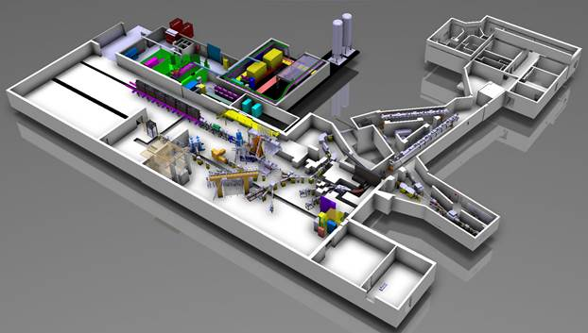

Slide 9
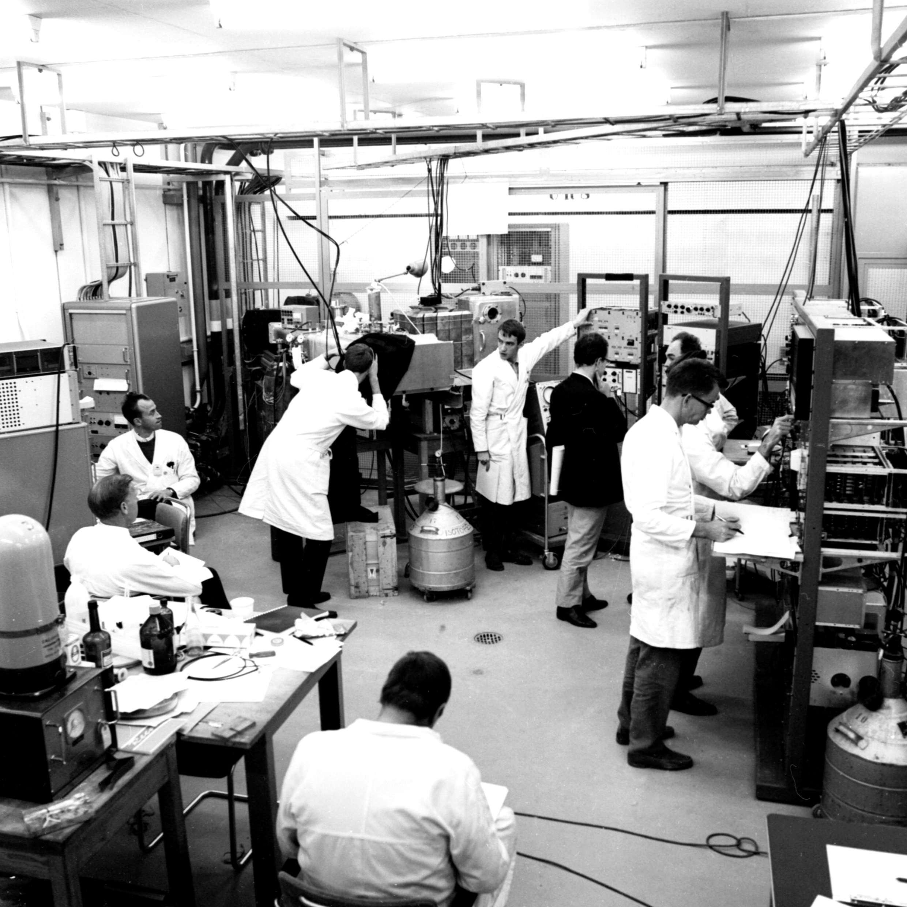
1967
Physics….
Visitor
1967

Slide 10

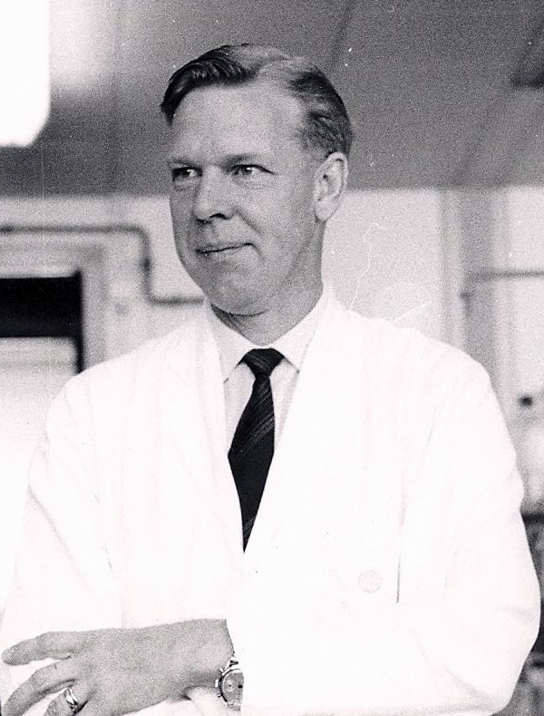
^{116,117}Xe, ….⁷³Kr…
On 2–3 November, a seminar was held at CERN on "ISOLDE chemistry problems" attended by about 50 scientists from 10 countries, including Israel, the USA and the USSR.
At the opening talk, G Rudstam reported on the first test run. Isotopes of xenon, iodine and krypton, separated by chemical techniques, were measured during the run. The isotopes Xe¹¹⁶ and Xe¹¹⁷ were observed for the first time and their half-lives were measured as around 50 s. Traces of another previously unobserved isotope Kr⁷³ were also seen but were insufficient for measurements. The achievements of this first run are very encouraging and make it possible to optimize various components ready for the start of more detailed experiments in December.
Gösta Rudstam

Slide 11
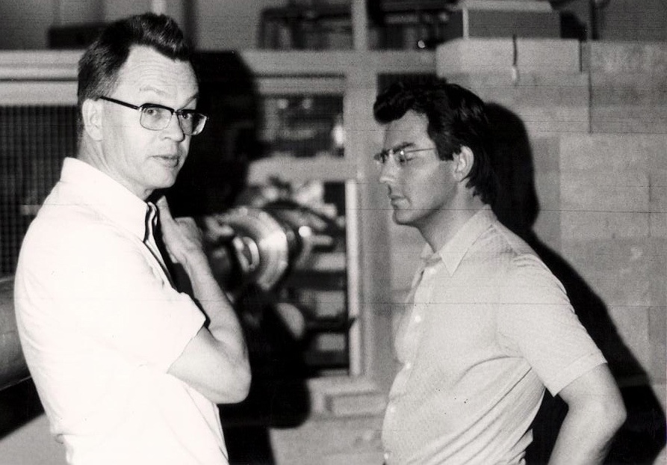
Nuclear Chemistry Group
Arve Kjelberg
1966-1971
Manfred Bühler-Broglin

Slide 12
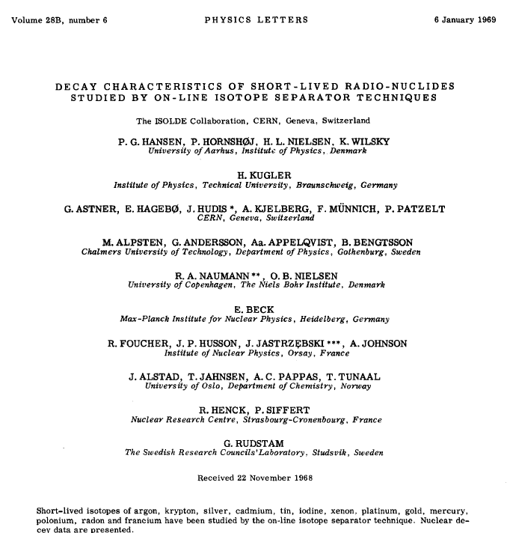
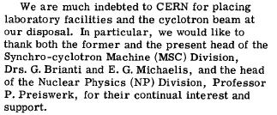
Ar, Kr, Ag
Cd, Sn, I
Xe, Pt, Au
Hg, Po, Rn, Fr

Slide 13
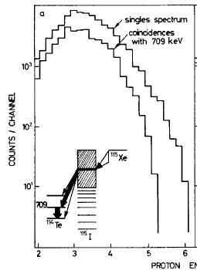
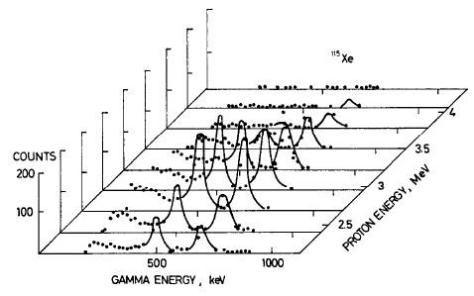
Beta-delayed protons
¹¹⁵Xe
NaI(Tl)
(β,p), (β,2p), (β,3p)
(β,n), (β,2n), (β,3n)
(β,α)
(β,d)
1970
(β,t)

Slide 14
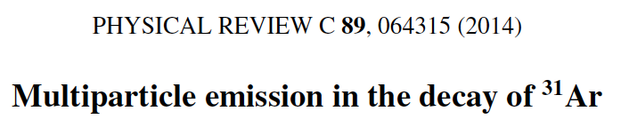

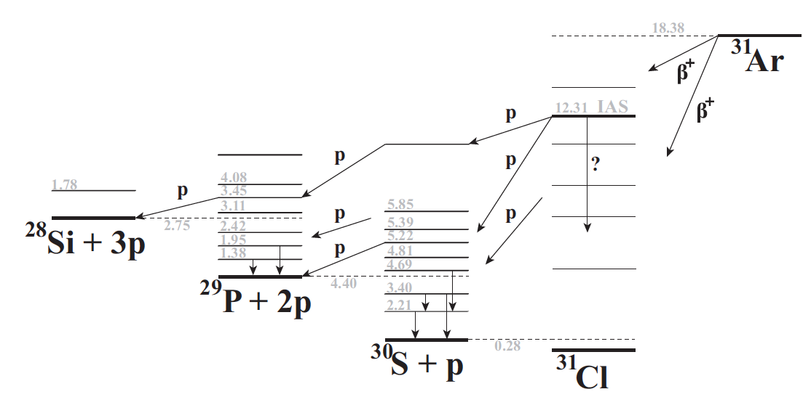

Slide 15

P. Gregers Hansen
1971-1978

Slide 16


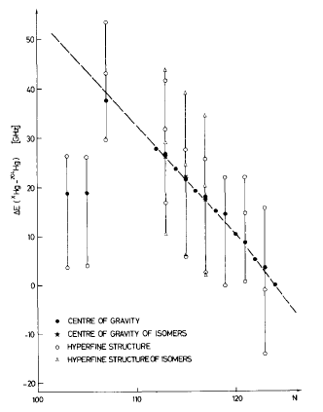
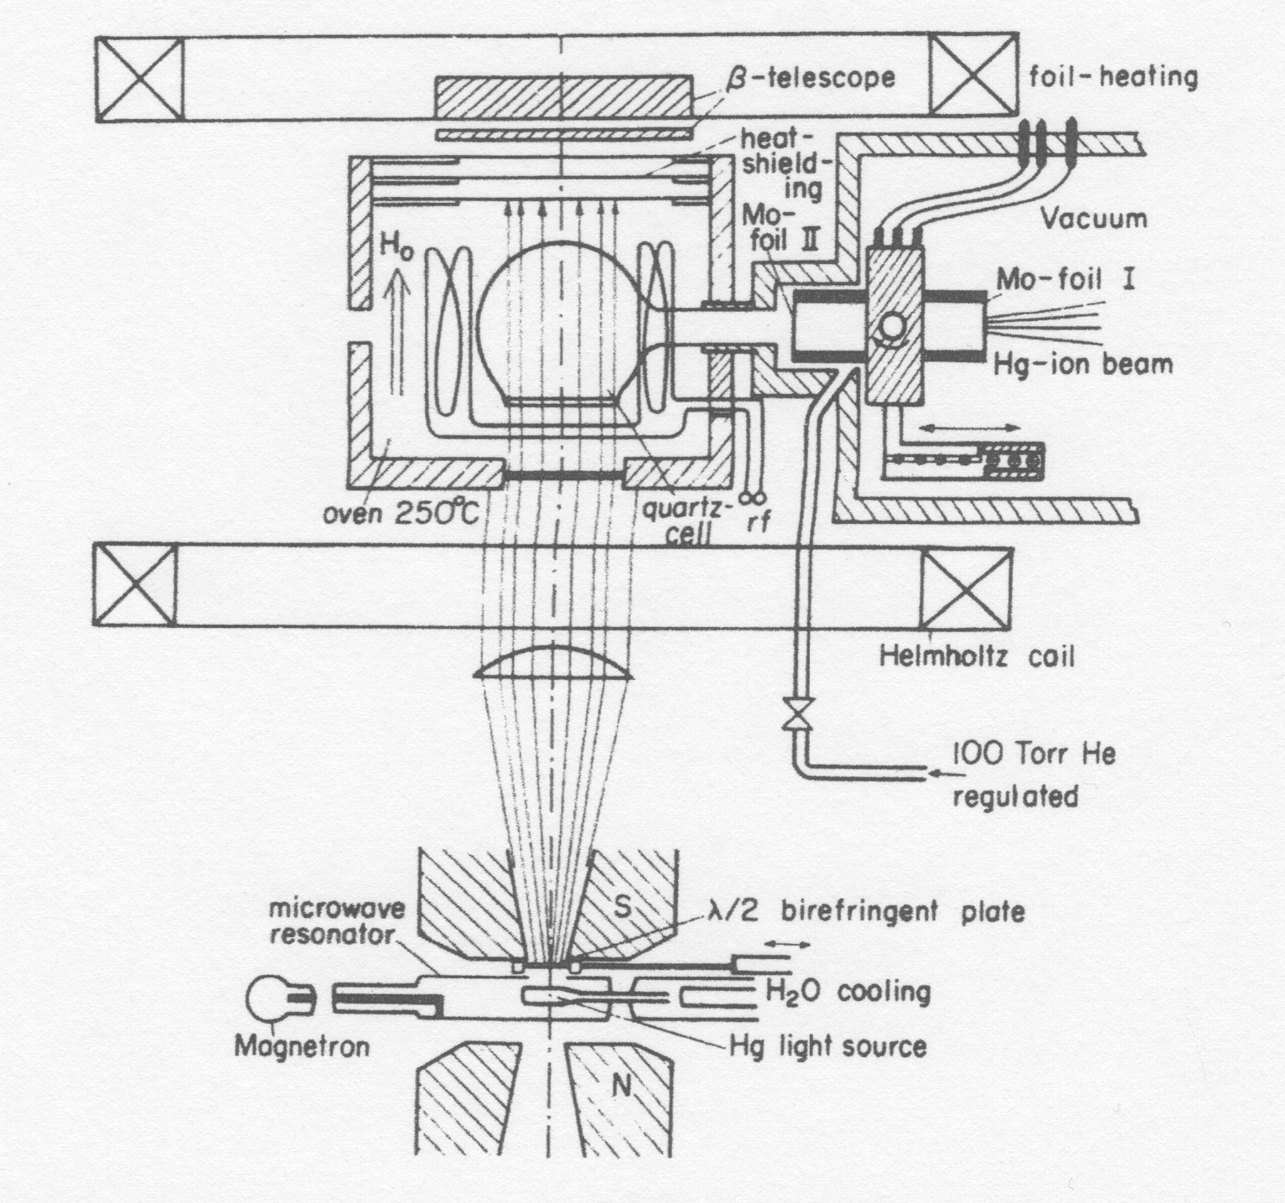
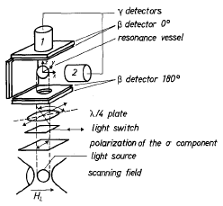
Phys. Lett. B 38 (1972) 308
Hg lamp

Slide 17
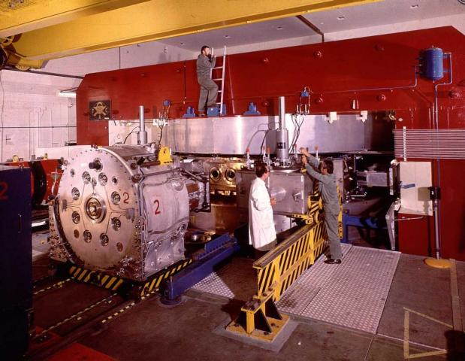
SCIP 1972-1974

Slide 18
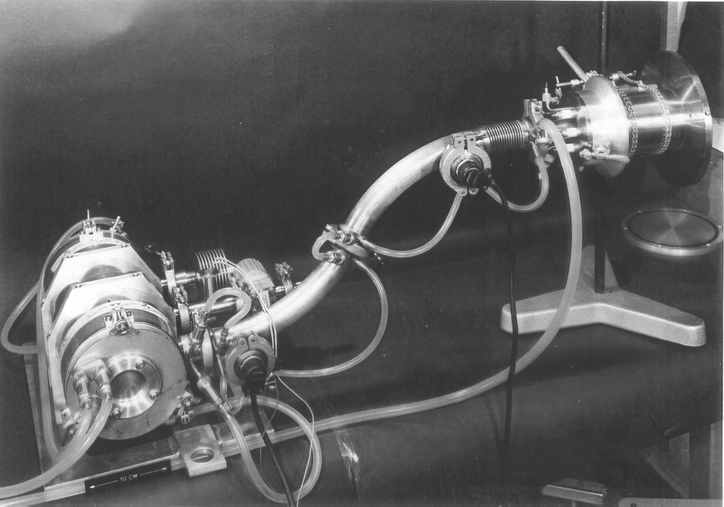


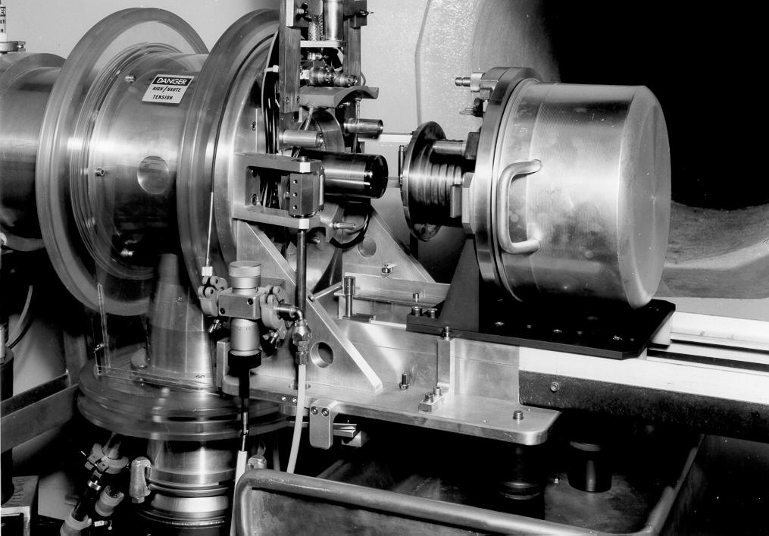

Slide 19
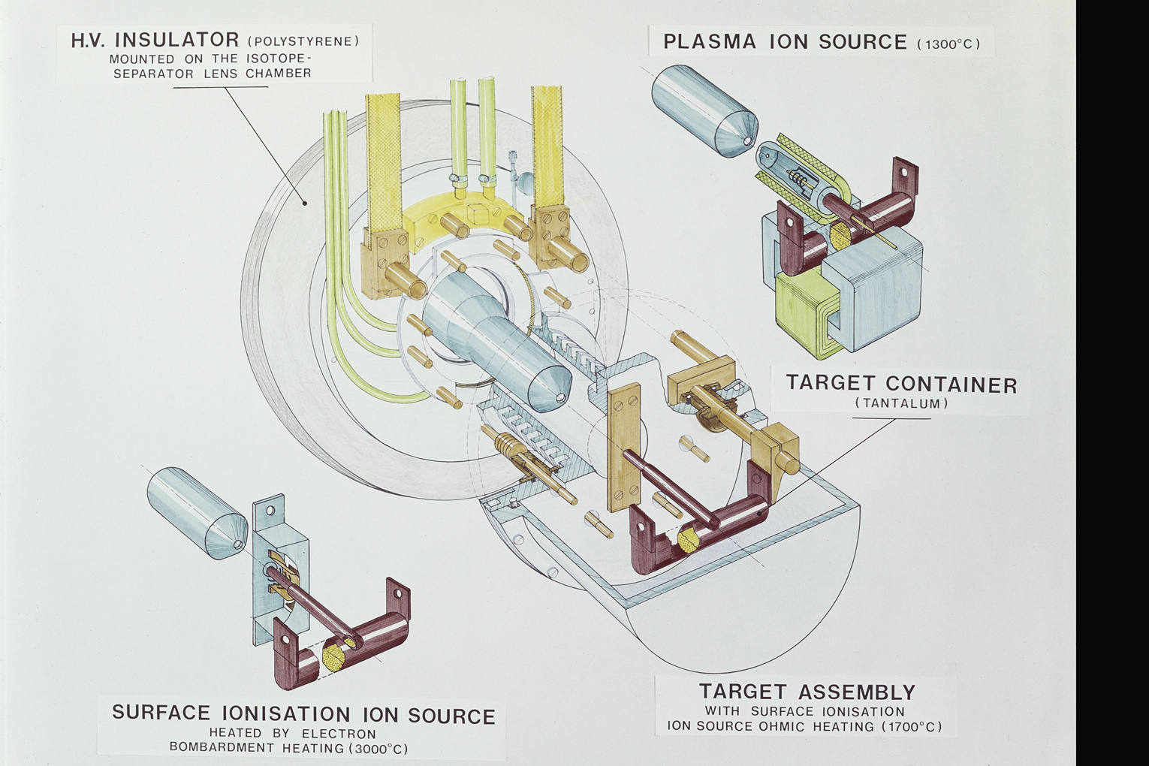

Slide 20
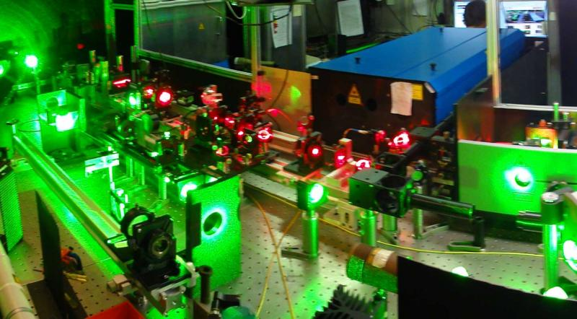
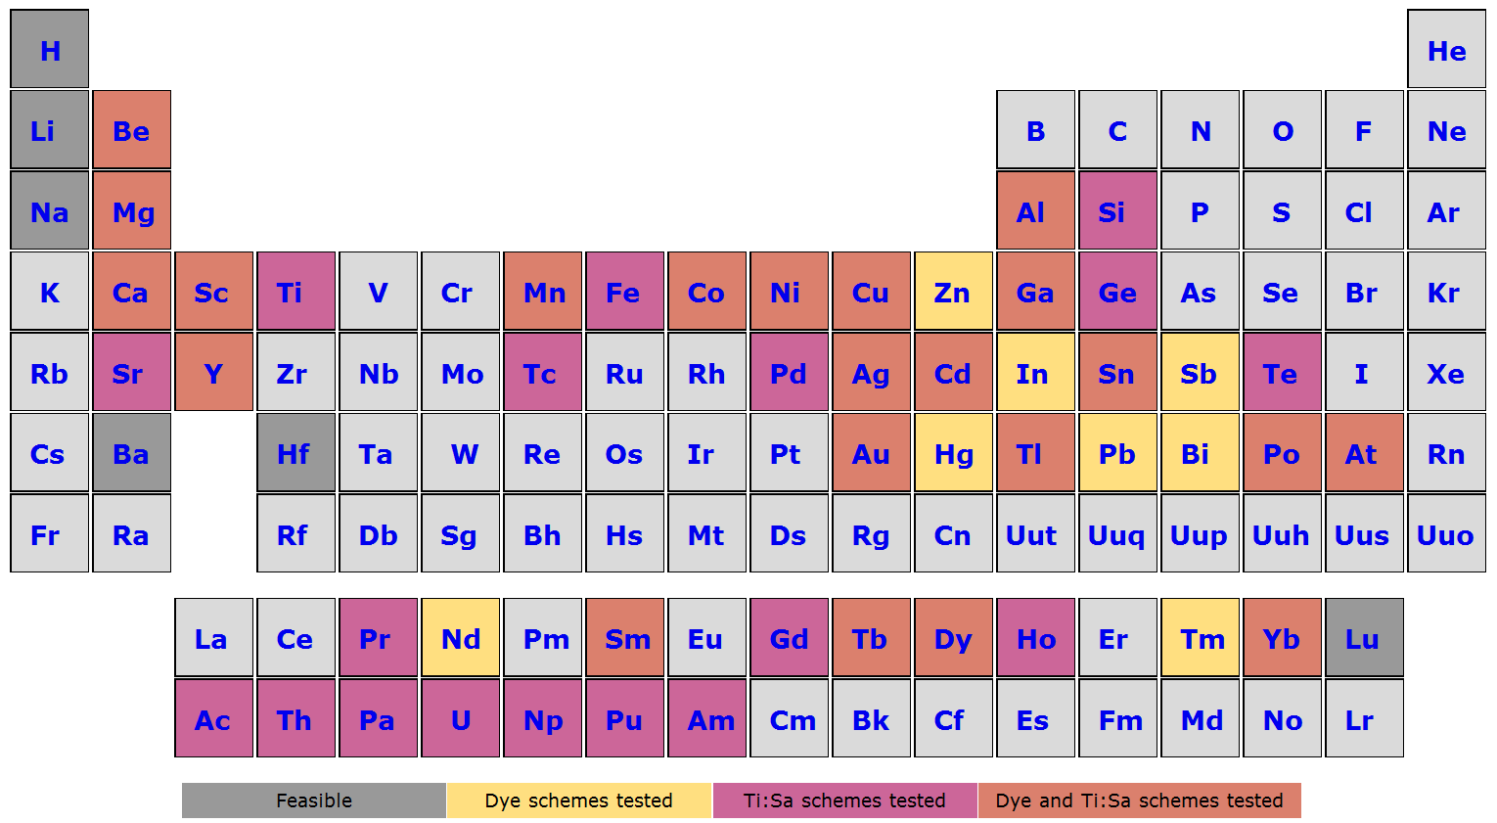
Part of the resonance ionization laser ion source (RILIS)

Slide 21


The ‘Day-1’ experiment at ISOLDE 2?

Slide 22
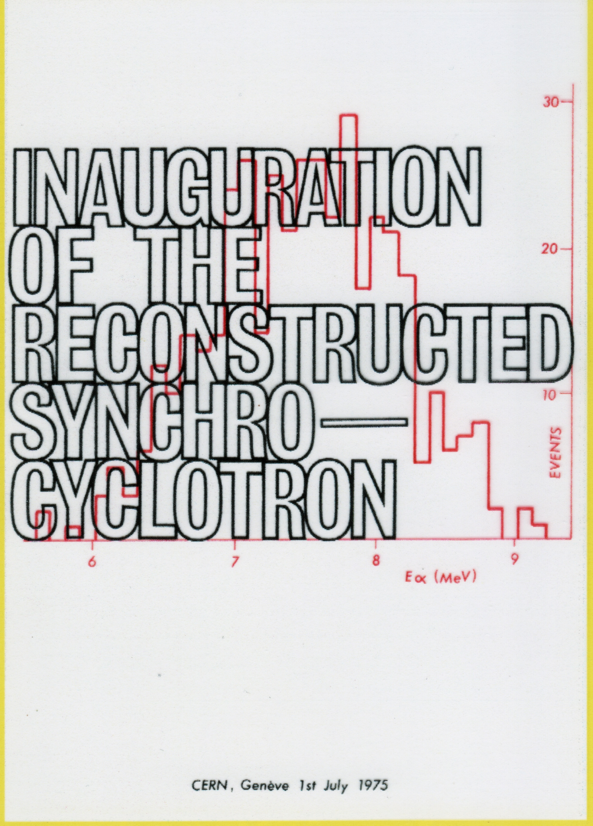
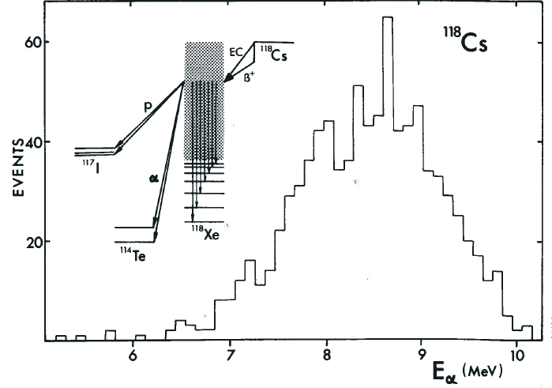

Slide 23
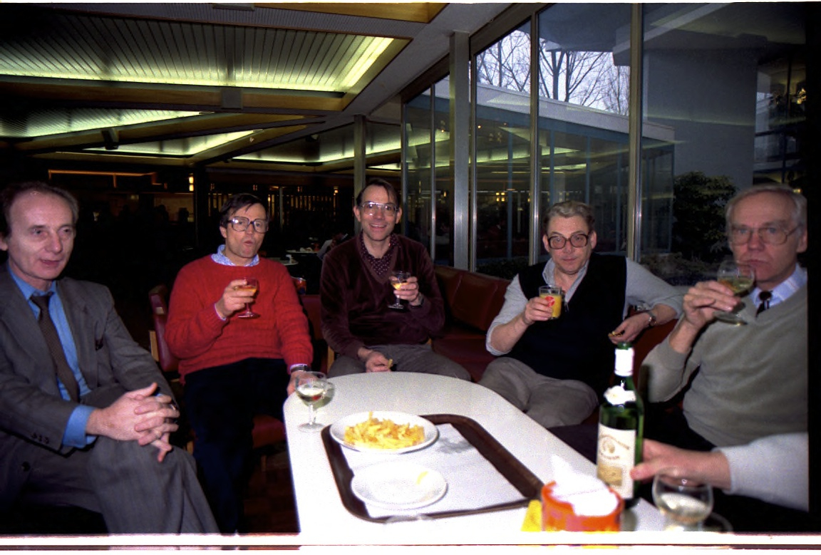
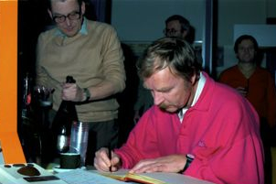

Slide 24
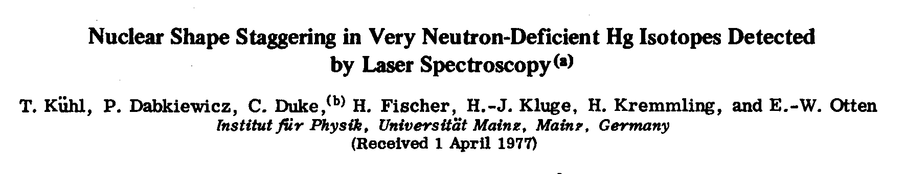
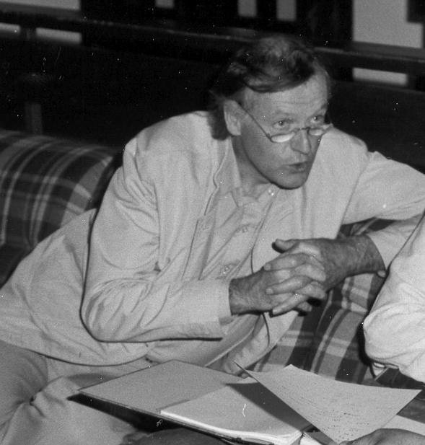
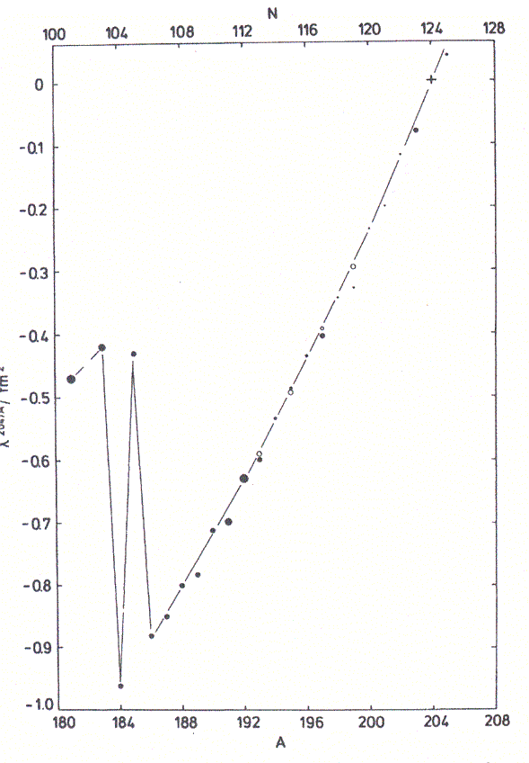
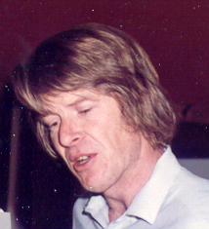
Collinear laser
PRL 39 (77) 180

Slide 25
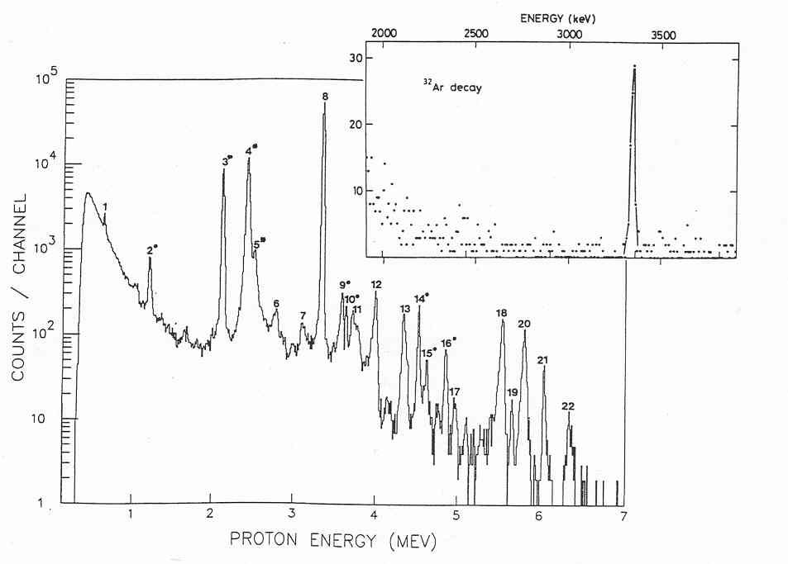
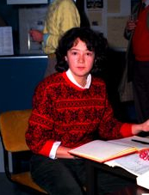
Hagberg et al.,
Phys. Rev. Lett. 39 (1977) 792
VC
1977
CaO
1984
Bjørnstad et al.,
Nucl. Phys. A 443 (1985) 283

Slide 26
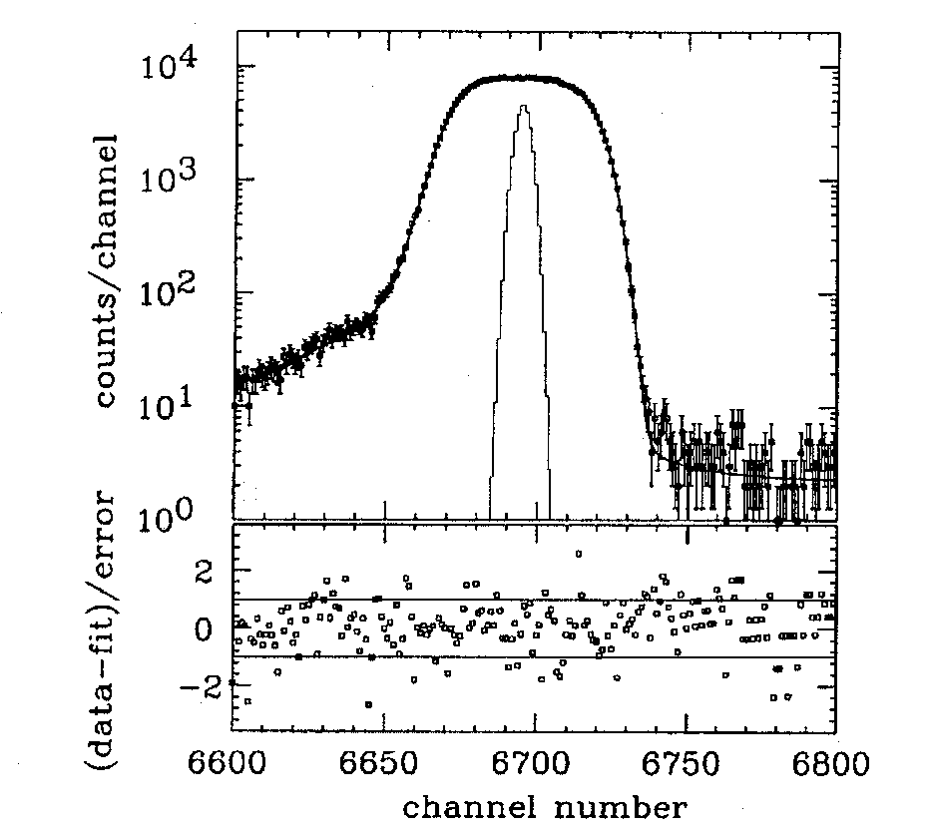
Positron-Neutrino Correlation
in the
0⁺→0⁺ Beta Decay of ³²Ar
eν correlation coeff.
a = 0.9989(52)
p
β⁺
θ_{βp}
θ_{βν}
R
ν
E. Adelberger et al., PRL83 (1999) 1299
M_{S} ≥ 4.1 M_{W}
a = 1.0050(52)
Blaum, PRL91(03)260801
δm=1.8 keV/c²

Slide 27
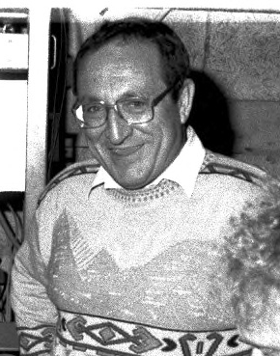
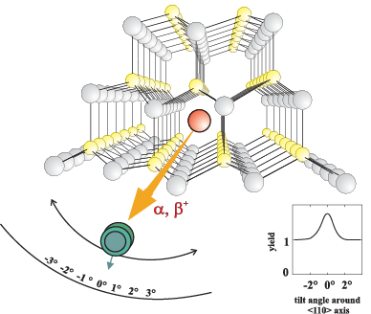
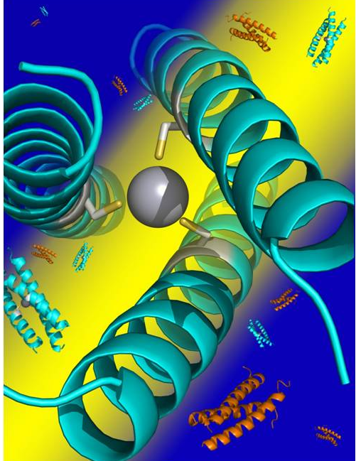
1976
Channeling
Blocking
PAC
DLTS
NO
Diffusion
PL
ESR
Mössbauer

Slide 28
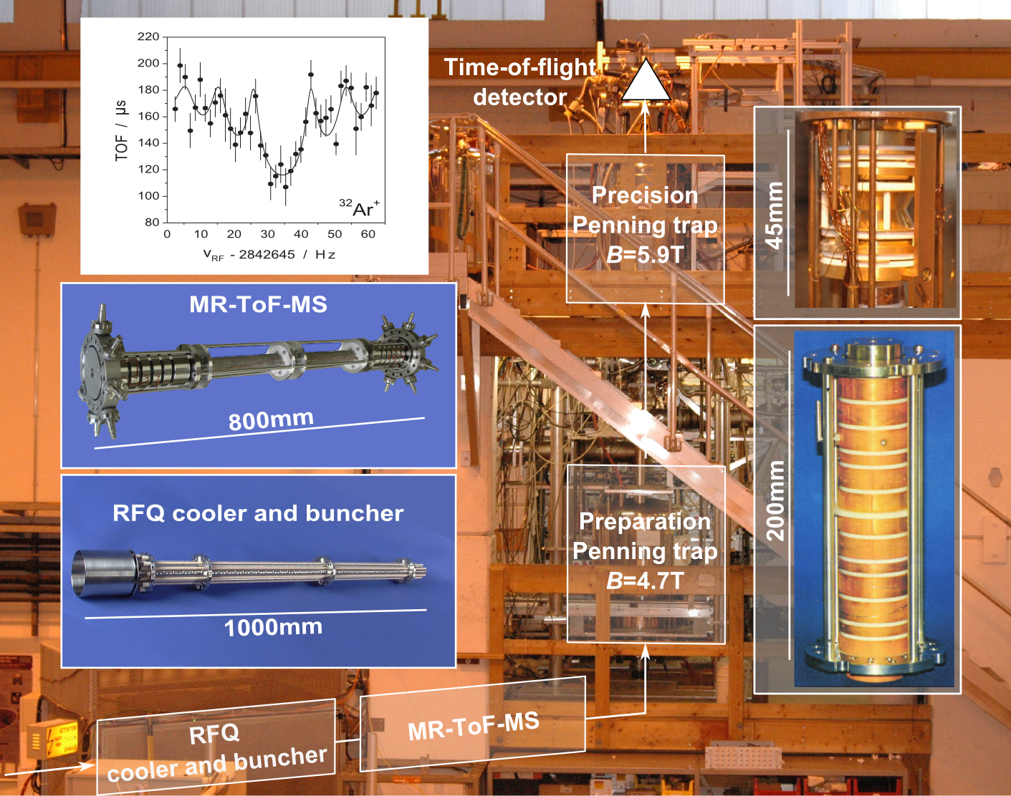
Nuclear masses
M. Epherre, G. Audi, C. Thibault et al.
PRC 19 (1979) 1504
ISOLTRAP Penning-trap
mass spectrometer

Slide 29
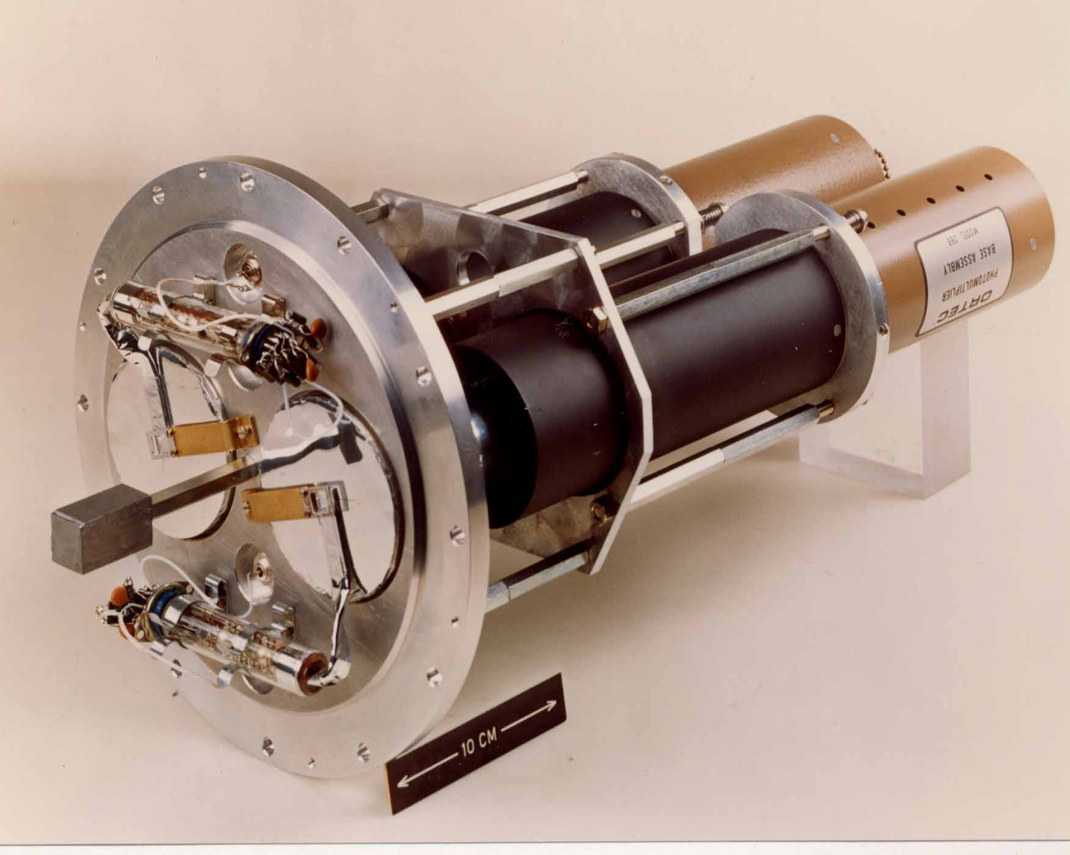
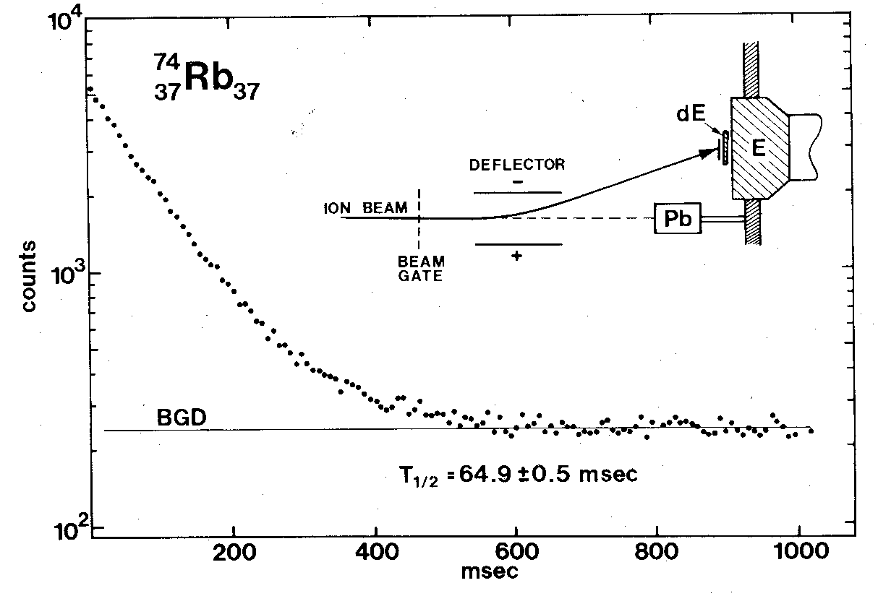
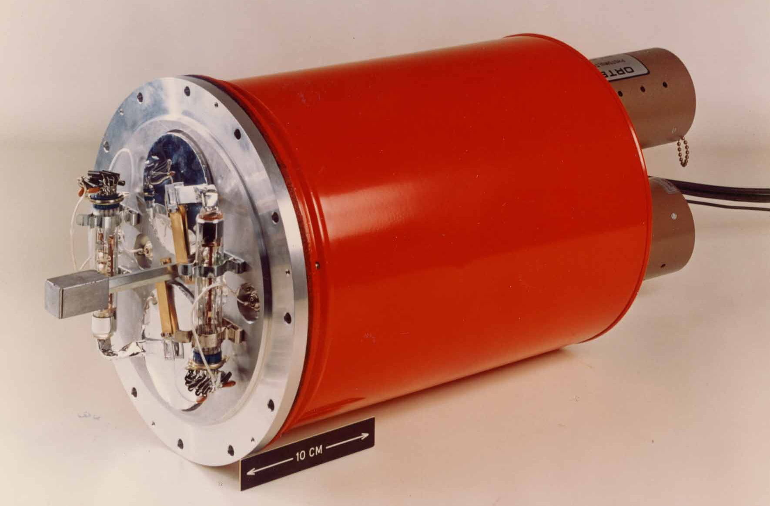
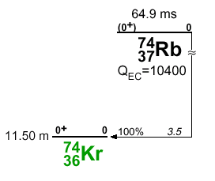
⁷⁴Rb, T,I^{π}=1,0⁺
D’Auria et al.,Phys. Lett. 66B (1977) 233
1977
0⁺
<0.07%
⁹³Nb(p,5p15n)⁷⁴Rb

Slide 30


The CKM Matrix
T_{1/2}
Q_{β}
Branching
Kellerbauer et al.,
PRC 76 (2007)04550

Slide 31


Dec. 7, 2008
M
K

Slide 32

1978
ISOLDE…

Slide 33

Sept. 29
1979

Slide 34



Slide 35


Slide 36

Octupole shapes
Parity doublets
½± , 3/2± , 5/2±
In 1978 I. Ragnarsson, S.G. Nilsson and R.K. Sheline, predicted ( Phys. Reports 45 (1978)1)
that ”stable octupole deformation might exist in this region”

Slide 37



²²⁴Ra
Collective excitations in the transitional nuclei ^{224,226}Ra. W. Kurcewicz, E. Ruchowska, N. Kaffrell, T. Björnstad, G. Nyman, Nucl. Phys. A356 (1981) 15.

Slide 38




L. P. Gaffney et al.
Nature 497, 199 (2013)

Slide 39


¹¹Li, (β,2n) and (β,3n)

Slide 40

Open delayed-particle channels in the ¹¹Li beta decay
20.6
3/2⁻
1996
¹¹Li
1966
17.916
1983
⁹Li+d
15.721
⁸Li+t
10.59
1980
8.82
8.982
1979
⁸Be+3n
7.315
⁹Be+2n
1974
0.320
0.504
(MeV)
¹⁰Be+n
Observation of β-delayed triton emission
M. Langevin, C. Détraz, M. Epherre,
D. Guillemaud-Mueller, B. Jonson, C. Thibault,
Phys. Lett. 146B (1984) 176.
¹¹Be

Slide 41




…and in the year 1984….
ISOLDE 2
Thanks!

