Slide 1
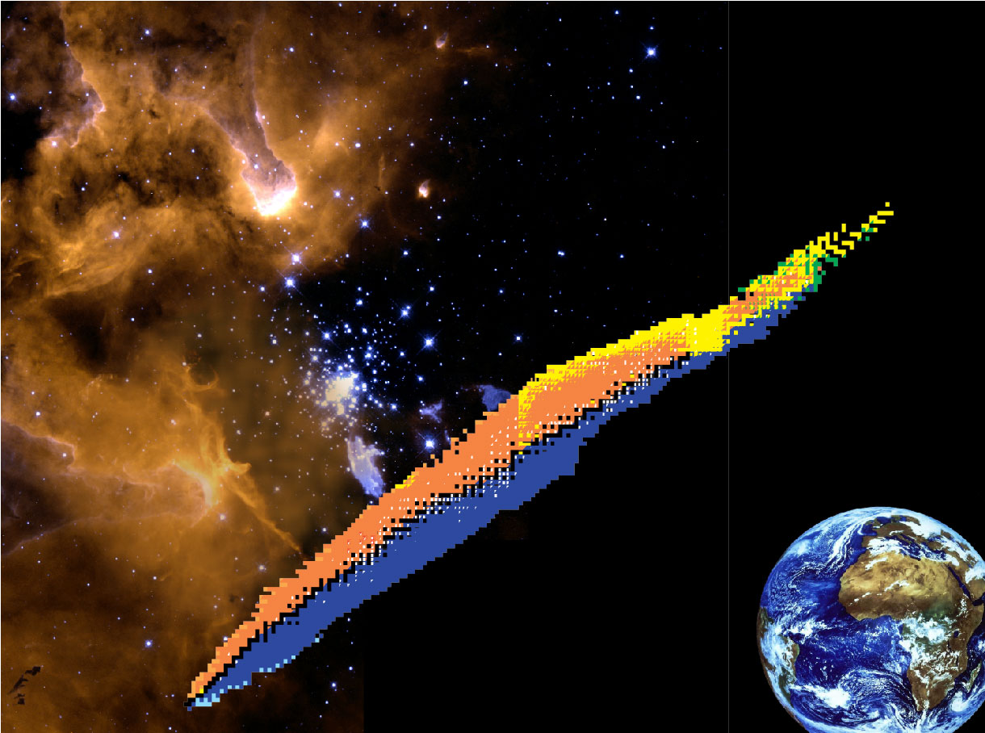


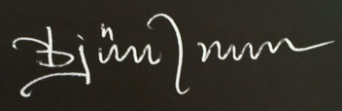
Exotic Nuclei
Björn Jonson
Chalmers University of Technology
Göteborg, Sweden
March 30,2018

Slide 2
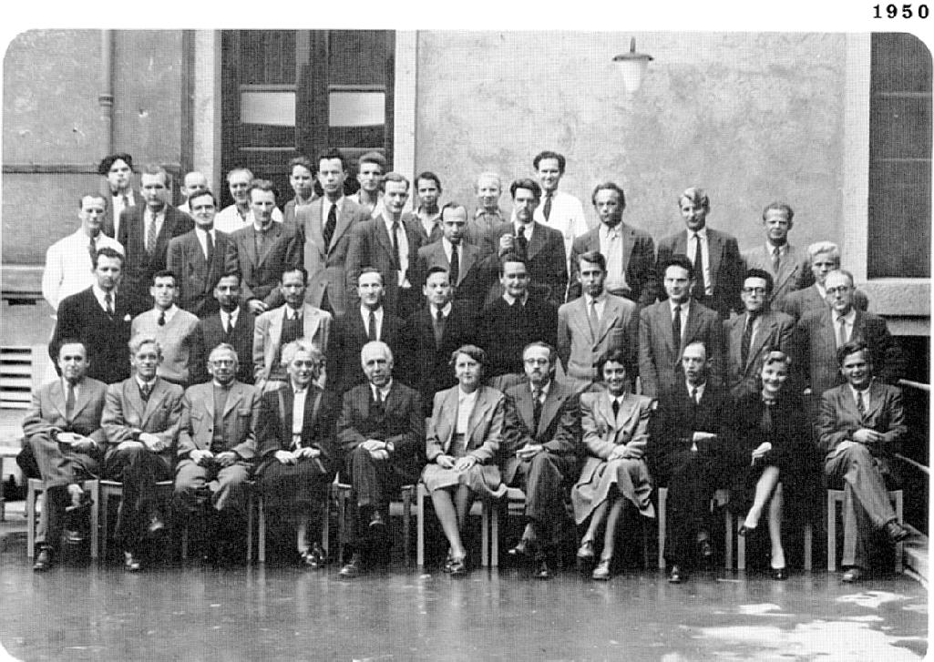
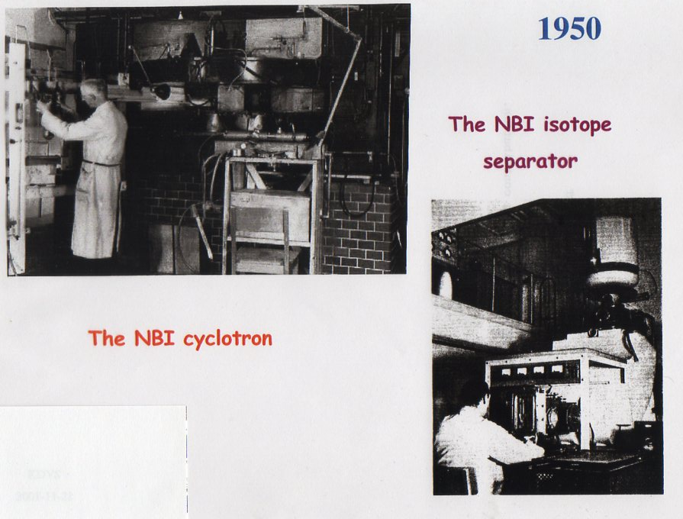
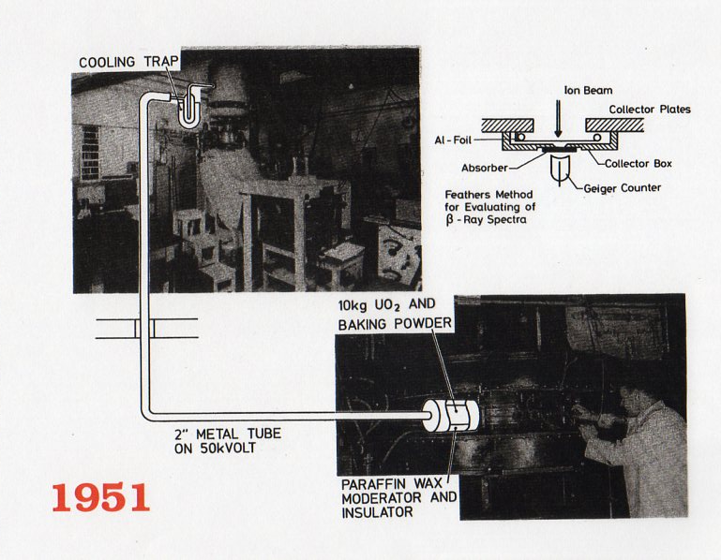
Niels Bohr
Prehistory
The Niels Bohr Institute
Copenhagen, Denmark
Isotope Separator On Line
Otto Kofoed-Hansen
Karl-Ove Nielsen

Slide 3
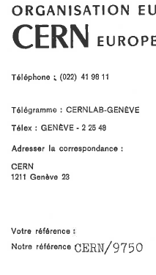
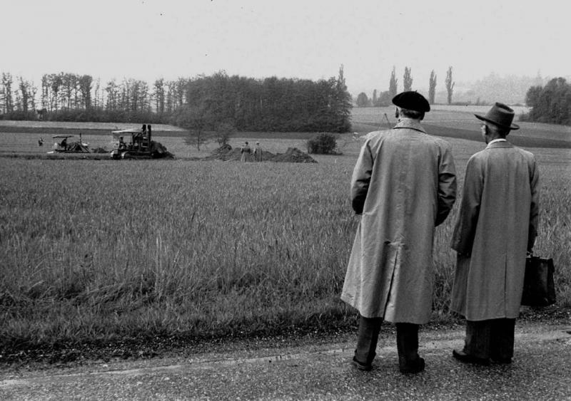
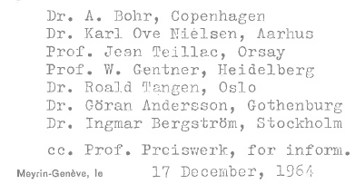
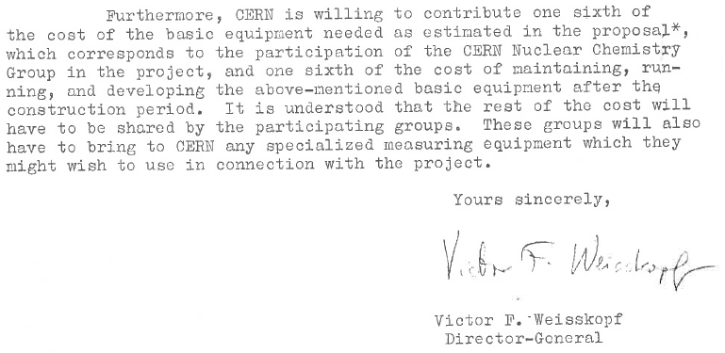
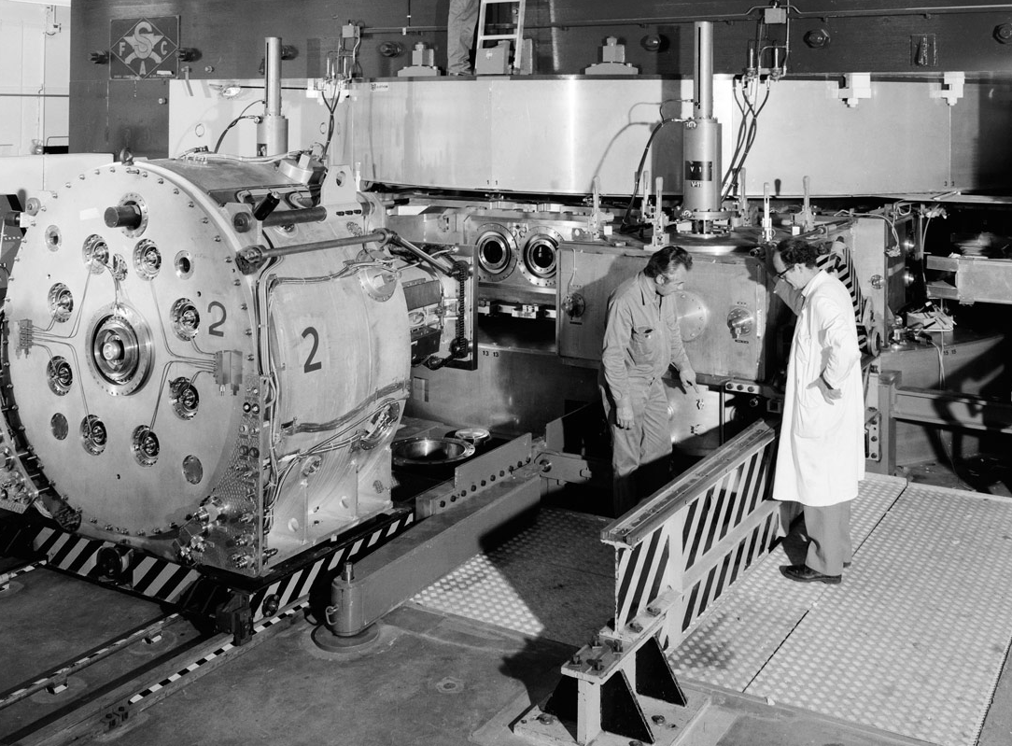
Letter from the
Director General at CERN
W.F. Weisskopf
to the
ISOLDE Community
Meyrin, Genève, Switzerland
September 29, 1954
600 MeV p
CERN SC

Slide 4
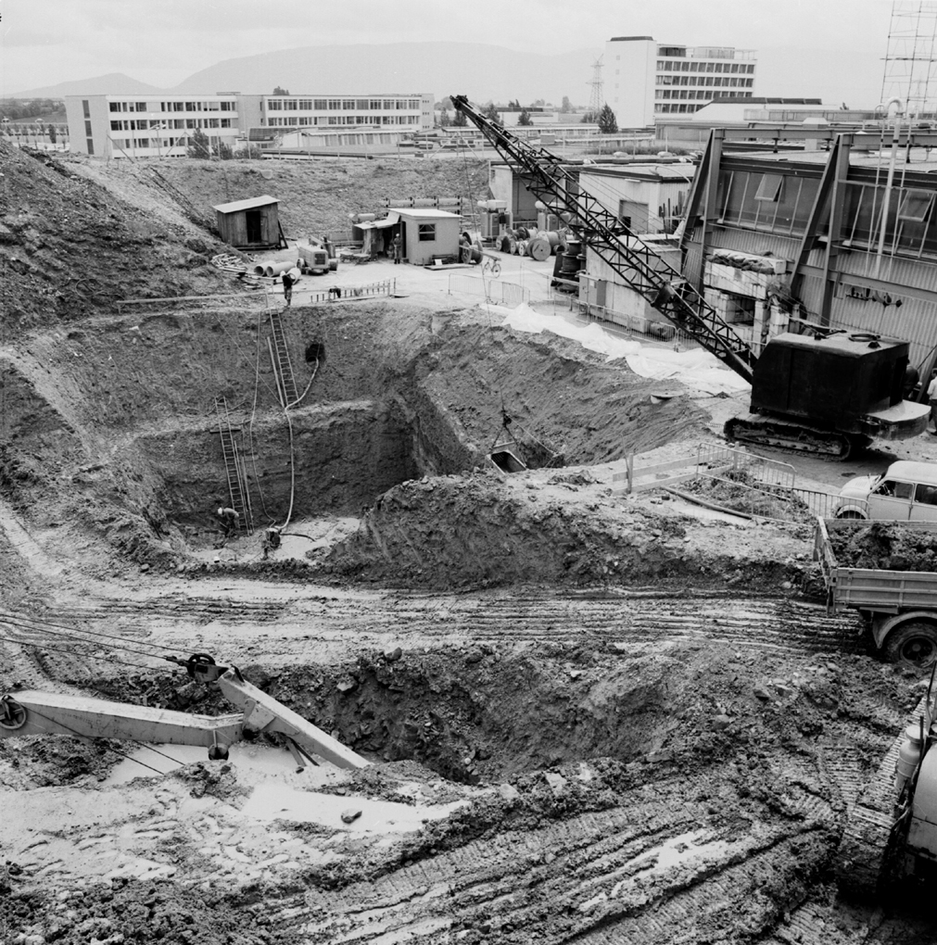
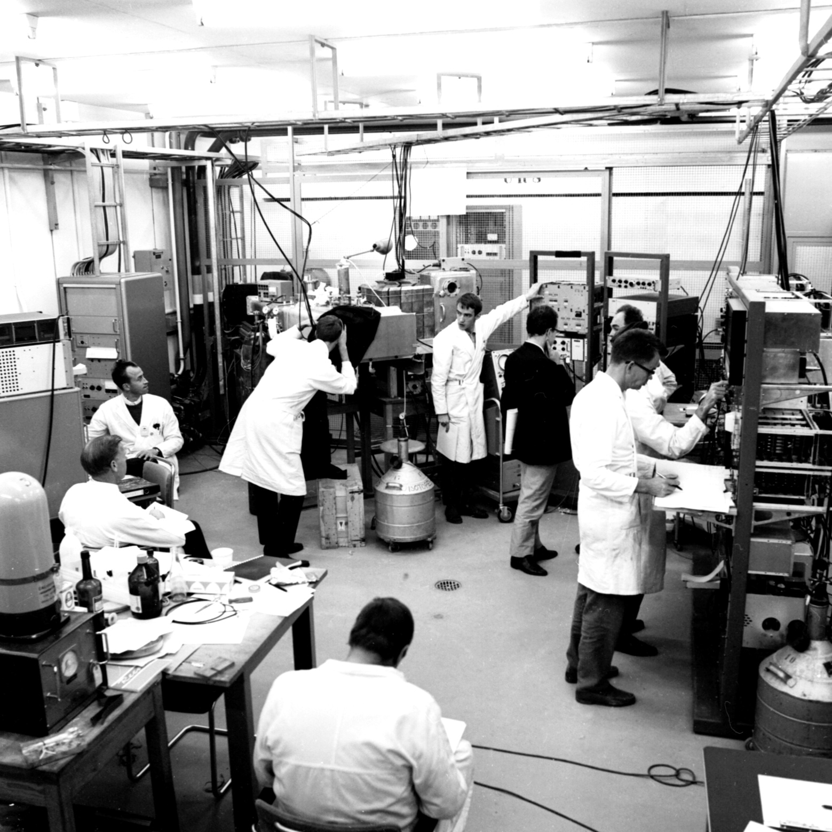
The first
experiment at
ISOLDE
On
October 16
1967
Ar, Kr, Ag
Cd, Sn, I
Xe, Pt, Au
Hg, Po, Rn, Fr

Slide 5

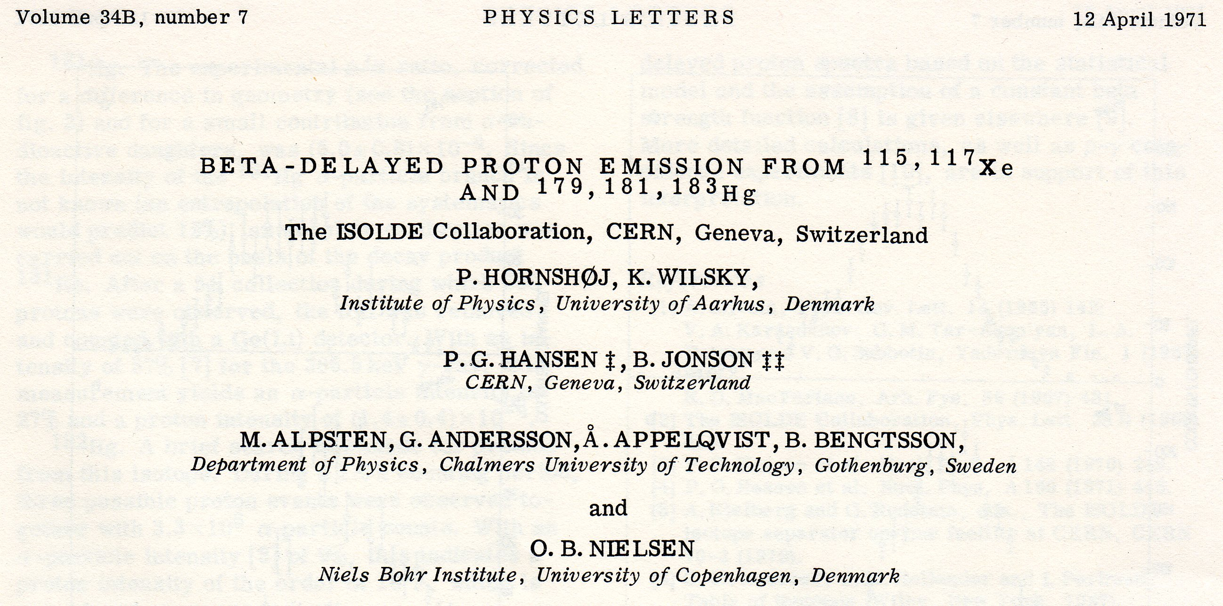
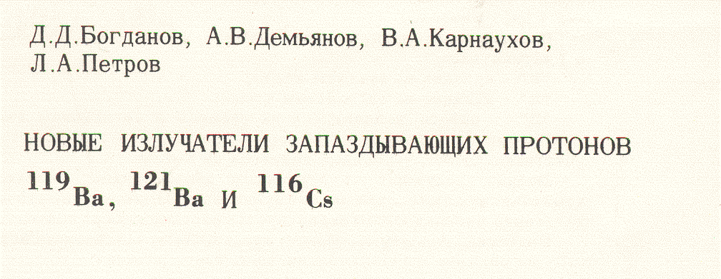
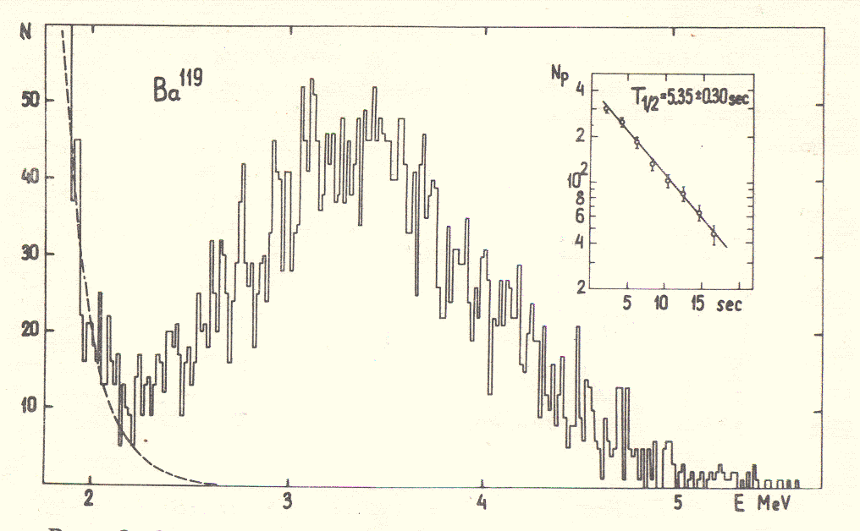
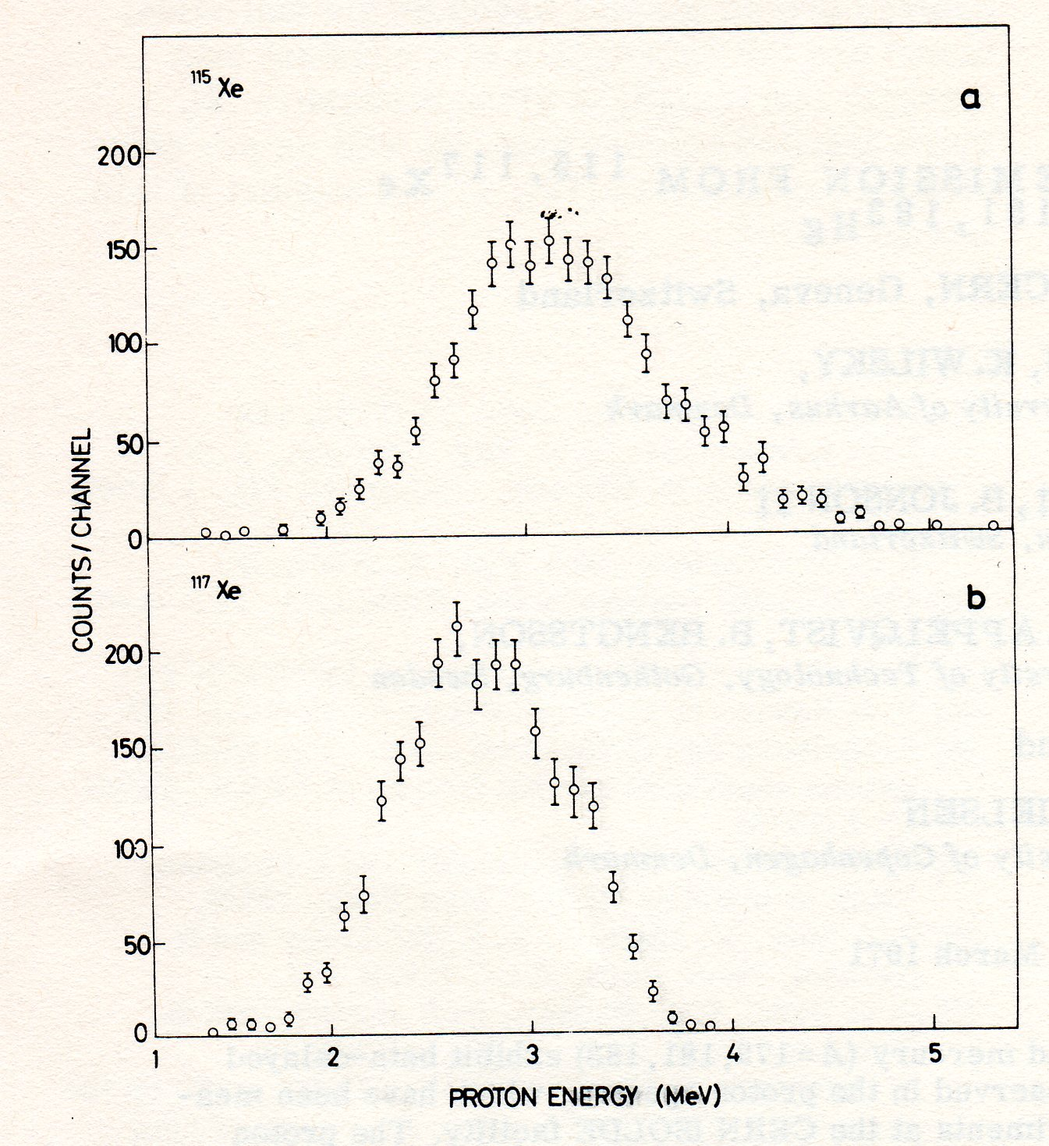
Beta-delayed proton emission

Slide 6
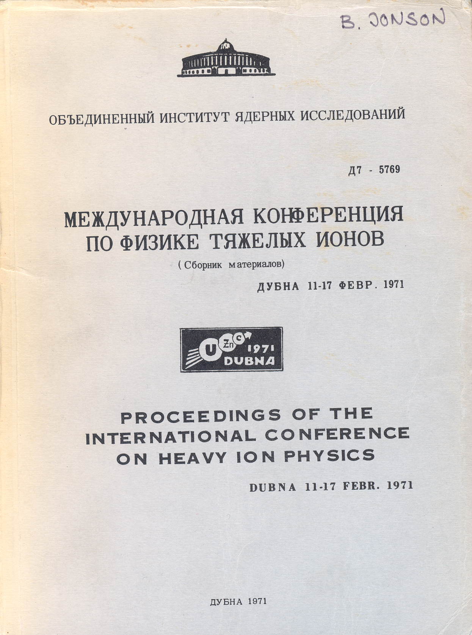
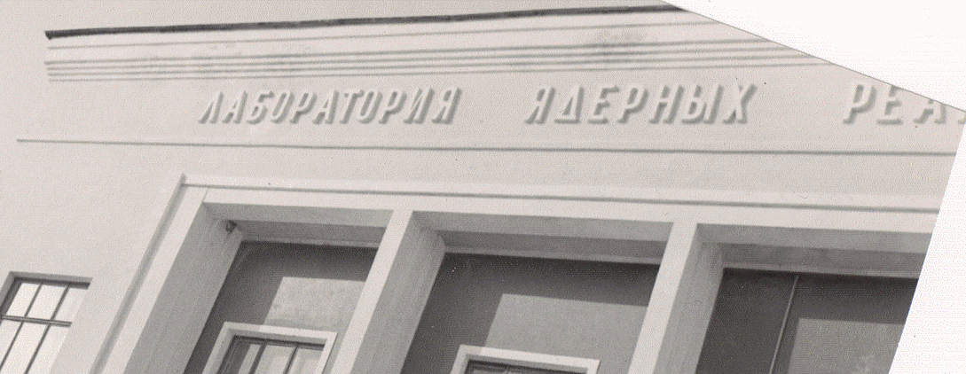
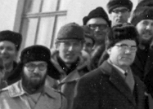
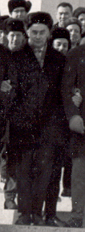

G.N. Flerov
Yu.Ts. Oganessian
B. Jonson

Slide 7
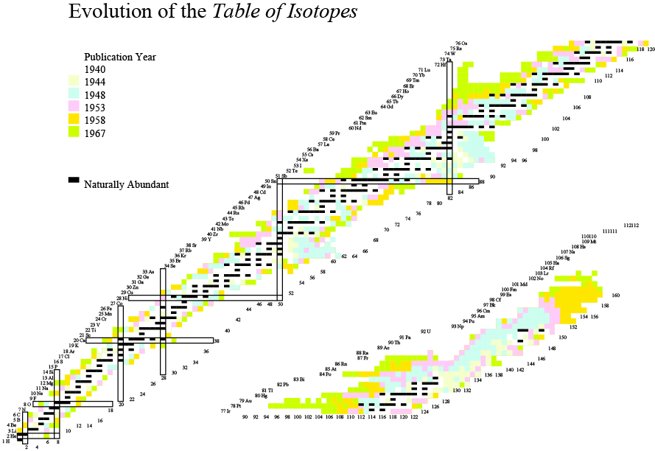
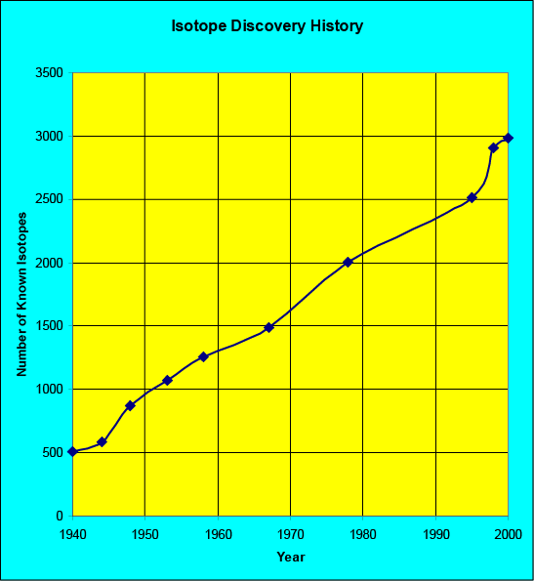
1957

Slide 8
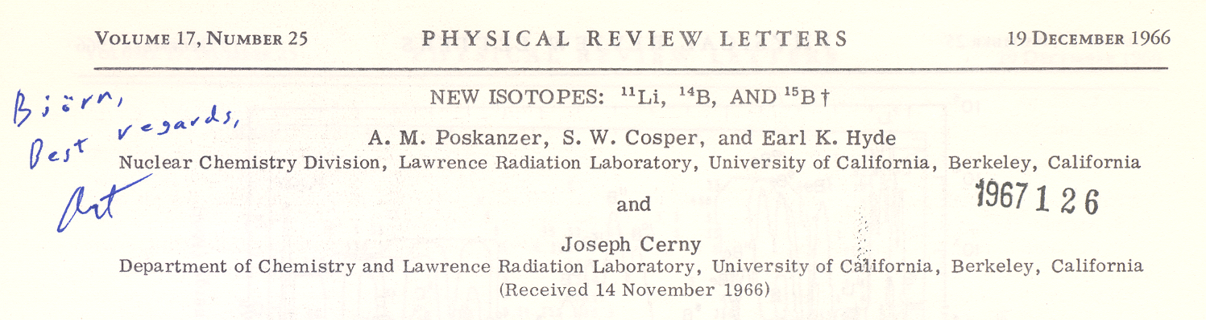
Open delayed-particle channels in the ¹¹Li beta decay
20.6
3/2⁻
1996
¹¹Li
1966
17.916
1983
⁹Li+d
15.721
⁸Li+t
10.59
1980
8.82
1979
8.982
⁸Be+3n
7.315
⁹Be+2n
0.320
1974
½⁻
γ
0.320
0.504
(MeV)
¹⁰Be+n
½⁺
¹¹Be
¹¹Be

Slide 9
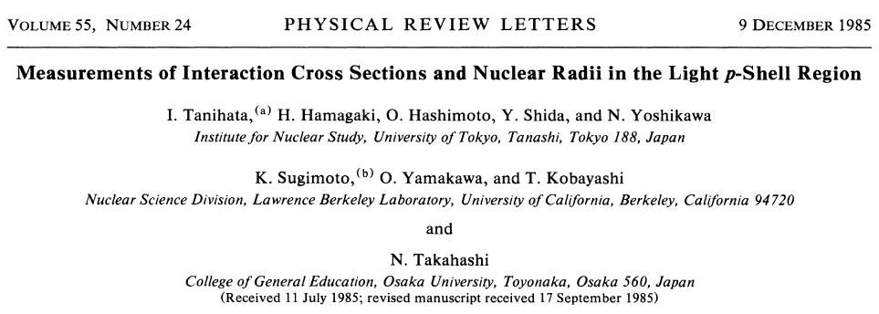
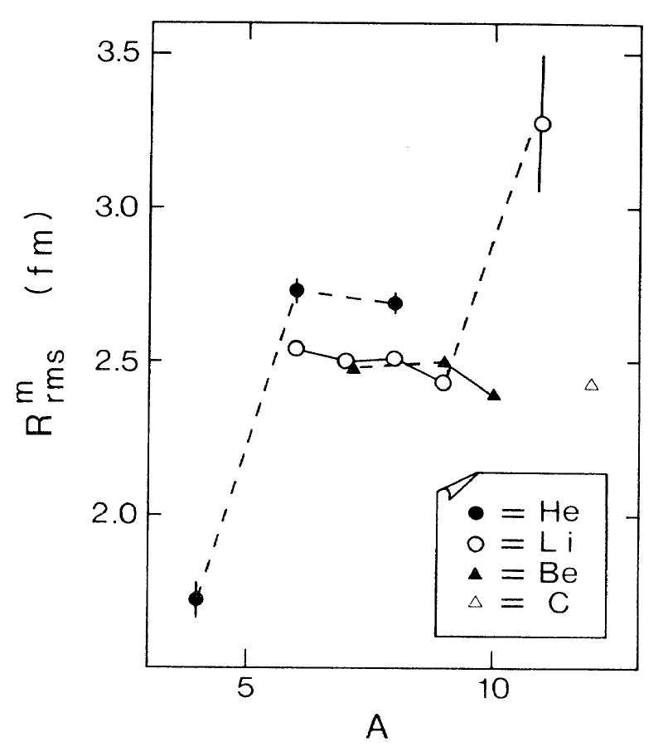
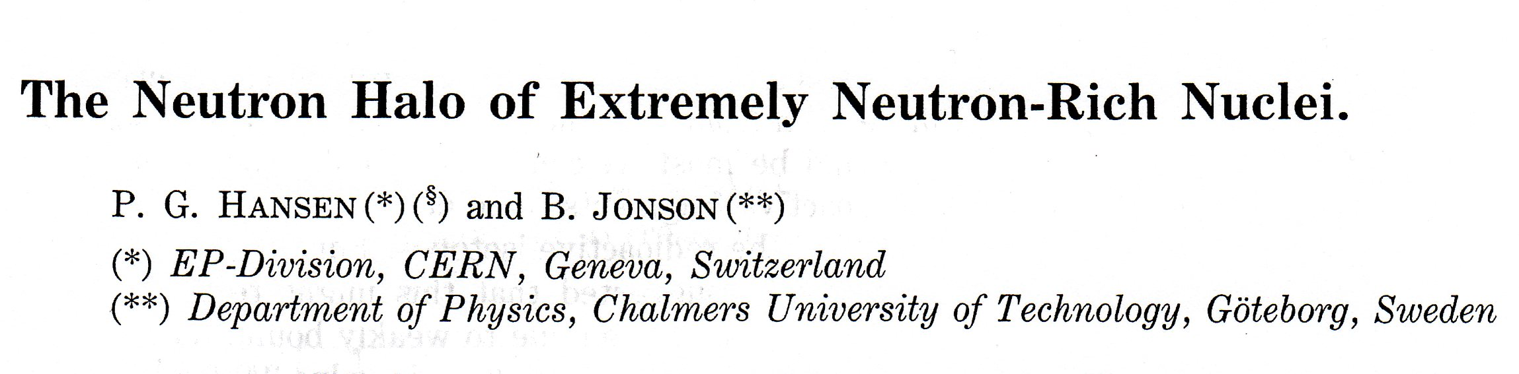
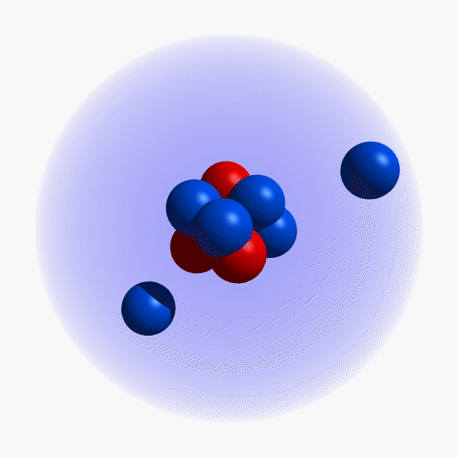

Slide 10
¹¹Be
13.8 s
¹²Be
23.6 ms
¹³Be
806 ms
¹⁴Be
4.35 ms
⁹Li
179 ms
¹⁰Li
806 ms
¹¹Li
8.5 ms
⁶He
806 ms
⁷He
806 ms
⁸He
119 ms
⁹He
806 ms
V_{nn}
N=8
V_{Cn}
V_{Cn}
Bound
Unbound

Slide 11
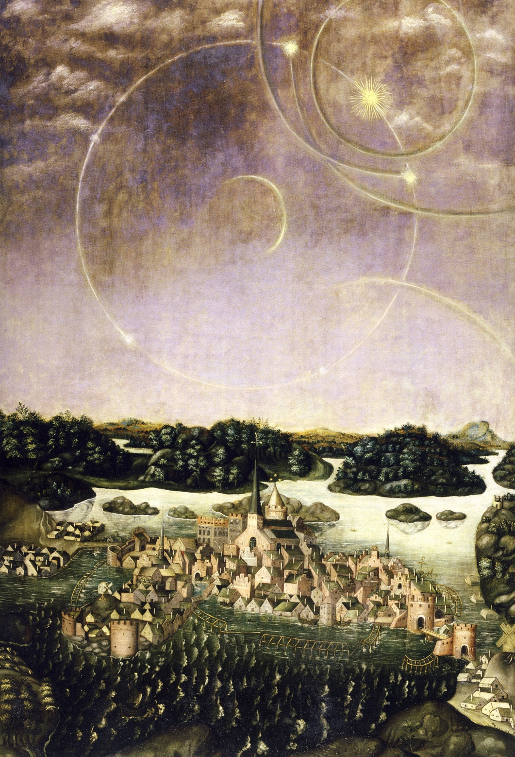

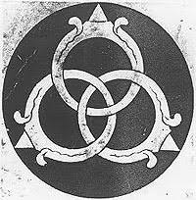
Stockholm,
April 20, 1535
VÄDERSOLS
TAVLAN
The Sun Dog Painting
Borromean nucleus
Urban Målare,
Storkyrkan, Stockholm
Jacob Heinrich Elbfas, 1636
M.V. Zhukov et al.,
Phys. Rep. 231 (1993) 151

Slide 12

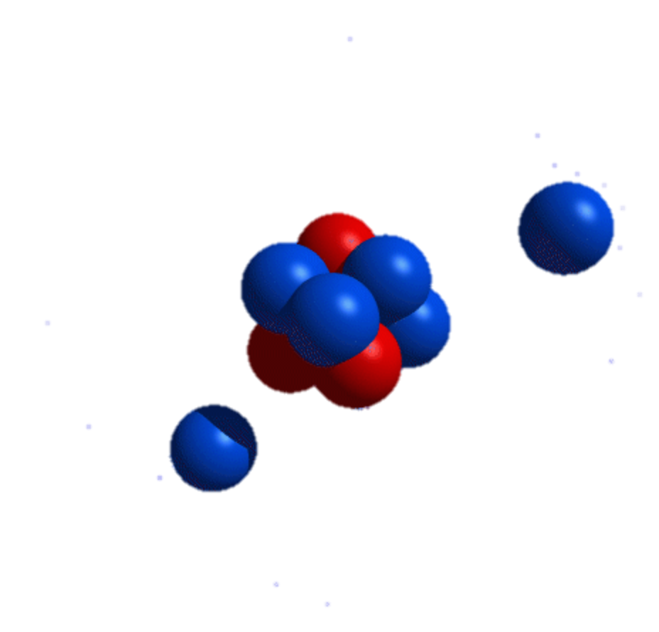
GANIL, GSI, ISOLDE, JINR, MSU, RIKEN

Slide 13
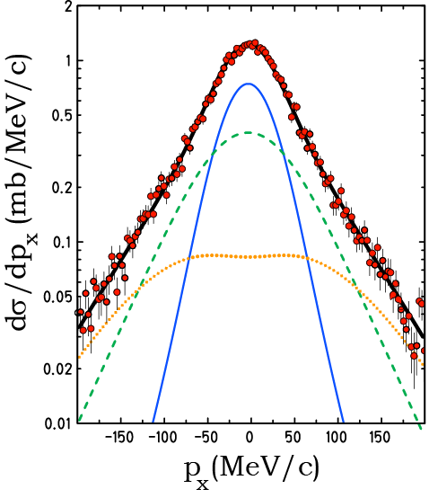
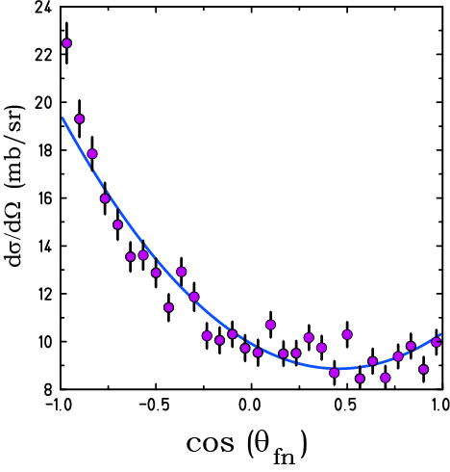
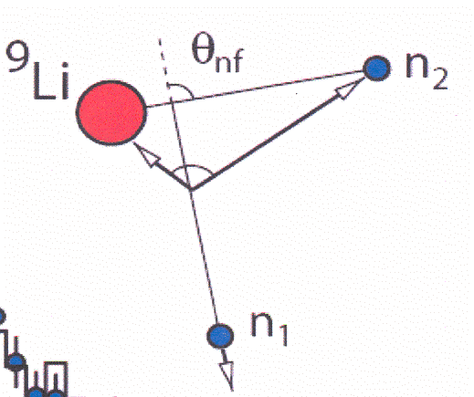
GSI, 287 MeV/u ¹¹Li
s
p
d
p_{n1} = -(p_{n1} + p_{9Li})
W(θ_{nf}) = 1-1.03cos (θ_{nf}) + 1.41cos²(θ_{nf})
Simon, et al., Nucl. Phys. A 791 (2007) 267.

Slide 14
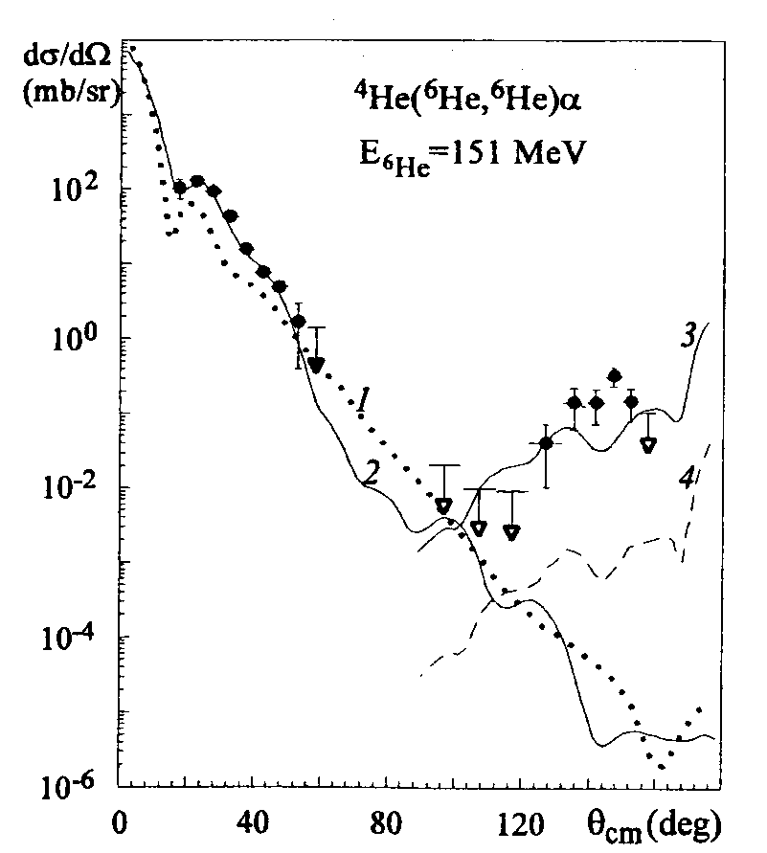
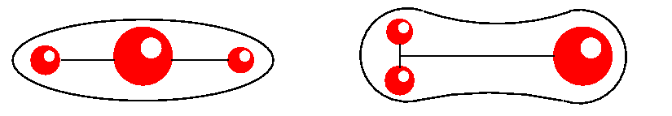
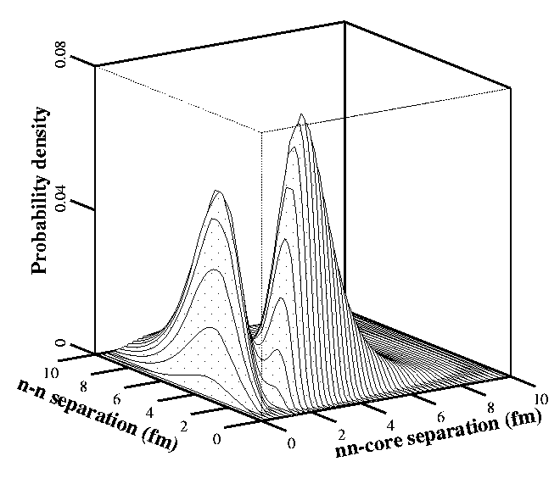
Two-neutron exchange in the
⁶He+⁴He reaction
DUBNA
G.M. Ter-Akopian et al.,
Phys. Lett. B 426 (1998) 251
Yu. Ts. Oganessian et al., PRL 82 (1999) 4996

Slide 15
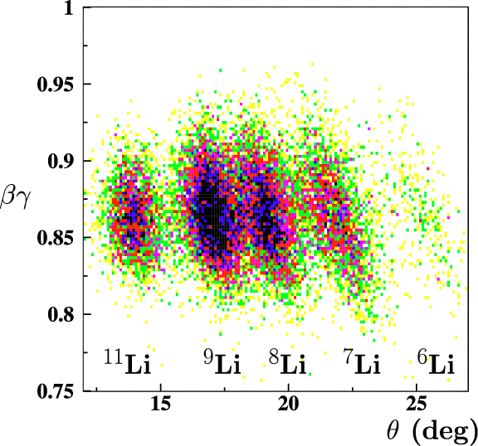
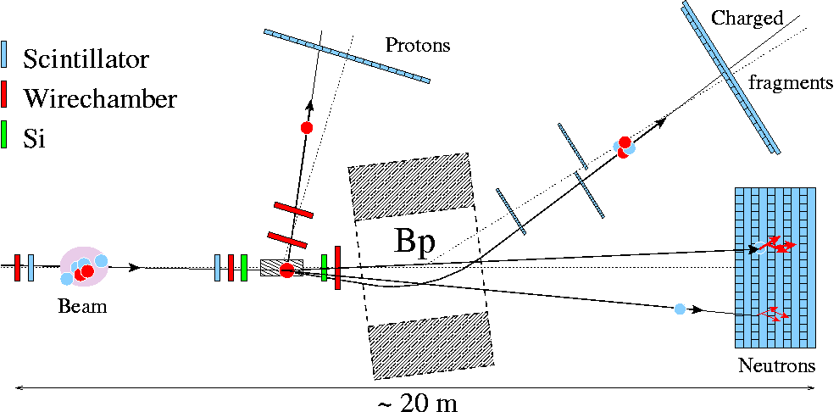
Exotic Beams
Proton knockout
from 304 MeV/u ¹⁴Be
Lq H target
S245
GSI
Yu. Aksyutina et al. (2008) 430

Slide 16
Dripline nuclei as stepping stones towards the unbound
⁷Be
⁸Be
unbound
⁹Be
¹⁰Be
1.6 10⁶ y
¹¹Be
13.8 s
¹²Be
23.6 ms
¹³Be
unbound
¹⁴Be
4.35 ms
⁶Li
⁷Li
⁸Li
840 ms
⁹Li
179 ms
¹⁰Li
unbound
¹¹Li
8.5 ms
¹²Li
unbound
¹³Li
unbound
⁴He
⁵He
unbound
⁶He
808 ms
⁷He
unbound
⁸He
119 ms
⁹He
unbound
¹⁰He
unbound
⁷H
unbound
¹¹Li: Neutron knock-out reaction -> ¹⁰Li
Proton knock-out reactions -> ^{9,10}He
¹⁴Be: Neutron knock-out reaction -> ¹³Be
Proton knock-out reactions -> ^{12,13}Li
⁸He: Neutron knock-out reaction -> ⁷He
Proton knock-out reaction -> (⁷H)

Slide 17
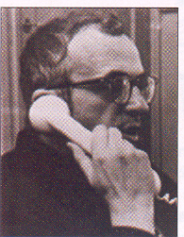
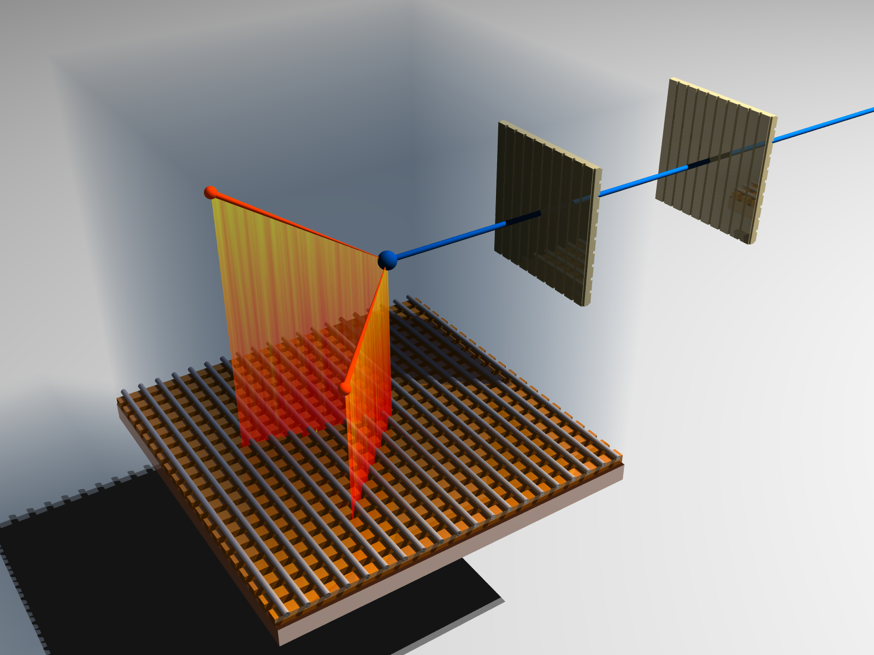
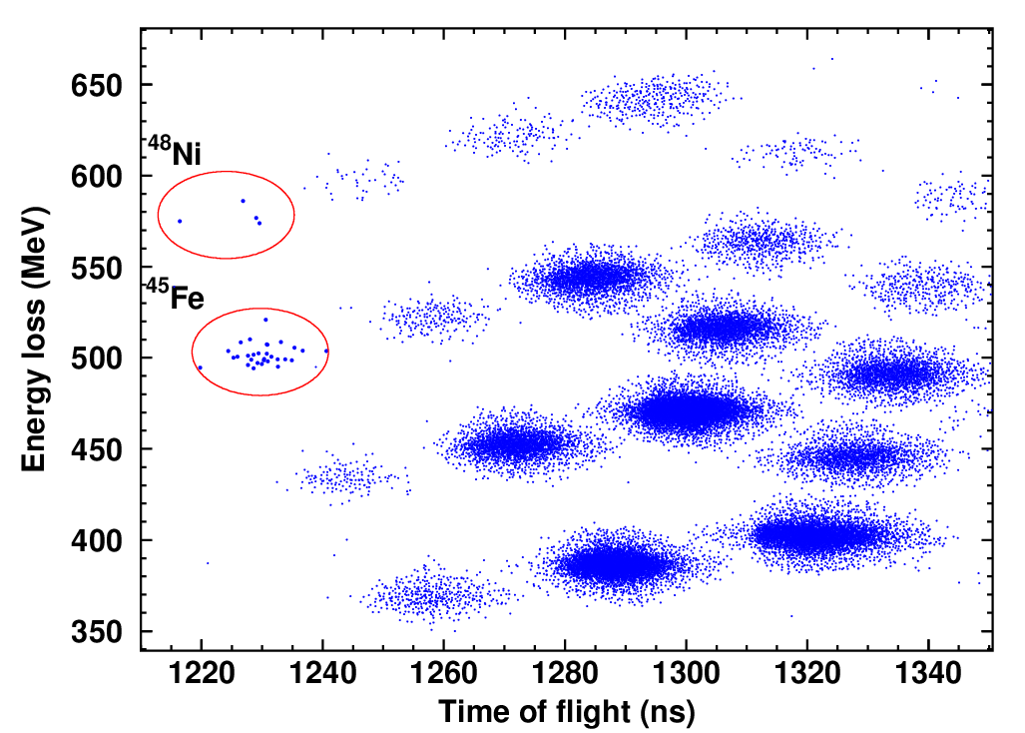
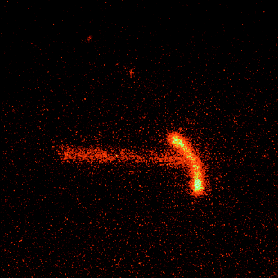
Goldanskii, Nucl. Phys. 19 (1960) 482
⁴⁸Ni
2p emitter
electric field
protons
identification of
implanted isotopes
drift of ionisation electrons
X-Y detector
⁴⁵Fe
J. Giovinazzo et al., PRL 99 (2007) 102501
¹⁹Mg
I. Mukha et al., PRL 99 (2007) 182501
K. Miernik et al., PRL 99 (2007) 192501

Slide 18
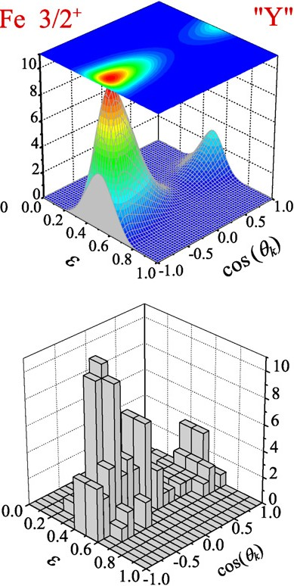
Comparison of energy-angular correlations from the 2p decay of ⁴⁵Fe in the Y system, theoretically predicted in 2003*)
and measured in 2007**) .
*) L.V. Grigorenko, M.V. Zhukov,
PRC 68(2003)054005
**) K. Miernik et al.,
PRL 99 (2007) 192501

Slide 19
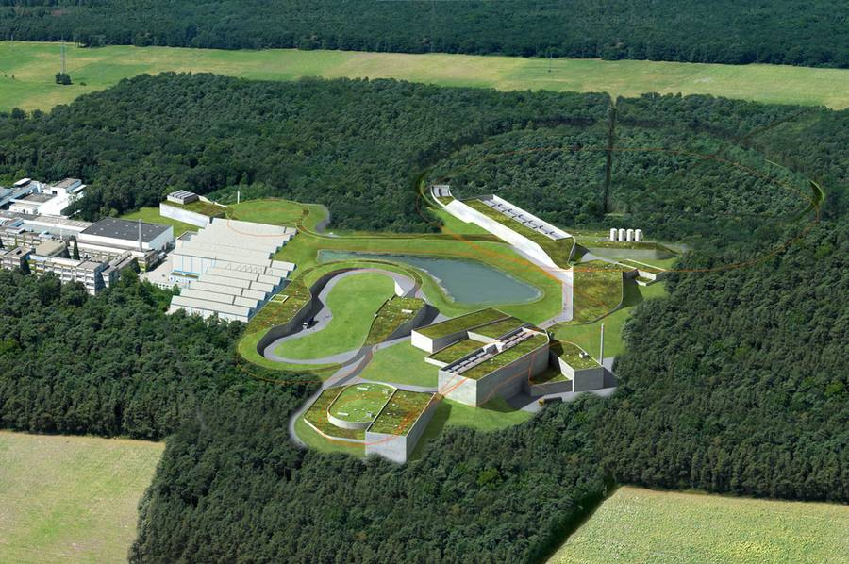
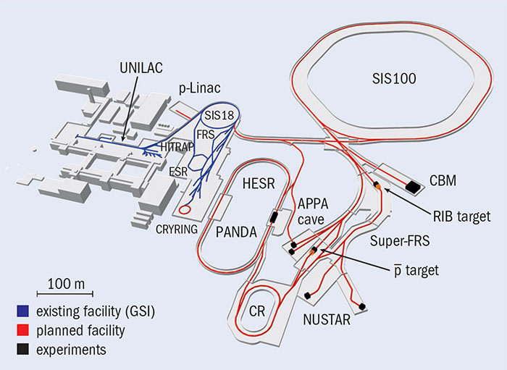


Slide 20
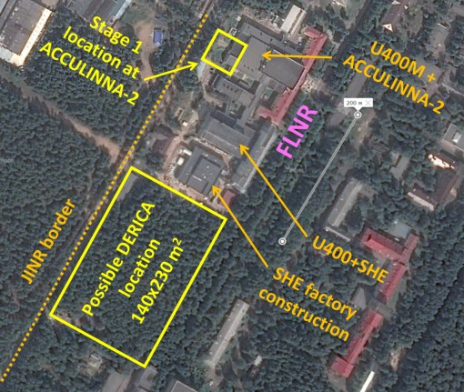
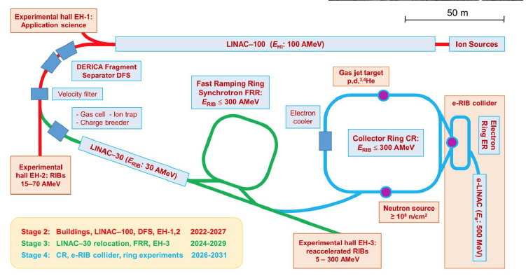
DERICA
Dubna Electron – Radioactive Ion Collider fAcility

Slide 21

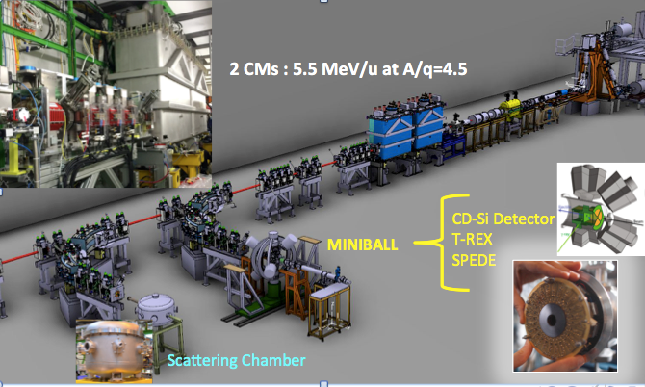
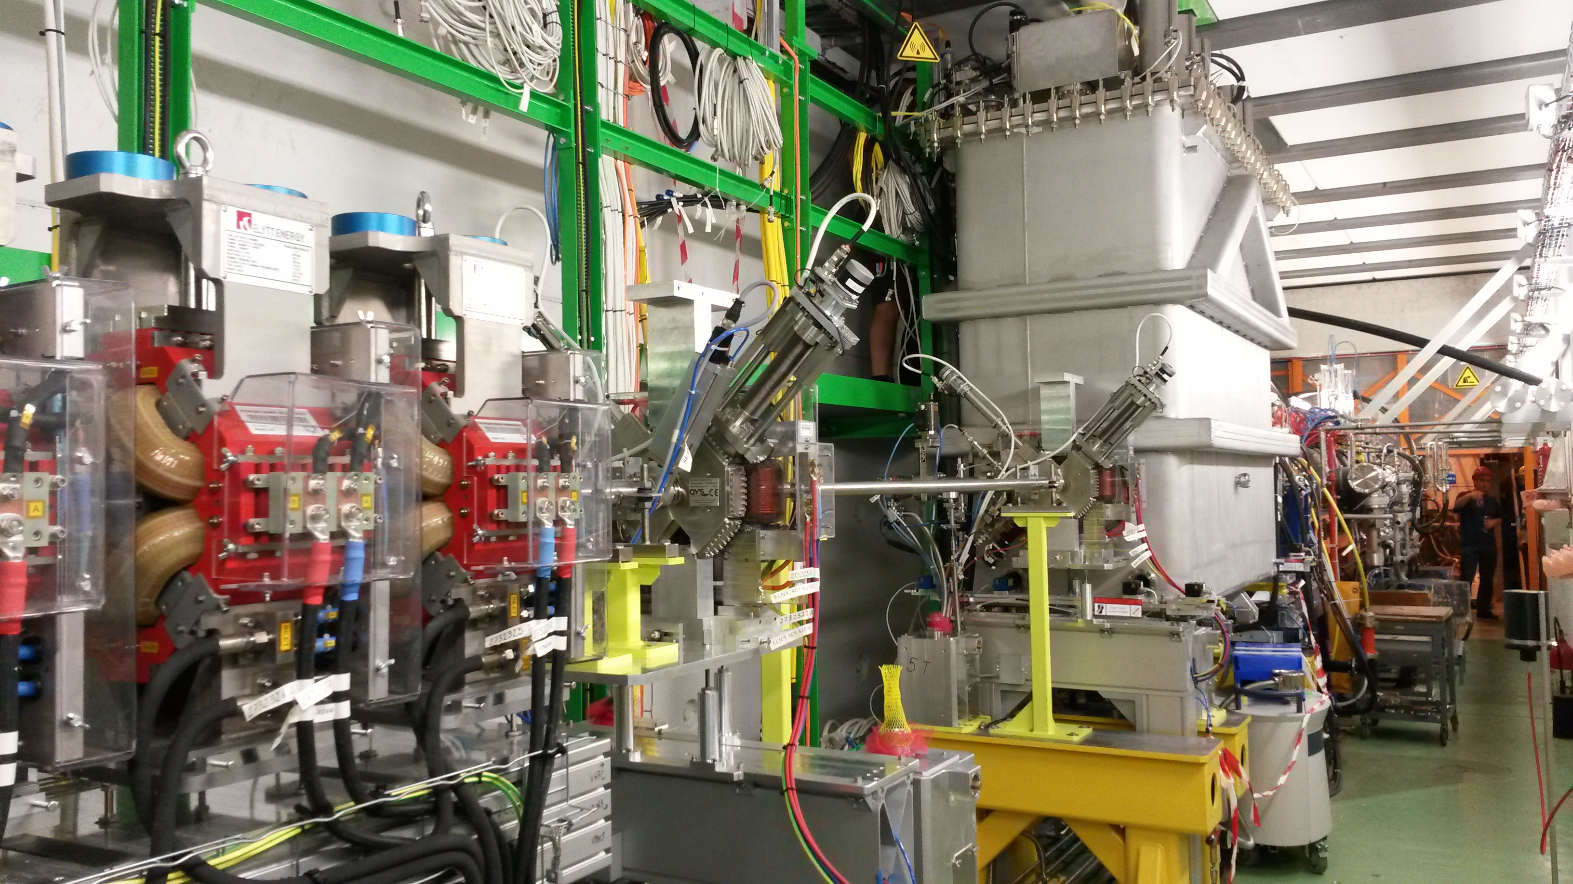
¹²Be(d,p)¹³Be
¹¹Be(t,p)¹³Be

Slide 22

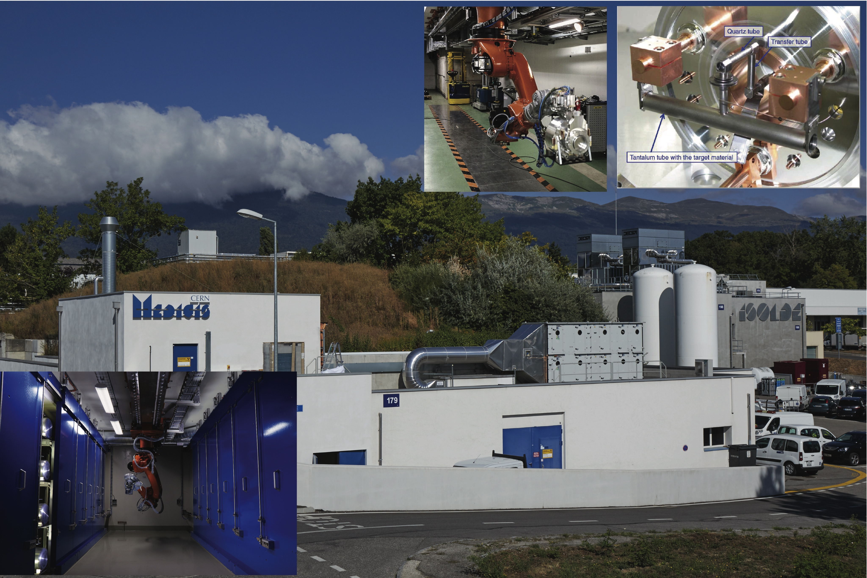

Slide 23

This is Man’s wonderful ability: to be able to grasp the inner essence of phenomena, not what they appear to be, but what they mean, and the reality that we see with our eyes is a symbol only of something higher.
Esaias Tegnér,
epilogue at the Master’s Degree Celebration in
University of Lund, Sweden in 1820.

